Slide 1
Title
Notes:
image
No alt text provided
image
No alt text provided
textbox
No alt text provided
shape
No alt text provided
TextEnhancerByMAQ46ASG0293G65JY43S89DKJ9
No alt text provided
image
No alt text provided
image
No alt text provided

Slide 2
Narrative Summary
High patient acuity & complexity
Persistent high acuity across services requires intensive interventions, seclusion, long-term segregation, Nasogastric (NG) nutrition (often involving restraint) and enhanced observations.
Complex physical health needs are impacting on patient dependency and acuity of need.
Discharge delays & out-of-pathway patients
Patients who are clinically ready for discharge remain in hospital due to delays in social care availability.
Out-of-pathway patients and use of seclusion/segregation beds for new admissions.
Staffing shortages & workforce strain
Continued reliance on the use of temporary staff.
Redeployment and working patterns increasing pressure.
The Spring Covid-19 booster vaccination campaign for patients has an impact on registered nurse staffing.
Training & development challenges
Difficulty supporting mandatory training and development.
High numbers of preceptees and internationally educated nurses not yet able to take charge, some of whom require a high level of support to complete preceptorship.
Healthcare Support Worker (HCSW) development and Enhanced Multidisciplinary Team (EMDT) participation is limited by staffing constraints.
Sickness & absences
High sickness levels in non-registered staff and leadership roles; clinical staff members working to reduced duties pending the outcome of investigations/ following pregnancy risk assessment; maternity leave impact on staffing levels.
Ongoing sickness and the need for debriefs are compounding pressures.
Operational & unit-specific pressures
Yewdale: no seclusion facility; limited agency staff availability; staff turnover.
Walkergate Park: Allied Health Professions (AHP) staffing remains below the British Society of Rehabilitative Medicine Guidelines.
Mitford: high overtime working and Working Time Directive opt-outs (maximum hours worked per week).
Rose Lodge: Limited internal response capacity.
31A: Increased NG nutrition requiring restraint.
Staffing & retention
Staff retention remains a persistent issue, particularly among Band 5 staff nurses post-preceptorship, compounded by the ongoing need to redeploy staff across wards and reliance on temporary workforce.
Training & supervision
Training, clinical supervision and appraisals remain below Trust standards, with essential training difficult to achieve due to staffing pressures and the related limited capacity for staff development.
Violence & safety
High number of incidents, particularly violence and aggression, affect staff wellbeing and contribute to increased reports, debriefs and safety measures.
Patient discharge delays
Some patients remain in hospital despite being clinically ready for discharge due to the lack of suitable social care or community services.
Operational pressures
Staffing needs due to observation levels, escorts and acuity hotspots place continued strain on service delivery, further complicated by sickness levels and staff turnover.
Recruitment challenges
Recruitment is challenged by vacant key posts in some services, a hold on recruitment in some areas and the ‘take charge’ issue.
Staffing & retention
Twice-daily staffing huddles and redeployment used to ensure safe staffing and skill-mix across sites.
Robust authorisation for temporary staffing; bank staff considered before agency.
Temporary staffing engaged to provide cover for essential training.
Training & supervision
Recovery plan in place for Clinical Supervision; increased focus on debriefs and MDT clarity.
Violence & safety
Weekly safety reviews for all significant incidents, including RIDDOR.
Specialist groups and MDT involvement addressing violence, aggression, and restrictive practices.
Patient discharge delays
Daily bed flow meetings and Acute Tracker in place to escalate and manage discharge barriers.
MDT and Associate Director review discharge planning and address acuity.
Pathway workstreams and protocolling (redeployment) to where required as restarted to improve discharge processes.
Operational pressures
Local and site-wide huddles manage pressure points and staffing gaps with senior oversight.
Use of specialist staff flexibility and MDT support to maintain safe care delivery.
Sickness and long-term absence proactively managed through clinics and triage meetings.
Recruitment challenges
Proactive recruitment and vacancy control processes in place.
Flexible working and Occupational Health support staff retention and return to work.
Ongoing service redesign (e.g. Mitford) to address recruitment-related capacity issues.
Staff Wellbeing
Focused initiatives are ongoing to improve staff wellbeing, some teams are reporting improved morale. Recruitment
Staff turnover is decreasing across multiple sites. Vacancies remain low, particularly in HCSW roles and new starters are in place or pending.
Training & Development
Training uptake improved. Band 5s have progressed into Band 6 roles in some areas and bespoke training for Physical Health Champions has been implemented.
Patient Care & Safety
Multidisciplinary Team (MDT) reviews of observations and care planning are ongoing. Approaches to reduce violence/aggression and increased physical health monitoring are in place and there has been some positive feedback from patients and relatives.
Operational Improvements
Bank and overtime is reducing agency reliance. Leadership is enhanced by Band 7s working into teams. Regular governance meetings support quality and safety.
Notes:
textbox
No alt text provided
shape
No alt text provided
shape
No alt text provided
shape
No alt text provided
textbox
No alt text provided
textbox
No alt text provided
shape
No alt text provided
shape
No alt text provided
textbox
No alt text provided
shape
No alt text provided
shape
No alt text provided
textbox
No alt text provided
shape
No alt text provided
shape
No alt text provided
TextEnhancerByMAQ46ASG0293G65JY43S89DKJ9
No alt text provided
TextEnhancerByMAQ46ASG0293G65JY43S89DKJ9
No alt text provided
TextEnhancerByMAQ46ASG0293G65JY43S89DKJ9
No alt text provided
TextEnhancerByMAQ46ASG0293G65JY43S89DKJ9
No alt text provided
shape
No alt text provided
TXT - Reporting Period
No alt text provided

Slide 3
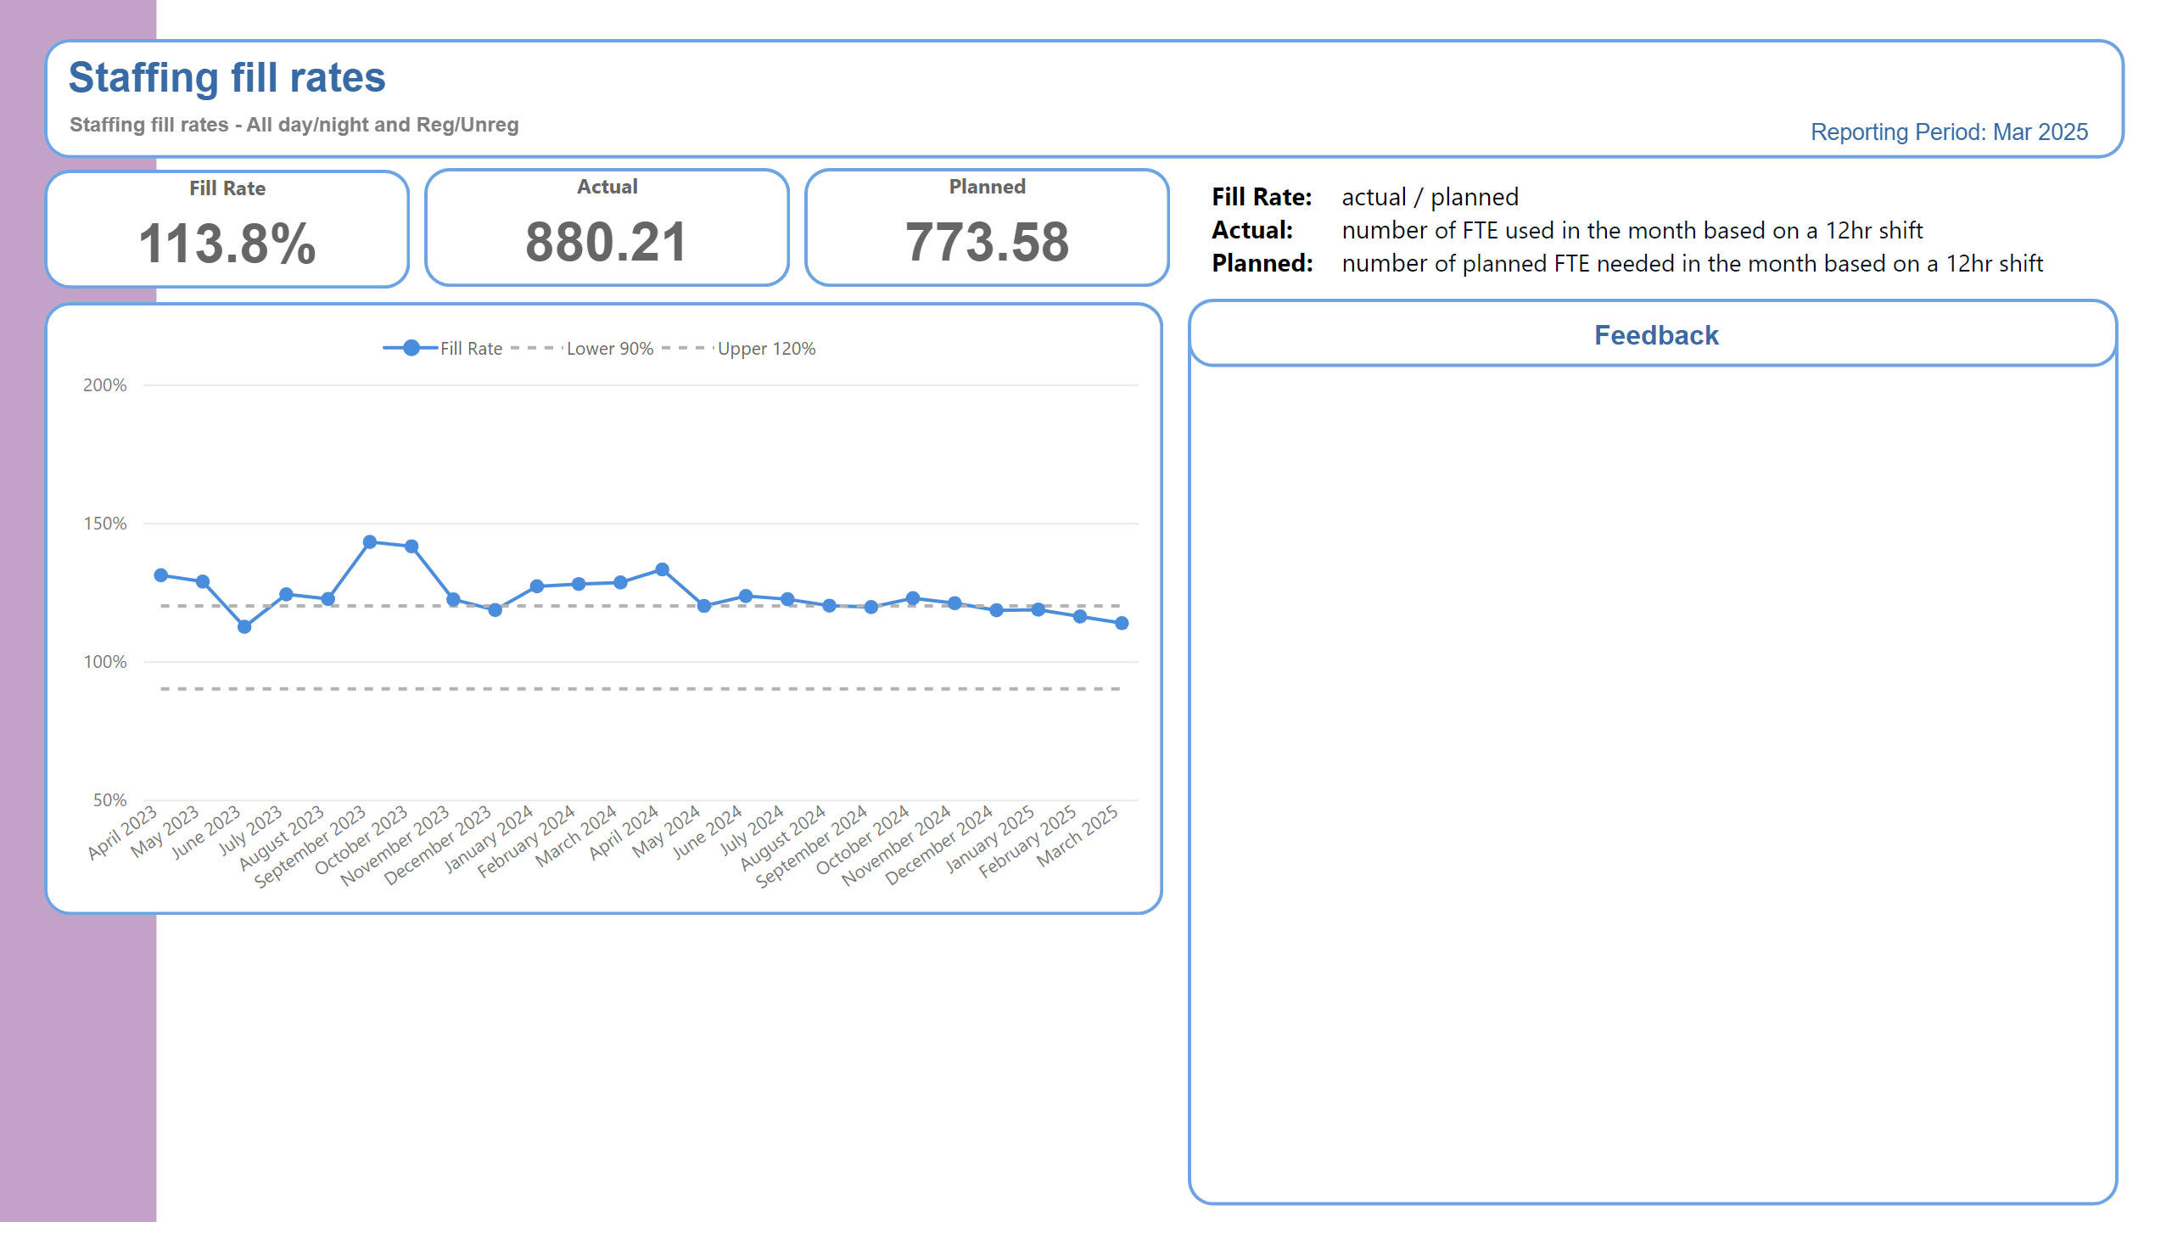
Trust Overview
Twice-daily staffing huddles and redeployment used to ensure safe staffing and skill-mix across sites.
Robust authorisation for temporary staffing; bank staff considered before agency.
Temporary staffing engaged to provide cover for essential training.
Sickness and long-term absence proactively managed through clinics and triage meetings.
Proactive recruitment and vacancy control processes in place.
Notes:
BOX - Header
No alt text provided
TXT - Indicator Name
No alt text provided
TXT - Indicator Definition
No alt text provided
shape
No alt text provided
PBI_CV_885EF3C3_31C1_4745_B2B9_20771D5AD196
No alt text provided
shape
No alt text provided
PBI_CV_885EF3C3_31C1_4745_B2B9_20771D5AD196
No alt text provided
shape
No alt text provided
PBI_CV_885EF3C3_31C1_4745_B2B9_20771D5AD196
No alt text provided
shape
No alt text provided
BOX - Performance
No alt text provided
Fill Rate
No alt text provided
textbox
No alt text provided
TextEnhancerByMAQ46ASG0293G65JY43S89DKJ9
No alt text provided
TextEnhancerByMAQ46ASG0293G65JY43S89DKJ9
No alt text provided
TextEnhancerByMAQ46ASG0293G65JY43S89DKJ9
No alt text provided
TextEnhancerByMAQ46ASG0293G65JY43S89DKJ9
No alt text provided
TextEnhancerByMAQ46ASG0293G65JY43S89DKJ9
No alt text provided
TextEnhancerByMAQ46ASG0293G65JY43S89DKJ9
No alt text provided
TextEnhancerByMAQ46ASG0293G65JY43S89DKJ9
No alt text provided
shape
No alt text provided
TextEnhancerByMAQ46ASG0293G65JY43S89DKJ9
No alt text provided
textbox
No alt text provided
textbox
No alt text provided
cardVisual
No alt text provided
cardVisual
No alt text provided
cardVisual
No alt text provided
tableEx
No alt text provided
textbox
No alt text provided
textbox
No alt text provided
BOX - SPCChart
No alt text provided
TXT - Feedback title
No alt text provided
BOX - Feedback body
No alt text provided
BOX - Feedback Title
No alt text provided
SPC Chart
No alt text provided
textbox
No alt text provided
BOX - Performance
No alt text provided
Actual
No alt text provided
BOX - Performance
No alt text provided
Planned
No alt text provided
TXT - Reporting Period
No alt text provided

Slide 4
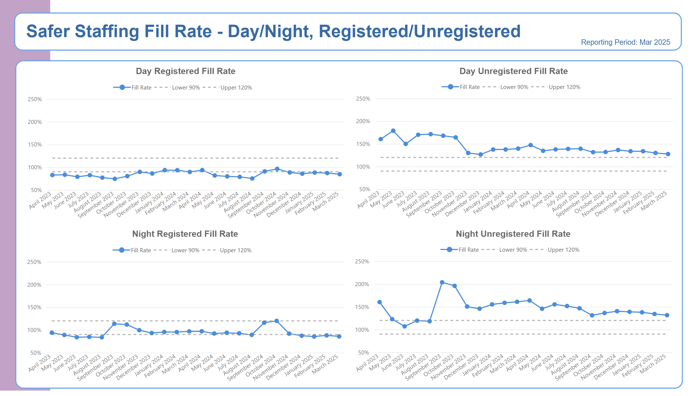
Fill Rate Graphs
Notes:
BOX - Header
No alt text provided
BOX - Background
No alt text provided
TXT - Page Heading
No alt text provided
TXT - Reporting Period
No alt text provided
shape
No alt text provided
TXT - Indicator Title
No alt text provided
SPC Chart
No alt text provided
TXT - Indicator Title
No alt text provided
SPC Chart
No alt text provided
TXT - Indicator Title
No alt text provided
SPC Chart
No alt text provided
TXT - Indicator Title
No alt text provided
SPC Chart
No alt text provided

Slide 5
Bank Agency Staff Use
Notes:
BOX - Header
No alt text provided
BOX - Background
No alt text provided
TXT - Page Heading
No alt text provided
TXT - Reporting Period
No alt text provided
shape
No alt text provided
TXT - Indicator Title
No alt text provided
SPC Chart
No alt text provided
TXT - Indicator Title
No alt text provided
SPC Chart
No alt text provided
TextEnhancerByMAQ46ASG0293G65JY43S89DKJ9
No alt text provided
lineChart
No alt text provided
TextEnhancerByMAQ46ASG0293G65JY43S89DKJ9
No alt text provided
lineChart
No alt text provided

Slide 6
Adult Acute Summary
High levels of acuity to manage risk including self-harm, violence, physical health needs, escorting, NG nutrition, increased seclusion, engagement & observations
EMDT roll out for all parts of MDT is in progress
Bed use above capacity. This includes patients temporarily at NSECH, in seclusion and long-term segregation beds being filled by new admissions
Patients who are clinically ready for discharge with no identified arrangements for ongoing care and support: the availability of social care remains a pressure.
Number of staff required to undertake essential training, resulting in additional shifts requiring cover.
Recently recruited Nursing Assistants needing intensive support with skills passport to help transition in roles.
High numbers of preceptees who cannot take charge, adding pressure to those who can
Use of temporary workforce to support vacancies, enhanced engagement, sickness and other absences.
Sickness and maternity leave is adding to pressures; the restriction of duties following pregnancy risk assessments also has an impact on staffing levels
Yewdale: increased level of engagement and observations; no seclusion facility; limited agency cover availability due to the geographical location of the ward; 6 x Mental Health Nurses moving to new CNTW posts
Refusal of staff to be protocolled (redeplyed) to acute based wards.
Staff retention remains a challenge, particularly staff nurses completing preceptorship.
Staffing levels are based on number of Within Eyesight Observations; escorts or therapeutic activity requires extra staffing to facilitate this.
Training, appraisals and Supervision continue to improve. PMVA & mandatory training on is well below Trust targets in some areas.
Yewdale: recruitment to vacancies currently on hold.
Daily or twice-daily staffing meetings to review staffing across sites
Admin attend daily staffing meetings to recording rational for increases in staffing
EMDT model is being implemented: Occupational Therapists are included; other disciplines will be included
Bed flow meetings daily to highlight barriers to discharge for escalation
Majority of vacancies now recruited into and awaiting start dates
Weekly Acute Tracker is in progress to enable ‘pull’ of patients towards discharges.
Staff wellbeing meetings continue
Senior authorisation process for temporary workforce
Workforce and psychology supporting staff wellbeing, regular staff support meetings
Yewdale: no admissions after 3pm Monday to Friday
Use of temporary staffing is only when all other options have been explored or related to essential training requirements
Shoredrift pilot (clinical OT lead) continues with positive feedback.
Staff turnover is reducing; retention remains a challenge
Ongoing MDT focus on reviewing of observations
Bank staff being used rather than agency evidenced by data
Focused work on staff wellbeing is ongoing
Protocolling work continues to support staff
Leadership teams report improvements in team morale Hadrian and Rowanwood; extension to Band 5s acting up to Band 6 role
Yewdale: patient activities increased & de-escalation techniques improving.
Notes:
textbox
No alt text provided
shape
No alt text provided
shape
No alt text provided
shape
No alt text provided
textbox
No alt text provided
textbox
No alt text provided
shape
No alt text provided
shape
No alt text provided
textbox
No alt text provided
shape
No alt text provided
shape
No alt text provided
textbox
No alt text provided
shape
No alt text provided
shape
No alt text provided
TextEnhancerByMAQ46ASG0293G65JY43S89DKJ9
No alt text provided
TextEnhancerByMAQ46ASG0293G65JY43S89DKJ9
No alt text provided
TextEnhancerByMAQ46ASG0293G65JY43S89DKJ9
No alt text provided
TextEnhancerByMAQ46ASG0293G65JY43S89DKJ9
No alt text provided
shape
No alt text provided

Slide 7
PICU Summary
There is a lack of substantive experienced post- preceptorship Band 5 staff.
High acuity: patients often have a forensic need/risk; this can be compounded by co-existing conditions, such as autism, and substance misuse.
Use of restrictive practice to support clinical need and safety (Seclusion).
Out of pathway patients.
Patients who are clinically ready for discharge, with no identified arrangements for ongoing care and support.
Enhanced Engagement and Observation levels.
Essential staff training is difficult to achieve as not able to release staff members.
Use of temporary workforce to support enhanced engagement, sickness and other absences.
Complex Physical Health needs.
Non-clinical staff due to ongoing investigations is creating pressure
Daily difficulties level-loading of substantive post-preceptorship Band 5 nurses.
Use of temporary workforce.
Levels of incidents relating to violence and aggression, including the impact on staff wellbeing.
Band 5 preceptees following completion of preceptorship progress to Band 6 posts out with inpatient CBU.
Working to achieve parity of esteem (physical and mental health).
Robust authorisation process for temporary workforce.
Use of Occupational Health to support staff returning to work.
Male only admissions continue, with a view to exploring a reduced capacity male PICU environment
Clinical Band 7 on wards work in the numbers, including weekends and night shift, to assist with leadership and quality.
Loan of experienced Band 6 and 5 staff from more established wards has bolstered the nursing team.
Use of temporary workers: Bank worker numbers are increasing, reducing the need for agency.
Focused work on staff wellbeing is in progress.
Realigned Physical Health Champions, with additional bespoke training offer
Notes:
textbox
No alt text provided
shape
No alt text provided
shape
No alt text provided
shape
No alt text provided
textbox
No alt text provided
textbox
No alt text provided
shape
No alt text provided
shape
No alt text provided
textbox
No alt text provided
shape
No alt text provided
shape
No alt text provided
textbox
No alt text provided
shape
No alt text provided
shape
No alt text provided
TextEnhancerByMAQ46ASG0293G65JY43S89DKJ9
No alt text provided
TextEnhancerByMAQ46ASG0293G65JY43S89DKJ9
No alt text provided
TextEnhancerByMAQ46ASG0293G65JY43S89DKJ9
No alt text provided
TextEnhancerByMAQ46ASG0293G65JY43S89DKJ9
No alt text provided
shape
No alt text provided

Slide 8
Adult Rehab Summary
High numbers of preceptee and internationally educated nurses who cannot take charge (adding pressure to those who can).
Some preceptees currently require significant support to complete the preceptorship process.
Patients who are clinically ready for discharge with no identified arrangements for ongoing care and support.
Some wards have patients with dysphagia, which is a significant risk requiring additional support
Use of temporary workforce to support vacancies, enhanced engagement, sickness and other absences.
The continued use of agency staff who are often unfamiliar with patients, to support vacancies, enhanced engagement and observations, sickness and other staffing issues.
Essential staff training is not being achieved as it is not possible to release staff, due to patient acuity and staffing levels.
Continuing observation levels, nurse sickness & maternity leave adds to pressures
Pressures relating to meeting training needs
Use of temporary workforce
Pressures due to escorting patients to other hospital sites and services
Significant support required for preceptees
Staffing levels based on number of observations, escorts or therapeutic activity requires extra staffing to facilitate
CBUs use locally agreed staffing huddles to manage resource gaps, with senior overview to support pressures.
Staff wellbeing meetings are being held.
Engagement with sexual safety work
Protocolling within pathways where possible
Pathway workstreams have restarted
Workforce support for flexible working
Use of temporary staffing to support essential training demands.
Redeployment of staff across site to support safer staffing levels
Twice daily staffing meetings to ensure safer staffing and skill mix across the site.
Bank staff being used rather than agency
Wider Multidisciplinary team supporting patient care
Focused work on staff wellbeing is in progress
Physical Health Champions realigned on all wards
No vacancies across HCSW roles
A vast improvement in training uptake
Elm House & Willow View: turnover reducing
Newton and Kinnersley: Band 6 posts now filled
Notes:
textbox
No alt text provided
shape
No alt text provided
shape
No alt text provided
shape
No alt text provided
textbox
No alt text provided
textbox
No alt text provided
shape
No alt text provided
shape
No alt text provided
textbox
No alt text provided
shape
No alt text provided
shape
No alt text provided
textbox
No alt text provided
shape
No alt text provided
shape
No alt text provided
TextEnhancerByMAQ46ASG0293G65JY43S89DKJ9
No alt text provided
TextEnhancerByMAQ46ASG0293G65JY43S89DKJ9
No alt text provided
TextEnhancerByMAQ46ASG0293G65JY43S89DKJ9
No alt text provided
TextEnhancerByMAQ46ASG0293G65JY43S89DKJ9
No alt text provided
shape
No alt text provided

Slide 9
Older Persons Summary
High number of preceptees, which reduces the capacity of registered nurses who can take charge; the effects of long-term illness and the increase in short-term illness; restricted duties relating to pregnancy risk assessments; maternity leave and vacancies
High levels of acuity requiring enhanced engagement and observations to manage patient acuity and risk.
Essential staff training is a challenge due to releasing staff, patient acuity, observation levels, escorts and staffing levels.
Ongoing need to redeploy staff members to wards other than their base ward, reducing continuity of care and increasing staff stress levels.
Use of temporary workforce to support vacancies, enhanced engagement, sickness and other absences.
Woodhorn: both Clinical Leads on long-term sick leave.
Woodhorn: limited resident doctor cover.
Hauxley: out of pathway patients.
Supervision, appraisals and essential staff training not meeting Trust standards.
Ongoing need to redeploy staff to wards other than their base ward, reducing continuity of care.
Difficulties level-loading Band 5 nurses across wards.
Essential staff training is not being achieved
Continued need to use temporary staff.
The impact of incidents relating to violence and aggression on staff wellbeing.
Limited development and support for preceptees
Ruskin: increase in assaults to staff and patients
Daily review of skill mix and flexibility of specialist nurses to cover take charge shifts on the wards
Flexibility of Specialist Nurse/Ward Manager to cover and support safer staffing levels on the wards
Individual tailored support for preceptees to aid their development and scheduled preceptee sign off
Improvement in Clinical supervision and appraisal completion; ‘Tartan Rug’ system is in place to improve Training monitoring. Regular HR Triage’s in place to support absence and performance management in line with policy.
Focused attention on debrief and wellbeing of staff
Focused attention on roles and responsibilities of MDT
Engagement and observation levels reviewed daily by MDT and the senior nursing team including the Clinical Manager to ensure correct staffing in place.
Leadership team meetings to ensure clear ward priorities and support to more inexperienced staff
Bank being used rather than agency.
Multi-Disciplinary Team supporting patient care.
Focused work on staff wellbeing is in progress.
Acute Trust handover process implemented, subject to on-going audit
Positive feedback from relatives of patient/carer and from a patient who has been discharged from service.
Central locality: staff turnover is reducing.
Ruskin & Oakwood: ongoing team culture and wellbeing work.
Notes:
textbox
No alt text provided
shape
No alt text provided
shape
No alt text provided
shape
No alt text provided
textbox
No alt text provided
textbox
No alt text provided
shape
No alt text provided
shape
No alt text provided
textbox
No alt text provided
shape
No alt text provided
shape
No alt text provided
textbox
No alt text provided
shape
No alt text provided
shape
No alt text provided
TextEnhancerByMAQ46ASG0293G65JY43S89DKJ9
No alt text provided
TextEnhancerByMAQ46ASG0293G65JY43S89DKJ9
No alt text provided
TextEnhancerByMAQ46ASG0293G65JY43S89DKJ9
No alt text provided
TextEnhancerByMAQ46ASG0293G65JY43S89DKJ9
No alt text provided
shape
No alt text provided
shape
No alt text provided

Slide 10
CYPS Summary
Long and short-term sickness, both registered and non-registered.
Number of maternity leaves and restricted duties due to pregnancy.
High levels of acuity and complex needs requiring enhanced observations.
Ongoing challenges and the related complexities with planning discharges.
Full and high occupancy across wards.
High levels of additional needs of eating disorder patients.
Registered nurse vacancies and turnover.
Unsuccessful recruitment to registered posts.
Increase in use of seclusion on the ward
Increasing in positive risk taking and supporting staff through this.
Supporting staff through internal rotations and opening of wards.
Supporting staff and patient through planning the end of Long-Term Seclusion on the ward
Review of enhanced observations and clinical need.
Daily staffing huddles to review staffing levels where level loading of skill mix within service, including temporary redeployment of staff to support qualified deficits.
Regular workforce support in place for managing staff sickness.
Staff wellbeing drop-in sessions that are also being offered during shift change over to facilitate all staff across shift patterns to attend.
Discharge planning meeting is in place
Regular attendance of HOPEs team on the ward
Reduction use of restraint.
Wards involved within culture of care staff improvement workshop
Reduction in severity of violence and aggression
Support from HOPEs and positive and safe teams
Reduction in overall incidents, severity of incidents and use of enhanced observations
Positive feedback from inspections – provider collaborative, Mock CQC and QNIC comprehensive review.
Continuing recruitment process for registered posts.
Positive MHA CQC report for Redburn
Notes:
textbox
No alt text provided
shape
No alt text provided
shape
No alt text provided
shape
No alt text provided
textbox
No alt text provided
textbox
No alt text provided
shape
No alt text provided
shape
No alt text provided
textbox
No alt text provided
shape
No alt text provided
shape
No alt text provided
textbox
No alt text provided
shape
No alt text provided
shape
No alt text provided
TextEnhancerByMAQ46ASG0293G65JY43S89DKJ9
No alt text provided
TextEnhancerByMAQ46ASG0293G65JY43S89DKJ9
No alt text provided
TextEnhancerByMAQ46ASG0293G65JY43S89DKJ9
No alt text provided
TextEnhancerByMAQ46ASG0293G65JY43S89DKJ9
No alt text provided
shape
No alt text provided

Slide 11
Secure Services Summary
Staffing Pressures resulting from:
Alwinton: high level of enhanced observations. Two patients requiring 3:1. Section 17 leave escorts are 2:1 ratio and gender specific.
Harthope: Increased acuity and engagement and observation levels.
Continued prolonged seclusion on Elsdon: individualised care package of 6:1
There are 18 preceptees across 10 wards
Agency use hotspots: Harthope and Alwinton
Hotspots of acuity: 282 patient related incidents across 10 wards (125 of theses violence and aggression).
High level total patient incident data by ward:
Linhope: 44
Elsdon: 46 (1 patient)
Rothbury: 42
Alwinton: 42
Tyne Mental Health: 28
Harthope: 27
Tweed Low Secure: 21
Tyne Hospital Based Rehab:15
Tweed Hospital Based Rehab: 15
Berwick: 3
Daily staffing huddles to review staffing levels chaired by clinical manager, all 10 ward managers/representative attend to ensure skill mix, level loading of temporary staffing across the wards.
Group Directors agency authorisation
Workforce supported sickness absence clinics
Preceptee induction programme
Group Director/Finance vacancy control process
Good vacancy fill rate
Good staff retention rate
Slight increase in sickness absence however downward trajectory indication
Overall reduction in use of bank staff.
Notes:
textbox
No alt text provided
shape
No alt text provided
shape
No alt text provided
shape
No alt text provided
textbox
No alt text provided
textbox
No alt text provided
shape
No alt text provided
shape
No alt text provided
textbox
No alt text provided
shape
No alt text provided
shape
No alt text provided
textbox
No alt text provided
shape
No alt text provided
shape
No alt text provided
TextEnhancerByMAQ46ASG0293G65JY43S89DKJ9
No alt text provided
TextEnhancerByMAQ46ASG0293G65JY43S89DKJ9
No alt text provided
TextEnhancerByMAQ46ASG0293G65JY43S89DKJ9
No alt text provided
TextEnhancerByMAQ46ASG0293G65JY43S89DKJ9
No alt text provided
shape
No alt text provided

Slide 12
LD Autism Summary
Number of preceptees and internationally educated nurses who cannot take charge
High nigh levels of acuity requiring enhanced engagement and observations to manage patient acuity and risk.
Essential staff training attendance and supervision are lower than the Trust standard.
Increased temporary staff support is needed due to enhanced engagement, staff sickness, annual leave and other absences.
High number of debriefs required due to acuity, which need staff attendance.
Releasing staff to engage in the HCSW development programme
Edenwood: numerous posts vacant and temporarily covered; continued high levels of acuity and aggression towards staff from a small number of patients
Mitford: overtime usage and those opting out of the Working Time Directive is high
Rose Lodge: limited to an internal response team, due to being a standalone unit; supporting a patient in long-tern seclusion (this commenced mid-July 2024).
Essential training and clinical supervision low.
Levels of incidents relating to violence, aggression and assaults on staff and how this impacts staff wellbeing.
Increase in staff incidents leading to RIDDOR reporting.
The ability to give staff focused time for involvement with staff debriefs.
Individual continuing to require 2:1 being supported in seclusion
Ward Manager, Admin & Consultant Psychiatrist vacancies
Lack of registered nurses who can take charge and substantive HCSWs to manage both ward area and long-term segregation safely.
Proactive utilisation of the wider multidisciplinary team.
Robust authorisation process for temporary staffing.
Weekly safety meeting of any incident of moderate harm or above, including RIDDOR that will impact on staff safety.
Specialist Care Group Violence and Aggression and Reducing Restrictive Interventions Group established,
An Incident Management Group reviewing service to provide improvement actions.
Rolling programme for HCSW to support and provide skills and knowledge.
Recovery plan in place for Clinical Supervision (Specialist Care Group CBU).
Daily staffing huddles facilitated to understand deficits and situational reporting to enable responsiveness.
Long-term sickness meetings and monthly triage meetings held to monitor and ensure actions adhered to.
Financial pressure of vacancies to care packages: a meeting is now in place with the finance team to monitor staffing need against discharges
Fortnightly Associate Director and union drop-in support; daily MDT observation reviews; pause to admissions; work around model redesign has commenced.
Bank and overtime being used before agency where possible.
Work on Mitford with the National HOPE(s) team to support patients.
Robust system in place to report RIDDOR and provide updates as required.
Increase in specialist clinical nursing resource.
Reduction in Long-Term Sickness cases.
Regular Clinically Ready For Discharge meeting with commissioning ICBs.
Notes:
textbox
No alt text provided
shape
No alt text provided
shape
No alt text provided
shape
No alt text provided
textbox
No alt text provided
textbox
No alt text provided
shape
No alt text provided
shape
No alt text provided
textbox
No alt text provided
shape
No alt text provided
shape
No alt text provided
textbox
No alt text provided
shape
No alt text provided
shape
No alt text provided
TextEnhancerByMAQ46ASG0293G65JY43S89DKJ9
No alt text provided
TextEnhancerByMAQ46ASG0293G65JY43S89DKJ9
No alt text provided
TextEnhancerByMAQ46ASG0293G65JY43S89DKJ9
No alt text provided
TextEnhancerByMAQ46ASG0293G65JY43S89DKJ9
No alt text provided
shape
No alt text provided

Slide 13
Neuro Specialist Summary
Sickness levels are above 5% threshold with Ward 1 and Ward 4 having the highest levels and therefore temporary staffing has increased
Sickness is predominantly non-registered workforce, with a high proportion of long-term sickness, appropriately managed in conjunction with Workforce.
Clinical acuity and requirement for additional response staff across St Nicholas Hospital site requiring additional staffing above agreed safer staffing budget
31A require additional staffing to support nasogastric nutrition requiring restraint.
Walkergate Park do not meet the British Society of Rehabilitative Medicine guidelines for Level 1 Rehabilitation providers, which impacts service provision. This is a commissioning issue which has been explored: there is no available funding from the ICB or NHSE to support an increase.
31A needs additional staffing to support the administration of NG nutrition requiring restraint.
Sickness levels and temporary staffing requirement
CBU staffing huddle held twice weekly to review clinical activity/sickness and level-load staffing resources where possible.
Acuity: regular reviews by the Multi-Disciplinary Team with Associate Director oversight where required to support discharge planning.
Acuity of admissions considered weekly to ensure patient safety for planned admissions.
Appropriate escalation to Clinical Manager/Point of Contact (POC) to support staffing levels as and when needed.
Regular liaison with Workforce to support long-term sickness cases and proactive approach to sickness management.
Proactive recruitment: vacancies are advertised promptly following group vacancy control meetings.
Proactive management of disciplinary cases to minimise impact on clinical services whilst maintaining safety.
Staff wellbeing support associated with clinical acuity increased
New staff in post or awaiting start dates
Lower numbers of vacancies
Lower incidence of violence and aggression
Low levels of agency use across Walkergate Park Hospital and Beadnell.
Notes:
textbox
No alt text provided
shape
No alt text provided
shape
No alt text provided
shape
No alt text provided
textbox
No alt text provided
textbox
No alt text provided
shape
No alt text provided
shape
No alt text provided
textbox
No alt text provided
shape
No alt text provided
shape
No alt text provided
textbox
No alt text provided
shape
No alt text provided
shape
No alt text provided
TextEnhancerByMAQ46ASG0293G65JY43S89DKJ9
No alt text provided
TextEnhancerByMAQ46ASG0293G65JY43S89DKJ9
No alt text provided
TextEnhancerByMAQ46ASG0293G65JY43S89DKJ9
No alt text provided
TextEnhancerByMAQ46ASG0293G65JY43S89DKJ9
No alt text provided
shape
No alt text provided

