Slide 1
Title
Notes:
image
No alt text provided
image
No alt text provided
textbox
No alt text provided
shape
No alt text provided
TextEnhancerByMAQ46ASG0293G65JY43S89DKJ9
No alt text provided
image
No alt text provided
image
No alt text provided

Slide 2
Narrative Summary
High Patient Acuity & Complexity
Continuing and increased levels of observations and engagement, physical health needs, escorts to acute hospital, violence & aggression and forensic risks.
Patients in long-term segregation and increased self-harm incidents leading to restrictive practice.
Discharge delays & out-of-pathway patients
Multiple patients clinically ready for discharge without identified arrangements for ongoing care and support.
Acute wards exceeding capacity: seclusion beds used for admissions
Cross-pathway functional and organic patients (Hauxley).
Out of pathway patients in PICU.
Staffing shortages & workforce strain
New HCSWs require intensive support; lack of substantive experienced Band 5 staff; preceptees unable to take charge; staff whose duties are restricted due to ongoing investigations; high agency and bank staff cover.
Releasing staff to support vaccination rollout and acute hospitals requiring staff escorts for physical health interventions.
Training & development challenges
Unable to release staff for increasing demand of essential training.
HCSW Development Programme adding additional pressures.
Impact of sickness & other absence
Ongoing sickness above 5% target; notable increases in Beadnell and Eating Disorder Service.
High levels of overtime and staff opting out of the Working Time Directive (Mitford).
Sickness predominantly among HCSWs with a high proportion of long-term absences.
Long-term sickness absence and maternity leave of registered staff.
Operational & unit-specific pressures
Woodhorn: Medical cover gaps, increased observations and reduced leadership capacity.
Mitford: High debrief and supervision demand
Rose Lodge: Limited to an internal response team due to being a standalone unit
Edenwood: High acuity for two patients, requiring increased resources
31A: Additional staffing required to support the administration of nasogastric nutrition requiring restraint.
Walkergate Park Hospital: AHP staffing below British Society of Rehabilitative Medicine guidelines.
Staffing & Retention: Challenge to balance experienced staff and preceptees; increased reliance on temporary staff and internal rotations to support/level load safer staffing; Band 5s leaving for Band 6 posts
Training & Supervision: Essential training gaps: focus on PMVA training; preceptorship support requires focused attention.
Violence & Safety: Rising incidents of violence and assaults on staff, reluctance to work in acute settings and increased use of restrictive interventions highlight ongoing safety concerns.
Patient Discharge Delays: Many clinically ready for discharge patients face delays due no identified arrangements for ongoing care and support.
Operational Pressures: Higher patient acuity and increased observations demand flexible staffing solutions, with ongoing challenges in aligning safer staffing levels with ward needs and ensuring parity of esteem
Recruitment Challenges: Difficulties in recruiting experienced staff results in wards being heavily reliant on preceptees, requiring additional leadership support and skill mix adjustments
Staffing & Retention
Specialist nurse covering Ward Manager role (Edenwood) and flexible redeployment across sites to support staffing levels. Clinical Occupational Therapy lead pilot continues positively (Shoredrift).
Daily or twice daily staffing meetings and inpatient care group ‘huddles’.
Registered Nurse Degree Apprenticeship (RNDA) staff incorporated into staffing.
CPD initiatives supporting retention, with focused supervision for preceptees, including planned sign-off meetings.
Wellbeing initiatives focussing on debriefing and mental health support.
Management of sickness absence and disciplinary cases with Workforce support.
Training & Supervision
Recovery plan in place for clinical supervision (Specialist Care Group).
HCSW programme rolled out to enhance staff skills (Mitford).
Temporary staff used to cover gaps due to essential training requirements.
EMDT working group established, with OTs providing daily ward presence.
Violence & Safety
Weekly safety reports of moderate/severe harm and RIDDOR (Mitford).
Specialist Care Group violence & aggression and reducing restrictive interventions groups established. Exploring possible male only PICU.
Daily reviews of observation levels and risk mitigation by MDTs.
Patient Discharge Delays
Discharge planning and bed flow meetings for timely escalation of delays.
Acuity reviews by MDT, with Associate Director oversight.
Pause to admissions at Mitford continues, reducing staffing pressures.
Operational Pressures
Staffing huddles and meetings aimed to balance workload and skill mix.
Admin support added to staffing meetings for accurate documentation of resourcing decisions.
Temporary workforce managed through a robust authorisation process and used strategically to fill gaps related to training demands.
Recruitment Challenges
Vacancies promptly advertised following vacancy control meetings, with increasing proportion of positions filled.
Staff wellbeing: Wellbeing initiatives, leadership accessibility and senior support. Reduced sickness and long-term cases managed effectively.
Recruitment: Further vacancies filled. Preceptee support ongoing. Increased use of bank staff reducing agency reliance.
Training & development: Focus on training, appraisals and supervision with improved tracking. Specialist roles enhancing clinical leadership.
Patient care & safety: Reduced seclusions/incidents, improved care planning, increased activities.
Leadership focus on safety;HOPE(S) team involvement.
Ward Managers working clinically.
Operational improvements: Successful Allocate rollout; improved discharge planning; strengthened nursing leadership; bank and overtime being used rather than agency.
Mitford: robust RIDDOR reporting, reduced long-term sickness, planned ICB meeting for patients clinically ready for discharge.
Lotus ward received positive Quality Network for Inpatient CAMHS (QNIC), Provider Collaborative and Mock CQC feedback.
Notes:
textbox
No alt text provided
shape
No alt text provided
shape
No alt text provided
shape
No alt text provided
textbox
No alt text provided
textbox
No alt text provided
shape
No alt text provided
shape
No alt text provided
textbox
No alt text provided
shape
No alt text provided
shape
No alt text provided
textbox
No alt text provided
shape
No alt text provided
shape
No alt text provided
TextEnhancerByMAQ46ASG0293G65JY43S89DKJ9
No alt text provided
TextEnhancerByMAQ46ASG0293G65JY43S89DKJ9
No alt text provided
TextEnhancerByMAQ46ASG0293G65JY43S89DKJ9
No alt text provided
TextEnhancerByMAQ46ASG0293G65JY43S89DKJ9
No alt text provided
shape
No alt text provided
TXT - Reporting Period
No alt text provided

Slide 3
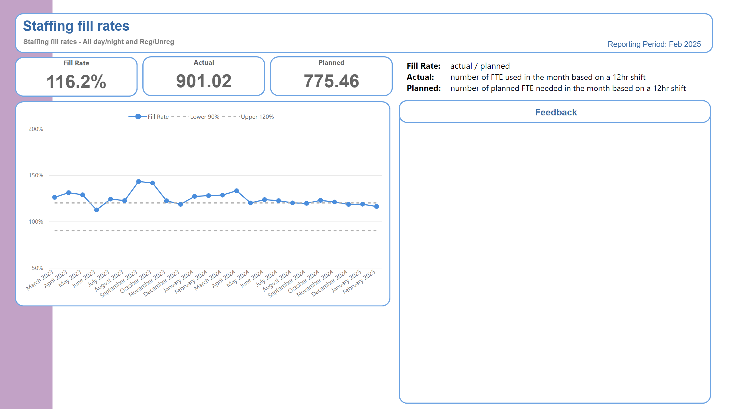
Trust Overview
Daily level-loading of experienced registered nurses is undertaken.
Daily or twice daily staffing huddles are held to reassess safe staffing levels.
Implementation of evaluation of competence at 9 months in the preceptorship process.
A robust authorisation process is in place for temporary staff utilisation.
Notes:
BOX - Header
No alt text provided
TXT - Indicator Name
No alt text provided
TXT - Indicator Definition
No alt text provided
shape
No alt text provided
PBI_CV_885EF3C3_31C1_4745_B2B9_20771D5AD196
No alt text provided
shape
No alt text provided
PBI_CV_885EF3C3_31C1_4745_B2B9_20771D5AD196
No alt text provided
shape
No alt text provided
PBI_CV_885EF3C3_31C1_4745_B2B9_20771D5AD196
No alt text provided
shape
No alt text provided
BOX - Performance
No alt text provided
Fill Rate
No alt text provided
textbox
No alt text provided
TextEnhancerByMAQ46ASG0293G65JY43S89DKJ9
No alt text provided
TextEnhancerByMAQ46ASG0293G65JY43S89DKJ9
No alt text provided
TextEnhancerByMAQ46ASG0293G65JY43S89DKJ9
No alt text provided
TextEnhancerByMAQ46ASG0293G65JY43S89DKJ9
No alt text provided
TextEnhancerByMAQ46ASG0293G65JY43S89DKJ9
No alt text provided
TextEnhancerByMAQ46ASG0293G65JY43S89DKJ9
No alt text provided
TextEnhancerByMAQ46ASG0293G65JY43S89DKJ9
No alt text provided
shape
No alt text provided
TextEnhancerByMAQ46ASG0293G65JY43S89DKJ9
No alt text provided
textbox
No alt text provided
textbox
No alt text provided
cardVisual
No alt text provided
cardVisual
No alt text provided
cardVisual
No alt text provided
tableEx
No alt text provided
textbox
No alt text provided
textbox
No alt text provided
BOX - SPCChart
No alt text provided
TXT - Feedback title
No alt text provided
BOX - Feedback body
No alt text provided
BOX - Feedback Title
No alt text provided
SPC Chart
No alt text provided
textbox
No alt text provided
BOX - Performance
No alt text provided
Actual
No alt text provided
BOX - Performance
No alt text provided
Planned
No alt text provided
TXT - Reporting Period
No alt text provided

Slide 4
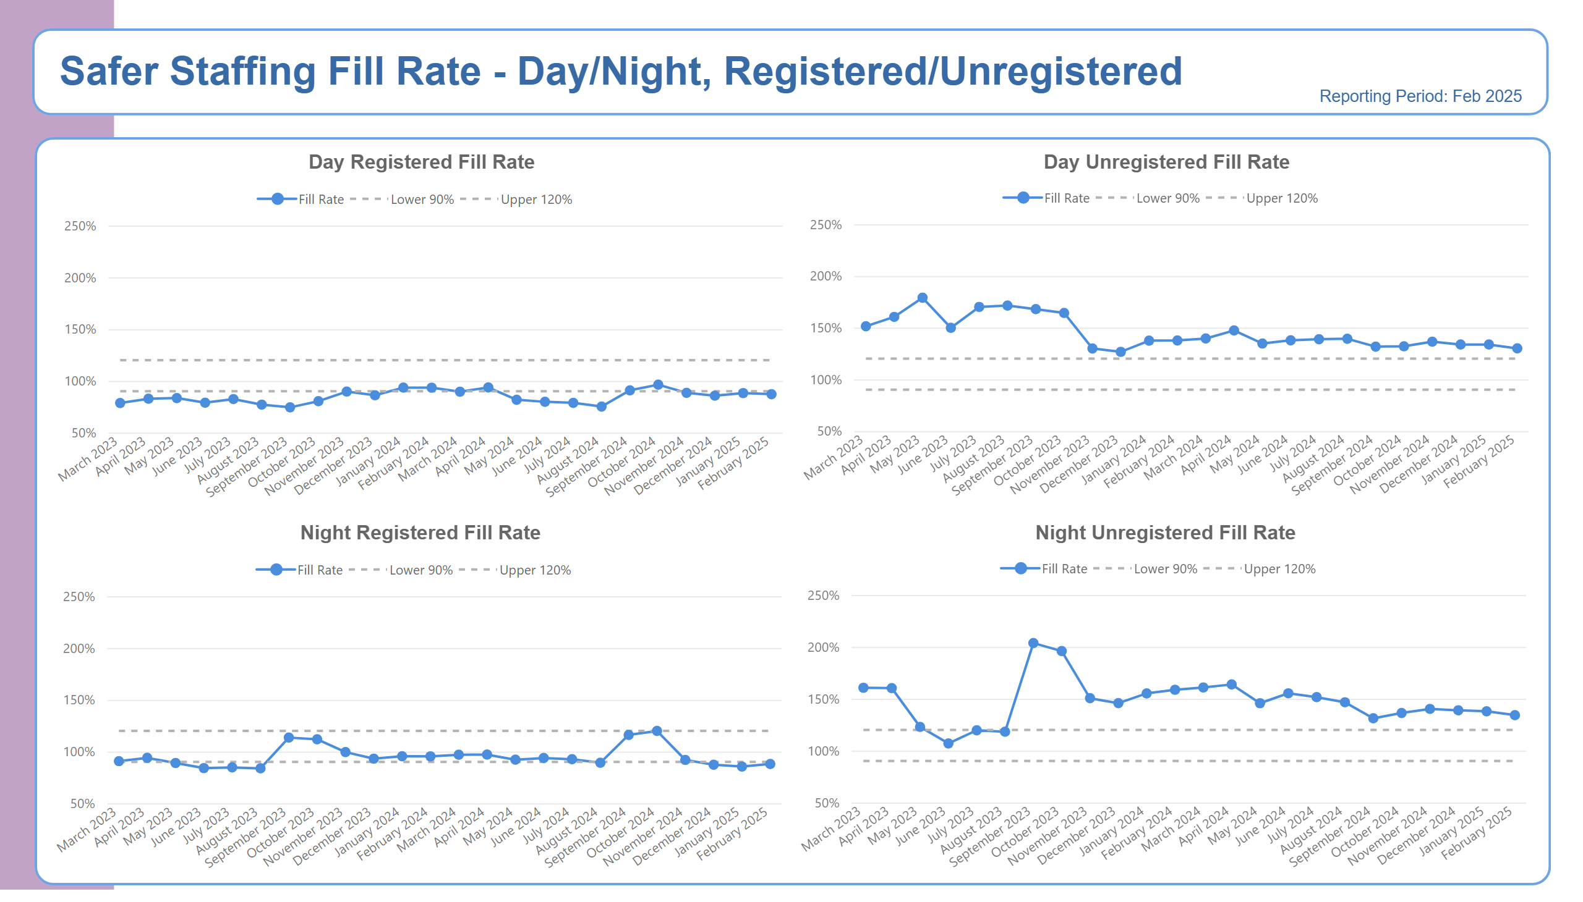
Fill Rate Graphs
Notes:
BOX - Header
No alt text provided
BOX - Background
No alt text provided
TXT - Page Heading
No alt text provided
TXT - Reporting Period
No alt text provided
shape
No alt text provided
TXT - Indicator Title
No alt text provided
SPC Chart
No alt text provided
TXT - Indicator Title
No alt text provided
SPC Chart
No alt text provided
TXT - Indicator Title
No alt text provided
SPC Chart
No alt text provided
TXT - Indicator Title
No alt text provided
SPC Chart
No alt text provided

Slide 5
Bank Agency Staff Use
Notes:
BOX - Header
No alt text provided
BOX - Background
No alt text provided
TXT - Page Heading
No alt text provided
TXT - Reporting Period
No alt text provided
shape
No alt text provided
TXT - Indicator Title
No alt text provided
SPC Chart
No alt text provided
TXT - Indicator Title
No alt text provided
SPC Chart
No alt text provided
TextEnhancerByMAQ46ASG0293G65JY43S89DKJ9
No alt text provided
lineChart
No alt text provided
TextEnhancerByMAQ46ASG0293G65JY43S89DKJ9
No alt text provided
lineChart
No alt text provided

Slide 6
Adult Acute Summary
The Enhanced Multidisciplinary Team (EMDT) roll out for all parts of MDT is in progress.
Low numbers of nurses who can take charge, particularly Embleton and Alnmouth.
High levels of observation and engagement: 2 patients on 2:1, plus a patient in Long Term Segregation (LTS) on 2:1 fluctuating to 3:1 when in the garden (North Inpatient CBU).
LTS bed is being used regularly as an extra bed taking numbers to 20: often the patient admitted is on high observations or secluded (North Inpatient CBU).
Nasogastric nutrition is undertaken on the wards: this requires increased staff resources safely and effectively to manage this.
Number of staff required to undertake essential training trajectories, e.g. PMVA, Learning Disability, and Autism,, resulting in additional shifts needing to be covered.
High level of physical health acuity; high levels of escorts to acute general wards across all acute wards. This is an ongoing situation with acute wards having at least one ongoing escort to NSECH for re-siting of Nasogastric tubes and self-harm (North Inpatient CBU).
Beds being filled above capacity. Beds of those patients at NSECH being filled by new admissions including seclusion beds.
Recently recruited Nursing Assistants needing intensive support with skills passport to help transition in the roles.
High numbers of preceptees who cannot take charge, adding pressure to those who can.
Patients who are clinically ready for discharge with no identified arrangements for ongoing care and support
Ongoing need to redeploy staff to other wards and some refusal of some staff to acute based on fear and level of perceived risk.
Patients clinically ready for discharge without social care provision or forensic bed.
Safer staffing levels are based on number of Within Eyesight observations: any escorts or therapeutic activity requires extra staffing to facilitate this.
EMDT model for all disciplines: needs understanding and exploring in more detail with wards and the CBU.
Attendance at essential training low due to staffing pressures.
Staff retention remains a challenge, particularly staff nurses completing the preceptorship period.
Admin support now in daily staffing meetings to aid detailed recording of rationale for any increases in staffing levels.
EMDT working started on 14th October 2024 with OTs working on wards so will have a visible presence throughout the day. Engagement has started with other professions.
Bed flow meetings are held daily to highlight barriers to discharge so escalation can occur.
Majority of vacancies have now been recruited into and are awaiting start dates.
Twice daily staffing meetings to look at level of staffing across site.
Staff wellbeing meetings are held.
Use of temporary staffing is only when all other options have been explored or related to essential training requirements.
Pilot on Shoredrift (clinical OT lead) continues with positive feedback from ward and wider MDT.
Low vacancies across Registered and non-registered roles.
Restarted weekly Acute Tracker to enable ‘pull’ of patients towards discharges.
Ongoing MDT focus on reviewing of observations.
Focused work on staff wellbeing is in progress.
Leadership teams report improvements in team morale across acute
Notes:
textbox
No alt text provided
shape
No alt text provided
shape
No alt text provided
shape
No alt text provided
textbox
No alt text provided
textbox
No alt text provided
shape
No alt text provided
shape
No alt text provided
textbox
No alt text provided
shape
No alt text provided
shape
No alt text provided
textbox
No alt text provided
shape
No alt text provided
shape
No alt text provided
TextEnhancerByMAQ46ASG0293G65JY43S89DKJ9
No alt text provided
TextEnhancerByMAQ46ASG0293G65JY43S89DKJ9
No alt text provided
TextEnhancerByMAQ46ASG0293G65JY43S89DKJ9
No alt text provided
TextEnhancerByMAQ46ASG0293G65JY43S89DKJ9
No alt text provided
shape
No alt text provided

Slide 7
PICU Summary
There is a lack of substantive experienced post- preceptorship Band 5 staff.
High acuity: patients often have a forensic need/risk; this can be compounded by co-existing conditions, such as autism, and substance misuse.
Use of restrictive practice to support clinical need and safety (Seclusion).
Out of pathway patients.
Patients who are clinically ready for discharge, with no identified arrangements for ongoing care and support.
Enhanced Engagement and Observation levels.
Essential staff training is difficult to achieve as not able to release staff members.
Use of temporary workforce to support vacancies, due to enhanced engagement, sickness and other absences.
Complex Physical Health needs.
Clinical staff working to restricted duties due to ongoing investigations is creating pressure.
Daily difficulties level-loading of substantive post-preceptorship Band 5 nurses.
Use of temporary workforce.
Levels of incidents relating to violence and aggression, including the impact on staff wellbeing.
Band 5 preceptees following completion of preceptorship progress to Band 6 posts out with inpatient CBU.
Working to achieve parity of esteem (physical and mental health).
Authorisation process for temporary workforce.
Use of the wider Occupational Health to support staff returning to work.
The Physical Health offer is being reviewed, in line with the Physical Health Strategy.
Male only admissions currently, with a view to exploring a reduced capacity male PICU environment
Clinical Band 7 on wards work in the numbers, including weekends and night shift, to assist with leadership and quality.
Loan of experienced Band 6 and 5 staff from more established wards has bolstered the nursing team.
Use of temporary workers: Bank worker numbers are increasing, reducing the need for agency.
Focused work on staff wellbeing is in progress.
Realigned Physical Health Champions, with additional bespoke training offer
Notes:
textbox
No alt text provided
shape
No alt text provided
shape
No alt text provided
shape
No alt text provided
textbox
No alt text provided
textbox
No alt text provided
shape
No alt text provided
shape
No alt text provided
textbox
No alt text provided
shape
No alt text provided
shape
No alt text provided
textbox
No alt text provided
shape
No alt text provided
shape
No alt text provided
TextEnhancerByMAQ46ASG0293G65JY43S89DKJ9
No alt text provided
TextEnhancerByMAQ46ASG0293G65JY43S89DKJ9
No alt text provided
TextEnhancerByMAQ46ASG0293G65JY43S89DKJ9
No alt text provided
TextEnhancerByMAQ46ASG0293G65JY43S89DKJ9
No alt text provided
shape
No alt text provided

Slide 8
Adult Rehab Summary
Staffing pressures resulting from the need to release staff to undertake essential training..
Releasing of vaccinators to support delivery of the staff and patient vaccination programme across the hospital site..
Ongoing increased level of observation and engagement (4 patients on 2:1).
Increased level of registered long-term sickness.
Five staff members on maternity leave.
High numbers of preceptees who cannot take charge, adding pressure to those who can.
High levels of acuity requiring enhanced observation and engagement to manage patient acuity and risk .
Patients who are clinically ready for discharge with no identified arrangements for ongoing care and support.
Use of temporary workforce to support vacancies, enhanced engagement, sickness and other absences .
High level of physical health acuity including dysphagia needs, high levels of escorts.
Supporting staff members that are part of workforce processes.
Attendance at essential training low due to staffing pressures.
Patients who are clinically ready for discharge with no identified arrangements for ongoing care and support, including social care.
Staff retention remains a challenge, particularly staff nurses completing preceptorship period.
Use of agency to fill staffing gaps related to training demands.
Band 6 posts have now been filled on Newton and Kinnersley.
Redeployment of staff across site to support safer staffing levels.
Daily or twice daily staffing meetings to ensure safer staffing and skill mix across the site.
Long term sick meetings and monthly triage meetings held to monitor and ensure actions adhered to.
No vacancies across HCSW roles.
Increased attendance at training in some areas.
Care planning to reduce observations as soon as safe to do so.
Notes:
textbox
No alt text provided
shape
No alt text provided
shape
No alt text provided
shape
No alt text provided
textbox
No alt text provided
textbox
No alt text provided
shape
No alt text provided
shape
No alt text provided
textbox
No alt text provided
shape
No alt text provided
shape
No alt text provided
textbox
No alt text provided
shape
No alt text provided
shape
No alt text provided
TextEnhancerByMAQ46ASG0293G65JY43S89DKJ9
No alt text provided
TextEnhancerByMAQ46ASG0293G65JY43S89DKJ9
No alt text provided
TextEnhancerByMAQ46ASG0293G65JY43S89DKJ9
No alt text provided
TextEnhancerByMAQ46ASG0293G65JY43S89DKJ9
No alt text provided
shape
No alt text provided

Slide 9
Older Persons Summary
Leadership team meetings to ensure clear priorities and provide support to less experienced staff.
Daily review of skill mix and flexibility of specialist nurses to cover take charge shifts on the wards.
Development and support to preceptees.
There is an ongoing need to redeploy staff members to wards other than their base ward, reducing continuity of care.
Daily difficulties level-loading of substantive post-preceptorship Band 5 nurses on the wards.
The number of staff required to undertake essential training.
High number of preceptees and the comparatively lower number of experienced nurses who can take charge.
Ongoing increased level of observation and engagement.
Reduced ward leadership support on Woodhorn ward due to long-term sickness absence of both clinical leads.
An increased proportion of out of pathway patients on Hauxley functional ward for the organic pathway and acute pathways.
Limited resident doctor cover on Woodhorn and high levels of physical health needs.
Use of temporary workforce to support high levels of enhanced observation and engagement, sickness and other absences.
Individual tailored support for preceptees to aid their development and scheduled preceptee sign off meetings.
Redeployment of staff across site to support safer staffing levels.
Flexibility of Specialist Nurse/Ward Manager to cover and support safer staffing levels on the wards.
Focused attention on completion of appraisals and sickness management to support staff wellbeing.
Focused attention on debrief and wellbeing of staff.
Focused attention on roles and responsibilities of wider MDT.
Engagement and observation levels reviewed daily by MDT and the senior nursing team including the Clinical Manager to ensure correct staffing in place.
Bank being used rather than Agency where possible.
Using the wider MDT to support patient care.
Daily staffing huddles facilitated to understand deficits
Long-term sickness absence meetings and monthly triage meetings held to monitor and ensure actions adhered to.
Positive feedback from relatives of patient/carer experience for both wards
‘You said, we did’ feedback received monthly
Focused work on staff wellbeing is in progress.
Notes:
textbox
No alt text provided
shape
No alt text provided
shape
No alt text provided
shape
No alt text provided
textbox
No alt text provided
textbox
No alt text provided
shape
No alt text provided
shape
No alt text provided
textbox
No alt text provided
shape
No alt text provided
shape
No alt text provided
textbox
No alt text provided
shape
No alt text provided
shape
No alt text provided
TextEnhancerByMAQ46ASG0293G65JY43S89DKJ9
No alt text provided
TextEnhancerByMAQ46ASG0293G65JY43S89DKJ9
No alt text provided
TextEnhancerByMAQ46ASG0293G65JY43S89DKJ9
No alt text provided
TextEnhancerByMAQ46ASG0293G65JY43S89DKJ9
No alt text provided
shape
No alt text provided
shape
No alt text provided

Slide 10
CYPS Summary
A high level of preceptees who are unable to take charge of wards.
Increased sickness in registered and non-registered staff both short and long term.
Use of agency staff to support staff vacancies/ sickness/ enhanced observations
High levels of disordered eating / eating disorder and high levels of enhanced observations to support with this.
Nasogastric nutrition requirements.
Delayed discharges / readmission to hospital with limited placement options, as well as Patients who are Clinically Ready For Discharge with no identified placements
High levels of acuity and complex care packages requiring enhanced observations
High levels of significant self-harm resulting in increasing restrictions both individual and ward restrictions.
Nasogastric nutrition and increased use of safety pod due to this.
High number of preceptee nurses who are unable to take charge of the ward and ratio of preceptees in proportion to experienced registered nurses.
Patients who are clinically ready for discharge with no identified placements or delays on placements.
Safer staffing increased in order to progress someone out of LTS
Supporting staff through internal rotations.
Reducing enhanced observations
Increasing in positive risk taking and supporting staff through this.
CYPS Inpatient Pathway Meeting.
Preceptee induction and support; band 5 fixed term recruitment to support preceptees.
Daily staffing huddles to review staffing levels where level loading of skill mix within service including temporary redeployment of staff to support qualified deficits.
Discharge planning meeting in place: delays in discharges escalated to increase focus on ensuring patients are being nursed in the correct pathway, dependent on level of risk or treatment need.
Regular workforce support in place for managing staff sickness.
Staff wellbeing drop-in sessions that are also being offered during shift change over to facilitate all staff across shift patterns to attend.
Positive feedback received from Quality Network for Inpatient CAMHS (QNIC), Provider collaborative and Mock CQC inspection on Lotus Ward.
Lotus: 0 seclusion episodes,0 prone restraints and 0 supine restraints.
Redburn: No levels of sickness absence. Low levels of Bank / agency requirements.
Increase in training / supervision statistics
Internal rotations to support leadership
Support from HOPEs and positive and safe teams
Reduction in overall incidents, severity of incidents and use of enhanced observations
Notes:
textbox
No alt text provided
shape
No alt text provided
shape
No alt text provided
shape
No alt text provided
textbox
No alt text provided
textbox
No alt text provided
shape
No alt text provided
shape
No alt text provided
textbox
No alt text provided
shape
No alt text provided
shape
No alt text provided
textbox
No alt text provided
shape
No alt text provided
shape
No alt text provided
TextEnhancerByMAQ46ASG0293G65JY43S89DKJ9
No alt text provided
TextEnhancerByMAQ46ASG0293G65JY43S89DKJ9
No alt text provided
TextEnhancerByMAQ46ASG0293G65JY43S89DKJ9
No alt text provided
TextEnhancerByMAQ46ASG0293G65JY43S89DKJ9
No alt text provided
shape
No alt text provided

Slide 11
Secure Services Summary
Staffing Pressures resulting from:
Alwinton: high level of enhanced observations. Two patients requiring 3:1. Section 17 leave escorts are 2:1 ratio and gender specific.
Continued prolonged seclusion on Elsdon: individualised care package of 6:1
There are 18 preceptees across 10 wards
Bank use hotspots: Alwinton, Elsdon, Tweed Low Secure and Tyne Mental Health
Hotspots of acuity: 299 patient related incidents across 10 wards (127 of theses violence and aggression).
High level total patient incident data by ward:
Elsdon: 67 (1 patient)
Alwinton: 68
Rothbury: 41
Tweed Hospital Based Rehab: 34
Linhope: 33
Tweed Low Secure: 32
Tyne Mental Health: 24
Tyne Hospital Based Rehab:18
Berwick: 8
Harthope: 8
Daily staffing huddles to review staffing levels chaired by clinical manager, all 10 ward managers/representative attend to ensure skill mix, level loading of temporary staffing across the wards.
Group Directors agency authorisation
Workforce supported sickness absence clinics
Preceptee induction programme
Group Director/Finance vacancy control process
Good vacancy fill rate
Good staff retention rate
Slight increase in sickness absence however downward trajectory indication
Overall reduction in use of bank and agency staff.
Notes:
textbox
No alt text provided
shape
No alt text provided
shape
No alt text provided
shape
No alt text provided
textbox
No alt text provided
textbox
No alt text provided
shape
No alt text provided
shape
No alt text provided
textbox
No alt text provided
shape
No alt text provided
shape
No alt text provided
textbox
No alt text provided
shape
No alt text provided
shape
No alt text provided
TextEnhancerByMAQ46ASG0293G65JY43S89DKJ9
No alt text provided
TextEnhancerByMAQ46ASG0293G65JY43S89DKJ9
No alt text provided
TextEnhancerByMAQ46ASG0293G65JY43S89DKJ9
No alt text provided
TextEnhancerByMAQ46ASG0293G65JY43S89DKJ9
No alt text provided
shape
No alt text provided

Slide 12
LD Autism Summary
High numbers of preceptees who cannot take charge (adding pressure to those who can).
High levels of acuity requiring enhanced engagement and observations to manage patient acuity and risk.
Patients who are clinically ready for discharge with no identified arrangements for ongoing care and support.
Essential staff training is not being achieved: difficulties releasing staff members due to staffing pressures.
Use of temporary workforce to support vacancies, enhanced engagement, sickness and other absences.
Rose Lodge is limited to an internal response team, due to being standalone unit.
Rose Lodge: currently supporting a patient in long tern seclusion (this commenced mid-July 2024).
Increase in the number of debriefs required needing staff attendance, taking staff away from clinical area (Mitford Unit)
Clinical supervision target not achieved due to ongoing clinical pressures (Mitford Unit).
Overtime usage and those opting out of the Working Time Directive is high within Mitford.
Releasing staff to engage in the HCSW development programme results in staffing pressure the last week of each month; temporary workforce support is required (Mitford Unit).
Edenwood: continues to experience high levels of acuity pertaining to 2 patients.
In patient care group locality staffing huddles to manage resource gaps, with senior overview to support pressures.
Utilisation of the wider multidisciplinary team where possible (Mitford).
Weekly staff-side drop-in support to promote staff wellbeing on Rose Lodge; fortnightly Assistant Director and staff-side drop-in support on Mitford.
Staff Wellbeing/Team meetings for Mitford staff are held and relevant actions progressed.
A robust authorisation process is in place for temporary workforce engagement.
Observation levels and risk mitigation form part of a daily assessment of need within the daily and clinical reviews on Mitford.
Weekly reports at safety meeting of any incident of moderate or severe harm or RIDDOR that will impact on staff safety (Mitford Unit).
Specialist Care Group Violence and Aggression and Reducing Restrictive Interventions Group established, led by Group Directors and attended by CBU members.
Service supported by an Incident Management Group to review service improvement actions (Mitford).
Pause to admissions to Mitford unit continues; staffing requirements have reduced following the discharge of a patient (Mitford).
HCSW programme to be rolled out to support and provide skills and knowledge (Mitford).
Recovery plan in place for Clinical Supervision (Specialist Care Group CBU).
Quality, safety, staffing meeting (Rose Lodge).
Daily staffing huddles facilitated to understand deficits
Long term sick meetings and monthly triage meetings held to monitor and ensure actions adhered to.
Daily difficulties level-loading of substantive post-preceptorship Band 5 nurses on the wards; the impact of an inexperienced Healthcare Support Worker workforce.
Essential staff training not being achieved.
Levels of incidents relating to violence, aggression and assaults on staff and how this impacts staff wellbeing (Rose Lodge and the Mitford Unit).
Patients who are clinically ready for discharge with no identified arrangements for ongoing care and support.
Increase in staff incidents leading to RIDDOR reporting.
The ability to give staff focused time for involvement with staff debriefs (Mitford Unit).
Financial pressure of vacancies to care packages: a meeting is now in place with the finance team to monitor staffing need against discharges (Mitford Unit).
Safer staffing levels increased safely to support acuity (Edenwood).
Clinical Band 7 on wards work in the numbers including weekends and night shift to assist with leadership and quality (Rose Lodge).
Psychology led staff support sessions (Rose Lodge).
Bank and overtime being used rather than Agency (Mitford).
Work on Mitford with the National HOPE(S) team is in progress to support patients.
Robust system in place to report RIDDOR and provide updates as required (Mitford Unit).
Increase in specialist clinical nursing resource (Mitford).
Reduction in Long-Term Sickness cases with staff returning on phased returns (Mitford Unit).
Planned meeting with commissioning ICBs for patients Clinically Ready For Discharge (Mitford).
Specialist nurse covering ward manager post (Edenwood).
Notes:
textbox
No alt text provided
shape
No alt text provided
shape
No alt text provided
shape
No alt text provided
textbox
No alt text provided
textbox
No alt text provided
shape
No alt text provided
shape
No alt text provided
textbox
No alt text provided
shape
No alt text provided
shape
No alt text provided
textbox
No alt text provided
shape
No alt text provided
shape
No alt text provided
TextEnhancerByMAQ46ASG0293G65JY43S89DKJ9
No alt text provided
TextEnhancerByMAQ46ASG0293G65JY43S89DKJ9
No alt text provided
TextEnhancerByMAQ46ASG0293G65JY43S89DKJ9
No alt text provided
TextEnhancerByMAQ46ASG0293G65JY43S89DKJ9
No alt text provided
shape
No alt text provided

Slide 13
Neuro Specialist Summary
Staffing pressures resulting from:
5 Wards have high levels of sickness over the Trust target of 5%.
Ward 1: 8.86% increase from previous month.
Ward 2: 9.17% decrease from previous month.
Ward 4: 7.12% decrease from previous month.
Eating disorders: 12.57% increase from previous month
Beadnell: 14.03% increase from previous month
Sickness is predominantly non-registered workforce, with a high proportion of long-term sickness, appropriately managed in conjunction with Workforce.
Clinical acuity of Gibside with increase of violence and aggression to staff and patients linked to 1 patient
31A are requiring additional staffing to support restraint feeding
Allied Health Professions staffing levels at Walkergate Park do not meet the British Society of Rehabilitative Medicine guidelines for Level 1 Rehabilitation providers, which impacts service provision.
Gibside has increased staffing numbers in order to provide a site response at SNH, following closure and movement of other wards. Clinical acuity on the ward has increased and this has resulted in increased use of temporary staff.
31A needs additional staffing to support the administration of nasogastric nutrition requiring restraint.
CBU staffing huddle held twice weekly to review clinical activity/sickness and level-load staffing resources where possible.
Acuity: regular reviews by the Multi-Disciplinary Team with Associate Director oversight where required to support discharge planning.
Acuity of admissions considered weekly to ensure patient safety for planned admissions.
Appropriate escalation to Clinical Manager/Point of Contact (POC) to support staffing levels as and when needed.
Regular liaison with Workforce to support long-term sickness cases and proactive approach to sickness management.
Proactive recruitment: vacancies are advertised promptly following group vacancy control meetings.
Proactive management of disciplinary cases to minimise impact on clinical services whilst maintaining safety.
Staff wellbeing support associated with clinical acuity increased
High number of RNDAs across WGP incorporated into staffing numbers as past year 1 of programme, requiring significant amount of study/ placement time.
New staff in post.
Lower numbers of vacancies in comparison to other parts of Trust.
Lower incidence of violence and aggression in comparison to other parts of Trust.
Low levels of agency use across Walkergate Park Hospital and Beadnell.
Notes:
textbox
No alt text provided
shape
No alt text provided
shape
No alt text provided
shape
No alt text provided
textbox
No alt text provided
textbox
No alt text provided
shape
No alt text provided
shape
No alt text provided
textbox
No alt text provided
shape
No alt text provided
shape
No alt text provided
textbox
No alt text provided
shape
No alt text provided
shape
No alt text provided
TextEnhancerByMAQ46ASG0293G65JY43S89DKJ9
No alt text provided
TextEnhancerByMAQ46ASG0293G65JY43S89DKJ9
No alt text provided
TextEnhancerByMAQ46ASG0293G65JY43S89DKJ9
No alt text provided
TextEnhancerByMAQ46ASG0293G65JY43S89DKJ9
No alt text provided
shape
No alt text provided

