Slide 1
Title
Notes:
image
No alt text provided
image
No alt text provided
textbox
No alt text provided
shape
No alt text provided
TextEnhancerByMAQ46ASG0293G65JY43S89DKJ9
No alt text provided
image
No alt text provided
image
No alt text provided

Slide 2
Ward Type Narrative Summary
Issues impacting on safe staffing:
A high proportion of preceptees and Internationally Educated Nurses who are unable to take charge of the ward.
A significant vacancy rate in Secure Services.
An increase in the number of patients requiring an enhanced level of observation.
A high level of patient acuity, compounded by co-existing conditions and physical health needs.
An increase in the number of patients who are Clinically Ready for Discharge (CRFD) with no identified arrangements for ongoing care and support.
Out of pathway patients.
Staff members are redeployed across CBUs according to need, which can reduce continuity of care and job satisfaction.
Pressures relating to enabling staff training.
Overall, the registered nursing workforce is relatively inexperienced.
There is a high level of incidents involving violence and aggression; focused work is in progress with respect to Mitford and Hadrian 1.
There are specific risks associated with stand-alone units (Yewdale; Elm House; Rose Lodge; Lotus ward; Mitford unit) and hospital sites not easily accessible by public transport (Northgate; Ferndene).
There is increasing incidence and complexity of physical health needs, with specific reference to the wards at Walkergate Park.
Daily level-loading of experienced registered nurses is undertaken.
Daily or twice daily staffing huddles are held to reassess safe staffing levels.
Implementation of evaluation of competence at 9 months in the preceptorship process.
Staff wellbeing meetings are held, and relevant actions implemented.
A robust authorisation process is in place for temporary staff utilisation.
Engagement in the Vacancy Control Process to provide evidence of need to recruit to clinical vacancies.
Use of Occupational Health to support staff returning to work.
Staff turnover is decreasing (Central Locality).
Work is in progress to increase the capacity of the nurse bank to address temporary staffing needs, rather than using agency workers; a recurring advert for band 3 bank workers is in progress.
There is focused work is being undertaken to promote staff wellbeing.
Implementation of the Quality Improvement Framework.
Progress of Inpatient Staffing Enhanced Multidisciplinary Team and Evidence-based Safer Staffing Tools (e.g. Mental Health Optimal Staffing Tool) workstreams.
Positive and Safe cohort meetings.
Notes:
textbox
No alt text provided
shape
No alt text provided
shape
No alt text provided
shape
No alt text provided
textbox
No alt text provided
textbox
No alt text provided
shape
No alt text provided
shape
No alt text provided
textbox
No alt text provided
shape
No alt text provided
shape
No alt text provided
textbox
No alt text provided
shape
No alt text provided
shape
No alt text provided
TextEnhancerByMAQ46ASG0293G65JY43S89DKJ9
No alt text provided
TextEnhancerByMAQ46ASG0293G65JY43S89DKJ9
No alt text provided
TextEnhancerByMAQ46ASG0293G65JY43S89DKJ9
No alt text provided
TextEnhancerByMAQ46ASG0293G65JY43S89DKJ9
No alt text provided
shape
No alt text provided

Slide 3
Adult Acute Summary
High numbers of preceptee and internationally educated nurses who cannot take charge (adding pressure to those who can).
High levels of acuity requiring enhanced engagement and observations to manage patient acuity and risk.
Patients who are clinically ready for discharge with no identified arrangements for ongoing care and support.
Use of temporary workforce to support vacancies, enhanced engagement, sickness and other absences.
Issues releasing Adult Nurses to support the development of the physical health hub, reducing available staff to roster on shift.
Physical Health complexities.
On some wards, the Ward Managers have worked into the staffing numbers frequently to provide additional registered nurse support.
Discussions are taking place relating to the recent environmental issues raised on Bede and whether the ward needs to close.
Yewdale is an isolated unit (80 mins approximate travel time from the nearest CNTW site). There are ongoing staffing deficits resulting in a continued need for agency usage, particularly on Yewdale; due to the ward location, it is also difficult to staff with bank or agency and requires frequently having to pay for taxi transport for agency workers.
Seclusion required within both male and female pathways.
Vacancies both registered and Healthcare Support Workers in all acute services.
There is an ongoing need to redeploy staff members to wards other than their base ward, reducing continuity of care.
Pressure relating to meeting clinical needs.
Workforce remains relatively inexperienced overall.
Daily difficulties level-loading of substantive post-preceptorship Band 5 nurses on the wards.
Essential staff training is not being achieved: difficulties releasing staff members due to staffing pressures.
Levels of incidents relating to violence and aggression impact on staff wellbeing: for example, 33 incidents of Violence and aggression on Hadrian 1, with 21 involving one patient.
Requirements to utilise seclusion to manage risk behaviours: for example, on 5 episodes of seclusions related to the same individual (North Cumbria).
Use of temporary workforce continues.
Following completion of preceptorship, B5 Preceptees are progressing quickly to Band 6 posts, out with inpatient CBU.
Increase in levels of acuity on Hadrian1 and Yewdale.
High incidents of sickness absence, both Long Term Sickness and Short-Term.
CBUs use locally agreed staffing huddles to manage resource gaps, with senior overview to support pressures.
Staff wellbeing meetings are held.
Use of temporary staffing is only when all other options have been explored or related to KPI training requirements.
Authorisation process for temporary workforce.
Ongoing recruitment for all Band 3 vacancies.
Use of Occupational Health to support staff returning to work.
The Physical Health offer is being reviewed, in line with the Physical Health Strategy
Clinical Nurse Manager and additional senior nursing support are aligned to Yewdale daily.
There is as Local agreement between senior teams on Yewdale and Evidence Based Medicine for admissions to be screened directly prior to admission. No admissions are accepted after 3pm.
The 136 suite on Yewdale temporarily closed.
Currently recruiting staff for flexi-pool opportunities in North Cumbria to reduce the use of bank and agency.
Staff turnover appears to be reducing, retention remains the biggest challenge.
Preceptorship rotation is planned to help ease redeployment concerns.
Use of temporary workforce: Bank being used rather than agency evidenced by data.
Focused work on staff wellbeing is in progress.
Physical Health Champions have been realigned on the wards.
Implementation of Allocate continues, which will strengthen monitoring of staffing levels and the related governance.
Appropriate change of pathway for patients has been progressed (Hadrian 1).
Staff continue to be flexible wherever possible.
Notes:
textbox
No alt text provided
shape
No alt text provided
shape
No alt text provided
shape
No alt text provided
textbox
No alt text provided
textbox
No alt text provided
shape
No alt text provided
shape
No alt text provided
textbox
No alt text provided
shape
No alt text provided
shape
No alt text provided
textbox
No alt text provided
shape
No alt text provided
shape
No alt text provided
TextEnhancerByMAQ46ASG0293G65JY43S89DKJ9
No alt text provided
TextEnhancerByMAQ46ASG0293G65JY43S89DKJ9
No alt text provided
TextEnhancerByMAQ46ASG0293G65JY43S89DKJ9
No alt text provided
TextEnhancerByMAQ46ASG0293G65JY43S89DKJ9
No alt text provided
shape
No alt text provided

Slide 4
PICU Summary
There is a lack of substantive experienced post- preceptorship Band 5 staff.
High admission rate.
High acuity: patients often have a forensic need/risk; this can be compounded by co-existing conditions, such as autism, and substance misuse.
Use of restrictive practice to support clinical need and safety (Seclusion).
Out of pathway patients.
Patients who are clinically ready for discharge, with no identified arrangements for ongoing care and support.
Enhanced Engagement and Observation levels.
Essential staff training not being achieved as not able to release staff members.
Use of temporary workforce to support vacancies, due to enhanced engagement, sickness and other absences.
Complex Physical Health needs.
Vacancies within the Ward Leadership Team.
Mixed gender PICU/Ward creates risks relating to sexual safety.
Daily difficulties level-loading of substantive post-preceptorship Band 5 nurses on the wards.
Essential staff training not being achieved.
Use of temporary workforce.
Levels of incidents relating to violence and aggression, including the impact on staff wellbeing.
Band 5 preceptees following completion of preceptorship progress to Band 6 posts out with inpatient CBU.
Working to achieve parity of esteem (physical and mental health).
Mixed gender PICU/Ward creates risks relating to sexual safety.
Daily staffing hub with senior overview to support pressures.
Authorisation process for temporary workforce.
Ongoing recruitment for all Band 3 vacancies.
Use of Occupational Health to support staff returning to work.
The Physical Health offer is being reviewed, in line with the Physical Health Strategy.
Engagement with sexual safety work.
Use of temporary workers: Bank worker numbers are increasing reducing the need for agency.
Focused work on staff wellbeing is in progress.
HOPE(S) team support to clinical teams is in place.
Realigned Physical Health Champions.
Notes:
textbox
No alt text provided
shape
No alt text provided
shape
No alt text provided
shape
No alt text provided
textbox
No alt text provided
textbox
No alt text provided
shape
No alt text provided
shape
No alt text provided
textbox
No alt text provided
shape
No alt text provided
shape
No alt text provided
textbox
No alt text provided
shape
No alt text provided
shape
No alt text provided
TextEnhancerByMAQ46ASG0293G65JY43S89DKJ9
No alt text provided
TextEnhancerByMAQ46ASG0293G65JY43S89DKJ9
No alt text provided
TextEnhancerByMAQ46ASG0293G65JY43S89DKJ9
No alt text provided
TextEnhancerByMAQ46ASG0293G65JY43S89DKJ9
No alt text provided
shape
No alt text provided

Slide 5
Adult Rehab Summary
High numbers of preceptee and internationally educated nurses who cannot take charge (adding pressure to those who can).
Patients who are clinically ready for discharge with no identified arrangements for ongoing care and support.
Use of temporary workforce to support vacancies, enhanced engagement, sickness and other absences.
All wards report a high number of patients who require enhanced engagement and observation. This can also relate to patients who have physical health and frailty need.
Elm House, Willow View and Bridgewell have several patients with dysphagia, which is a significant risk and requires additional one to one support at mealtimes.
Higher staff sickness levels at Elm House.
Patients who are clinically ready for discharge with no identified arrangements for ongoing care and support.
The continued use of agency staff who are often unfamiliar with patients, to support vacancies, enhanced engagement and observations, sickness and other staffing issues.
Essential staff training is not being achieved as it is not possible to release staff, due to patient acuity and staffing levels.
Due to physical health needs, patients received care within the acute Trust, which results in staff support to attend appointments.
Outbreaks:
Significant Norovirus outbreak on Ruskin, impacting on safer staffing levels, which impacted on Oakwood, as the ward providing additional staffing resource.
Covid outbreak on Willow View.
There is still a need to redeploy staff to wards which is not their base ward, reducing continuity of care.
Pressures relating to meeting training needs.
Daily difficulties level-loading of substantive post-preceptorship Band 5 nurses on the wards.
Barriers to onward care pathways due to unable to identify appropriate care and support.
Use of temporary workforce.
The impact of incidents relating to violence and aggression and the impact on staff wellbeing.
Pressures due to escorting patients to other hospital sites and services.
High incidents of sickness absence both long-term and short-term.
CBUs use locally agreed staffing huddles to manage resource gaps, with senior overview to support pressures.
Staff wellbeing meetings are being held.
Use of temporary staffing is only when all other options have been explored. There is an authorisation process for the use of temporary workforce. South Inpatient had and external advert out for all Band 3 vacancies.
Review Physical Health offer has been strengthened in line with Trust Physical Health Strategy.
Engagement with sexual safety work.
Currently recruiting staff for flexi- pool opportunities in Cumbria locality to reduce the use of bank and agency workers.
Use of temporary workforce: Bank being used rather than Agency.
Using the wider Multi- Disciplinary Team to support patient care.
Focused work on staff wellbeing is in progress.
Physical Health Champions have been realigned on all wards in South locality.
Bridgewelll ward pilot of use of choking rescue device (LifeVcac).
Elm House and Willow View: staff turnover appears to be reducing.
Ruskin has been able to support preceptee nurses to complete their preceptorship.; Reduction in violence and aggression incidents on Ruskin and Oakwood wards.
Notes:
textbox
No alt text provided
shape
No alt text provided
shape
No alt text provided
shape
No alt text provided
textbox
No alt text provided
textbox
No alt text provided
shape
No alt text provided
shape
No alt text provided
textbox
No alt text provided
shape
No alt text provided
shape
No alt text provided
textbox
No alt text provided
shape
No alt text provided
shape
No alt text provided
TextEnhancerByMAQ46ASG0293G65JY43S89DKJ9
No alt text provided
TextEnhancerByMAQ46ASG0293G65JY43S89DKJ9
No alt text provided
TextEnhancerByMAQ46ASG0293G65JY43S89DKJ9
No alt text provided
TextEnhancerByMAQ46ASG0293G65JY43S89DKJ9
No alt text provided
shape
No alt text provided

Slide 6
Older Persons Summary
High numbers of preceptee and internationally educated nurses who cannot take charge (adding pressure to those who can).
High levels of acuity requiring enhanced engagement and observations to manage patient acuity and risk.
Patients who are clinically ready for discharge with no identified arrangements for ongoing care and support.
Use of temporary workforce to support vacancies, enhanced engagement, sickness and other absences.
Essential staff training is not being achieved as it is not possible to release staff, due to patient acuity and staffing levels.
There is an ongoing need to redeploy staff members to wards other than their base ward, reducing continuity of care.
Daily difficulties level-loading of substantive post-preceptorship Band 5 nurses on the wards.
Essential staff training is not being achieved: difficulties releasing staff members due to staffing pressures.
Continue need to use temporary staff.
The impact of incidents relating to violence and aggression, including on staff wellbeing.
Barriers to onward care pathways due to no identified arrangements for ongoing care and support.
Localities use locally agreed staffing huddles to manage resource gaps, with senior overview to support pressures.
Staff wellbeing meetings are being held.
Use of temporary staffing is only when all other options have been explored. There is an authorisation process for the use of temporary workforce.
Ongoing recruitment to Band 3 vacancies.
Review Physical Health offer has been strengthened in line with Trust Physical Health Strategy.
Engagement in sexual safety work.
Staff turnover in Central locality appears to be reducing.
In Central locality it is planned to rotate preceptees to help ease redeployment concerns from staff.
Bank being used rather than Agency.
Using the wider Multi-Disciplinary Team to support patient care.
Focused work on staff wellbeing is in progress.
Notes:
textbox
No alt text provided
shape
No alt text provided
shape
No alt text provided
shape
No alt text provided
textbox
No alt text provided
textbox
No alt text provided
shape
No alt text provided
shape
No alt text provided
textbox
No alt text provided
shape
No alt text provided
shape
No alt text provided
textbox
No alt text provided
shape
No alt text provided
shape
No alt text provided
TextEnhancerByMAQ46ASG0293G65JY43S89DKJ9
No alt text provided
TextEnhancerByMAQ46ASG0293G65JY43S89DKJ9
No alt text provided
TextEnhancerByMAQ46ASG0293G65JY43S89DKJ9
No alt text provided
TextEnhancerByMAQ46ASG0293G65JY43S89DKJ9
No alt text provided
shape
No alt text provided
shape
No alt text provided

Slide 7
CYPS Summary
Patients who are clinically ready for discharge, with no identified arrangements for ongoing care and support.
Over 18 years old patients within children’s service and difficulty transferring to adult services (out of Trust) also contributes to enhanced engagement and observations, due to safeguarding concerns.
High clinical acuity within inpatient services.
Qualified nurse sickness (2 x B6 and 1 x B5 long- term.
Staffing deficit due to medium-term absence, relating to maternity leave and vacancies.
Patients have been nursed in acute hospitals requiring high levels of staff resources.
Due to redeployment of staff, several new staff members have been employed. These staff members will start at approximately the same time, requiring induction support.
Increase in enhanced engagement and observations due to the high acuity of need.
Lotus Ward is a standalone unit, which has a limited response team.
High use of agency workers due to staff sickness and the acuity needs of the young people.
Daily staffing huddles are held to review staffing levels with Ward Managers and Clinical Managers.
Reduction in enhanced engagement and observation levels.
Staff members are being redeployed from other wards, ensuring supportive skill-mix across the site.
Drop-in sessions for staff with senior management are in place.
Reflective practice available for all staff members.
If agency use cover is required, familiar workers will pick up shifts, which supports continuity.
Level-loading of skill mix within services, including temporary redeployment of staff to support.
Current vacancies are out to advert.
There have been several successful recruitment campaigns.
Since moving to Ferndene, the environment has been much more positive for the young people and staff (positive feedback has been received).
Additional support is available from the wider Children and Young Peoples Services workforce due to the location of inpatient services on one site.
Daily staff wellbeing drop-in sessions with ward manager are in progress.
Notes:
textbox
No alt text provided
shape
No alt text provided
shape
No alt text provided
shape
No alt text provided
textbox
No alt text provided
textbox
No alt text provided
shape
No alt text provided
shape
No alt text provided
textbox
No alt text provided
shape
No alt text provided
shape
No alt text provided
textbox
No alt text provided
shape
No alt text provided
shape
No alt text provided
TextEnhancerByMAQ46ASG0293G65JY43S89DKJ9
No alt text provided
TextEnhancerByMAQ46ASG0293G65JY43S89DKJ9
No alt text provided
TextEnhancerByMAQ46ASG0293G65JY43S89DKJ9
No alt text provided
TextEnhancerByMAQ46ASG0293G65JY43S89DKJ9
No alt text provided
shape
No alt text provided

Slide 8
Secure Services Summary
Issues Impacting on Safer Staffing:
Vacancies: Band 5 x 12.5wte.
Increased sickness absence 5.81% (13 short-term sickness; 15 long term sickness)
Increased numbers of preceptees on the wards who require additional support and cannot take charge.
There is a significant number of patients requiring enhanced engagement and observations due to high acuity of needs.
Seclusion was used for 13 episodes for 8 patients in March.
Long Term Segregation continues for some patients.
Individualised Care Package for a patient required 6 nursing staff to be with them continually.
There has been a noted increase in incidents of violence and aggression. High level activity data:
20 incidents on Elsdon x 1 patient
18 incidents on Alwinton x 2 patients (10, 8)
14 incidents on Harthope x 2 patients (9, 5)
9 incidents on Tweed Low Secure x 1 patient
7 incidents on Tyne Low Secure x 1 patient
Daily Staffing Huddles to level-load experience and agency and any gender specific observations.
Recruitment is ongoing.
Nursing Assistants Inductions/Development are in progress.
Weekly continued professional development programme is being supported on the wards.
Staff drop-ins increasing senior leadership accessibility.
Staff and Patient Debriefs held following violence and aggression incidents.
Continued monitoring of agency use with reduction to 18 WTE (additional 9 WTE for Individualised Care Package).
Notes:
textbox
No alt text provided
shape
No alt text provided
shape
No alt text provided
shape
No alt text provided
textbox
No alt text provided
textbox
No alt text provided
shape
No alt text provided
shape
No alt text provided
textbox
No alt text provided
shape
No alt text provided
shape
No alt text provided
textbox
No alt text provided
shape
No alt text provided
shape
No alt text provided
TextEnhancerByMAQ46ASG0293G65JY43S89DKJ9
No alt text provided
TextEnhancerByMAQ46ASG0293G65JY43S89DKJ9
No alt text provided
TextEnhancerByMAQ46ASG0293G65JY43S89DKJ9
No alt text provided
TextEnhancerByMAQ46ASG0293G65JY43S89DKJ9
No alt text provided
shape
No alt text provided

Slide 9
LD Autism Summary
High numbers of preceptee and internationally educated nurses who cannot take charge (adding pressure to those who can).
High levels of acuity requiring enhanced engagement and observations to manage patient acuity and risk.
Patients who are clinically ready for discharge with no identified arrangements for ongoing care and support.
Essential staff training is not being achieved: difficulties releasing staff members due to staffing pressures.
Use of temporary workforce to support vacancies, enhanced engagement, sickness and other absences.
Increase in Hate Crime on Rose Lodge, which is impacting on staff.
Use of temporary workforce to support vacancies, enhanced engagement, sickness and other absences.
Rose Lodge is limited to an internal response team, due to being standalone unit
Edenwood: one of the patient always requires 3 staff with them; additional site support is available if needed.
Ongoing unfilled vacancies on Mitford.
Daily difficulties level-loading of substantive post-preceptorship Band 5 nurses on the wards.
Essential staff training not being achieved.
Use of temporary workforce.
Levels of incidents relating to violence, aggression and assaults on staff and how this impacts on staff wellbeing.
Patients who are clinically ready for discharge with no identified arrangements for ongoing care and support.
Focused work on Mitford in relation to RIDDOR incident.
Focused workforce work in relation to right to Work on Mitford.
Daily level-loading of experienced registered nurses is undertaken on Mitford.
Daily staffing hub with senior overview to support pressures on Rose Lodge; twice daily on Mitford and Edenwood to reassess safe staffing levels.
Weekly staff-side drop-in support to promote staff wellbeing on Rose Lodge.
Staff wellbeing meetings for Mitford staff are held and relevant actions progressed.
A robust authorisation process is in place for temporary workforce engagement.
Rose Lodge staff and senior managers are working with the police to pursue individual incidents in relation to Hate Crime.
Use of temporary workforce: Bank being used rather than Agency.
Focused work on staff wellbeing is in progress across all wards.
Work on Rose Lodge with the National HOPE(S) team is in progress to support discharge of a patient now clinically ready for discharge.
Physical Health Champions have been realigned on Rose Lodge.
There were no incidents recorded relating to violence and aggression on Edenwood.
Notes:
textbox
No alt text provided
shape
No alt text provided
shape
No alt text provided
shape
No alt text provided
textbox
No alt text provided
textbox
No alt text provided
shape
No alt text provided
shape
No alt text provided
textbox
No alt text provided
shape
No alt text provided
shape
No alt text provided
textbox
No alt text provided
shape
No alt text provided
shape
No alt text provided
TextEnhancerByMAQ46ASG0293G65JY43S89DKJ9
No alt text provided
TextEnhancerByMAQ46ASG0293G65JY43S89DKJ9
No alt text provided
TextEnhancerByMAQ46ASG0293G65JY43S89DKJ9
No alt text provided
TextEnhancerByMAQ46ASG0293G65JY43S89DKJ9
No alt text provided
shape
No alt text provided

Slide 10
Neuro Specialist Summary
High levels of sickness, over the Trust target of 5%, however 3 wards within target (Beadnell, 31a, and Gibside)
Ward 1: 12.4% increase
Ward 2: 11.34% decrease
Ward 3: 9.20% increase
Ward 4: 7.38% decrease
Increased acuity on several wards across the CBU.
Acuity associated with complexities of physical health needs, rather than mental health needs, at Wakergate Park. This often means 2 staff members are required for interventions such as moving and handling, personal care and Percutaneous Endoscopic Gastrostomy (PEG Feeding tube) care.
High numbers of preceptee and internationally educated nurses who cannot take charge (adding pressure to those who can).
Complex discharge requiring ward support for twice daily interventions putting additional pressure on 31a ward staff.
Frequent Prevention and Management of Violence and Aggression (PMVA planned intervention) required to administer Nasogastric (NG) feed to patient on ward 31a.
Complex admission on Ward 4, which has required increased nursing and operational management intervention to support the family.
CBU staffing huddle is held twice per week to review clinical activity/sickness and level-load staffing resources where possible.
Acuity of admissions considered weekly to ensure patient safety for planned admissions.
Appropriate escalation to Clinical Manager/Point of Contact (POC) to support staffing levels as and when needed.
Regular liaison with Workforce to support long-term sickness cases and proactive approach to sickness management.
Proactive recruitment: vacancies are advertised promptly following weekly vacancy control meetings.
Band 3 recruitment at Walkergate Park Hospital now shortlisted.
Acuity: regular reviews by the Multi-Disciplinary Team and Associate Director oversight where required to support discharge planning.
Proactive management of disciplinary cases to minimise impact on clinical services whilst maintaining safety.
2 Nursery Nurses starting in April on Beadnell.
3 Specialist wards within sickness target and some other wards showing a decrease in sickness (Wards 2 and 4).
Lower numbers of vacancies in comparison to other parts of Trust.
Lower frequency of violence and aggression in comparison to other parts of Trust.
Work is ongoing to reduce sickness levels and support people back to work with reasonable adjustments where required.
Notes:
textbox
No alt text provided
shape
No alt text provided
shape
No alt text provided
shape
No alt text provided
textbox
No alt text provided
textbox
No alt text provided
shape
No alt text provided
shape
No alt text provided
textbox
No alt text provided
shape
No alt text provided
shape
No alt text provided
textbox
No alt text provided
shape
No alt text provided
shape
No alt text provided
TextEnhancerByMAQ46ASG0293G65JY43S89DKJ9
No alt text provided
TextEnhancerByMAQ46ASG0293G65JY43S89DKJ9
No alt text provided
TextEnhancerByMAQ46ASG0293G65JY43S89DKJ9
No alt text provided
TextEnhancerByMAQ46ASG0293G65JY43S89DKJ9
No alt text provided
shape
No alt text provided

Slide 11
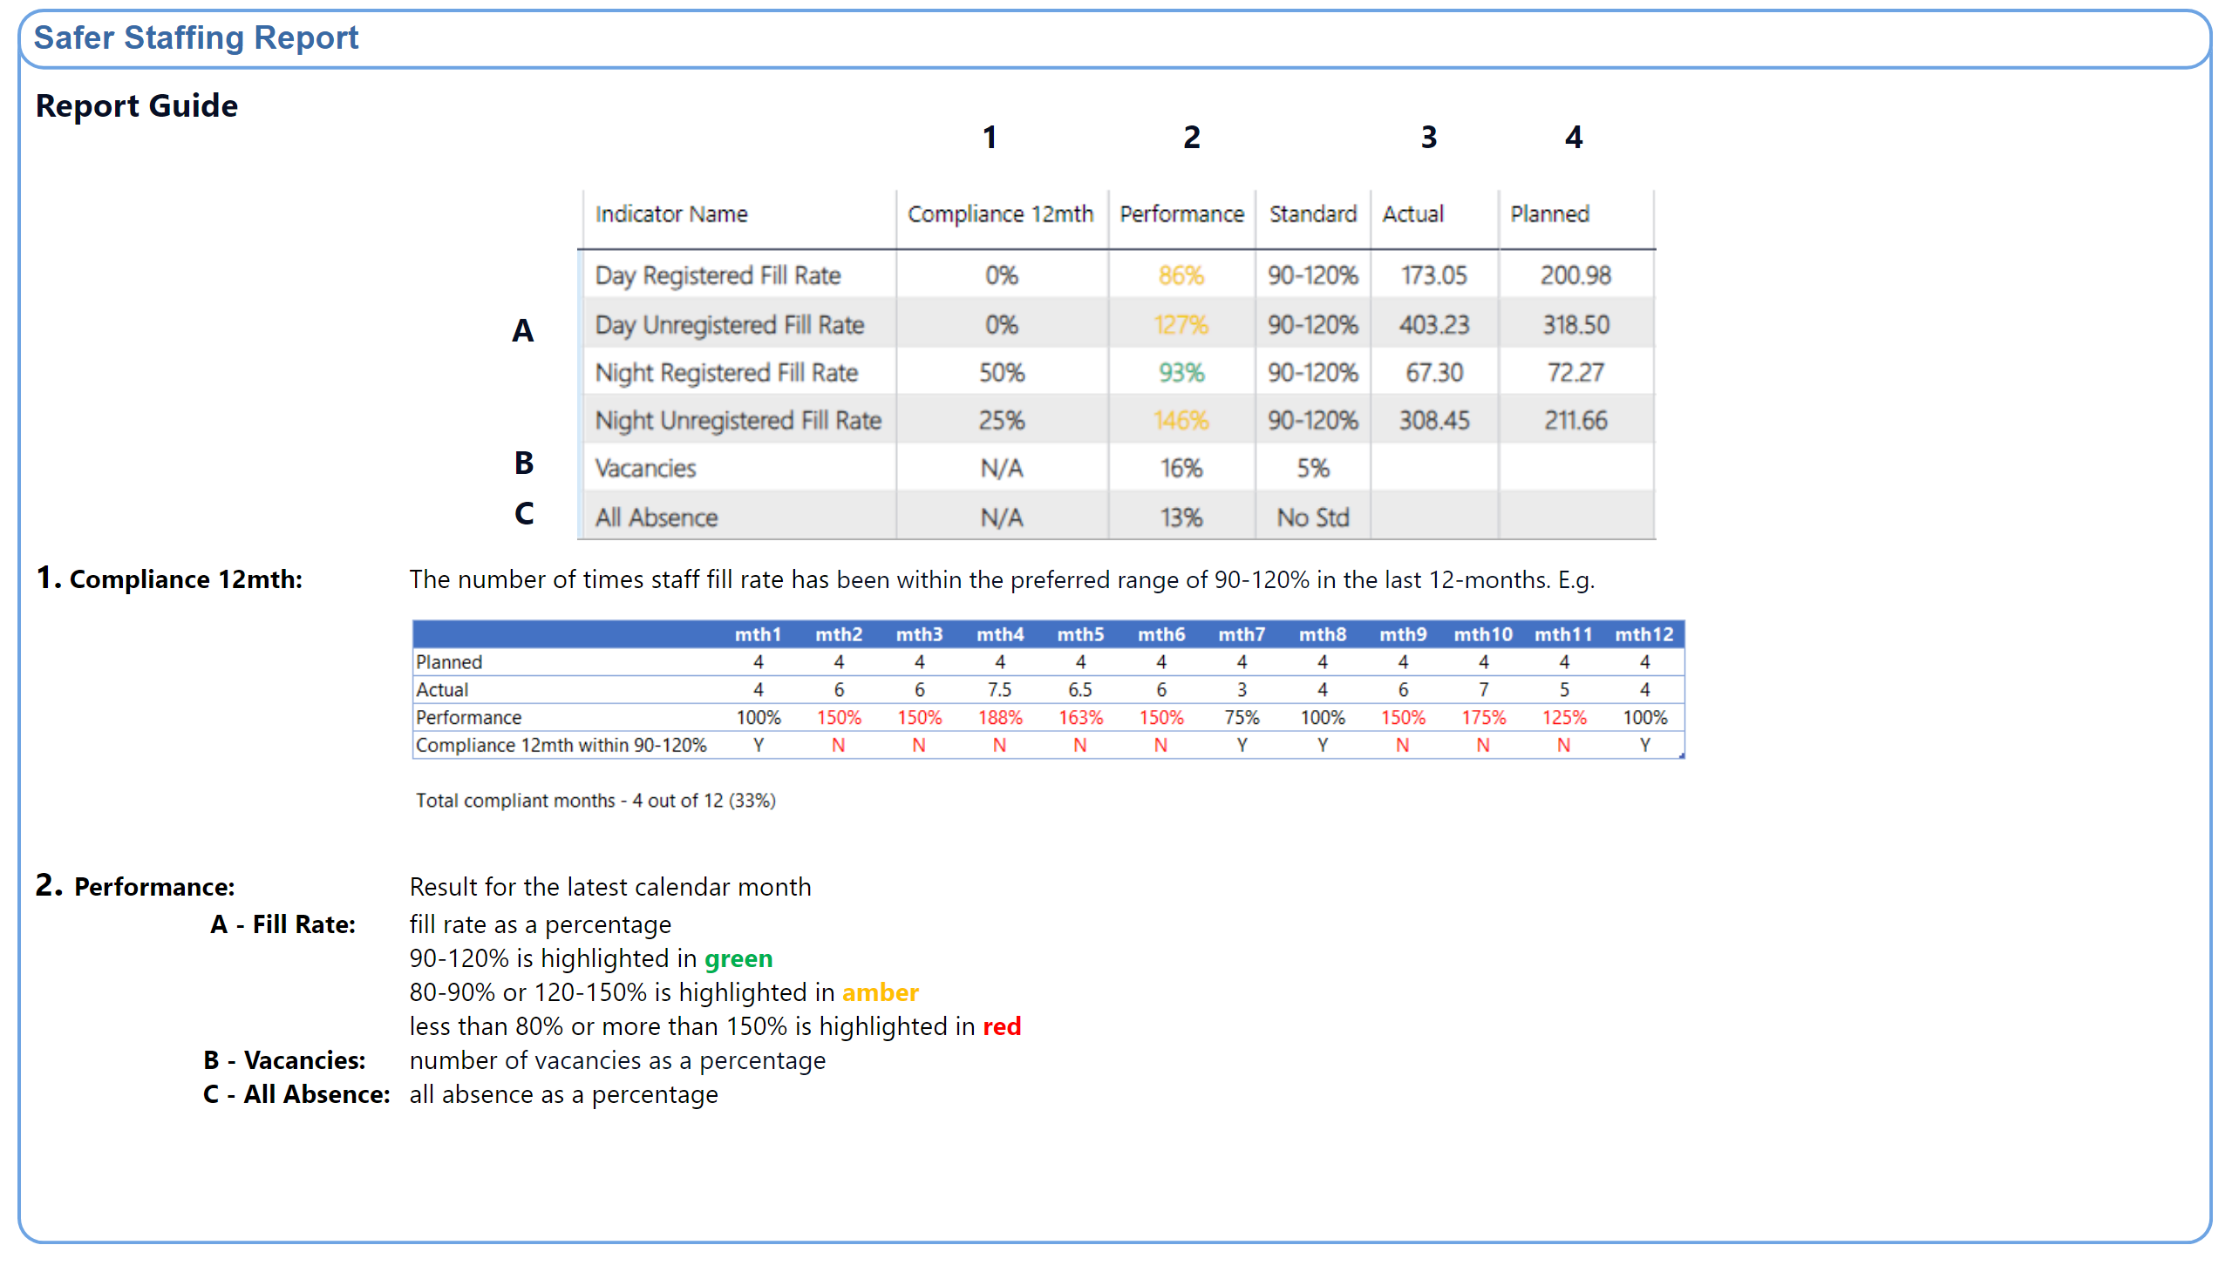
Guide
Notes:
textbox
No alt text provided
shape
No alt text provided
shape
No alt text provided
textbox
No alt text provided
textbox
No alt text provided
textbox
No alt text provided
textbox
No alt text provided
textbox
No alt text provided
textbox
No alt text provided
textbox
No alt text provided
textbox
No alt text provided
textbox
No alt text provided
image
No alt text provided
image
No alt text provided

Slide 12
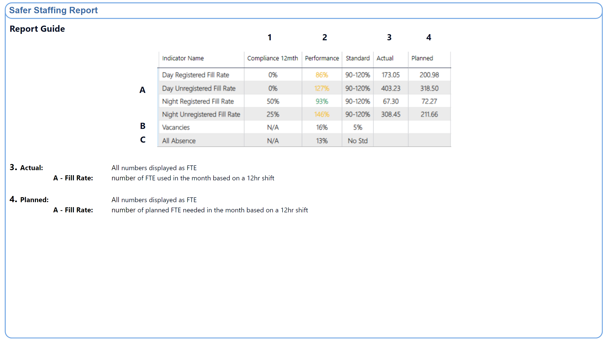
Guide 2
Notes:
textbox
No alt text provided
shape
No alt text provided
shape
No alt text provided
textbox
No alt text provided
textbox
No alt text provided
textbox
No alt text provided
textbox
No alt text provided
textbox
No alt text provided
textbox
No alt text provided
textbox
No alt text provided
textbox
No alt text provided
textbox
No alt text provided
image
No alt text provided

Slide 13
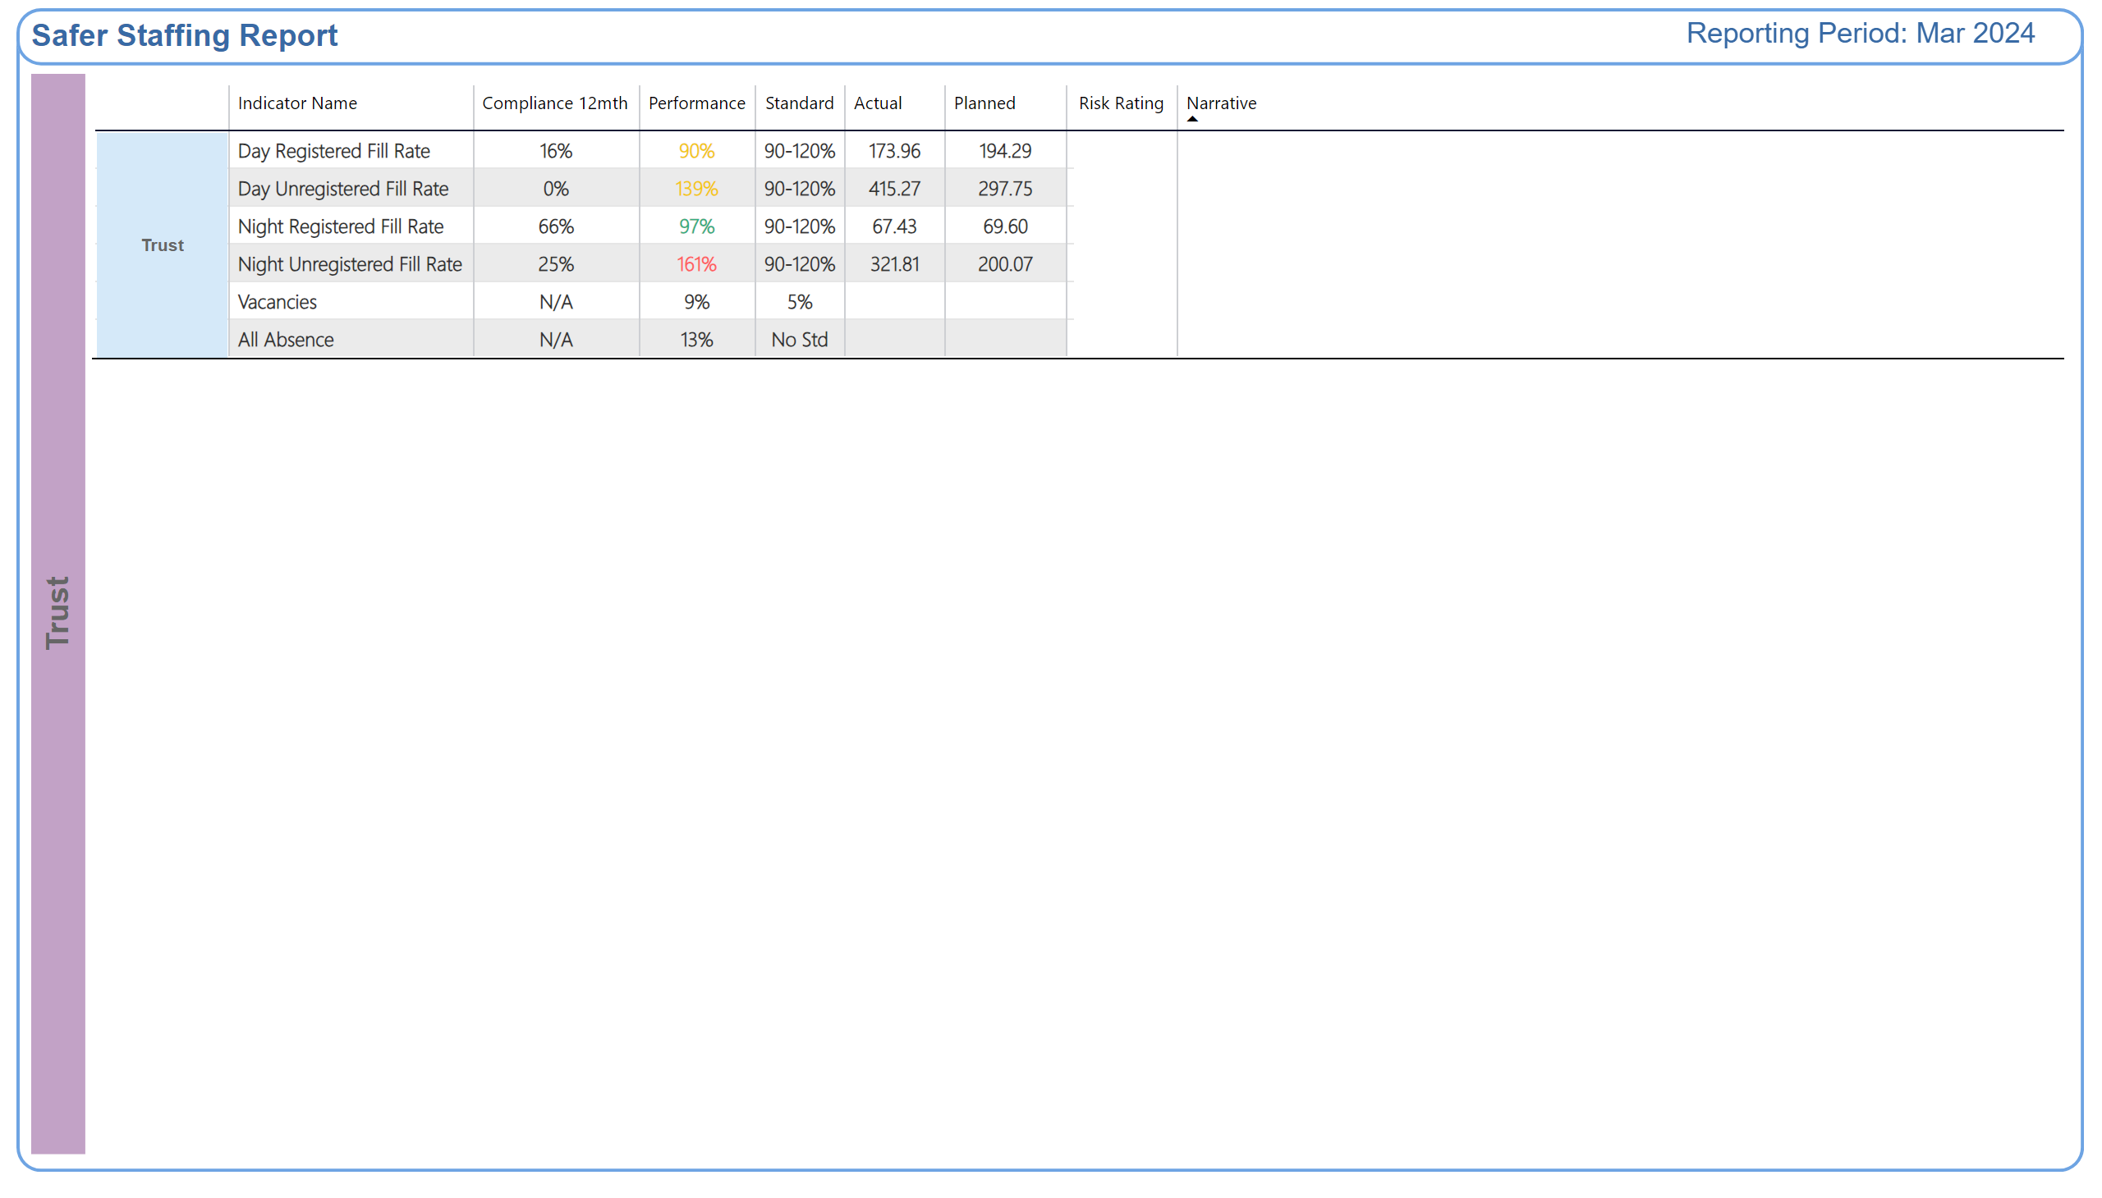
Trust
Notes:
shape
No alt text provided
textbox
No alt text provided
shape
No alt text provided
shape
No alt text provided
shape
No alt text provided
TBL - Commitment
No alt text provided
TBL - Commitment
No alt text provided
TXT - Reporting Period
No alt text provided
shape
No alt text provided

Slide 14
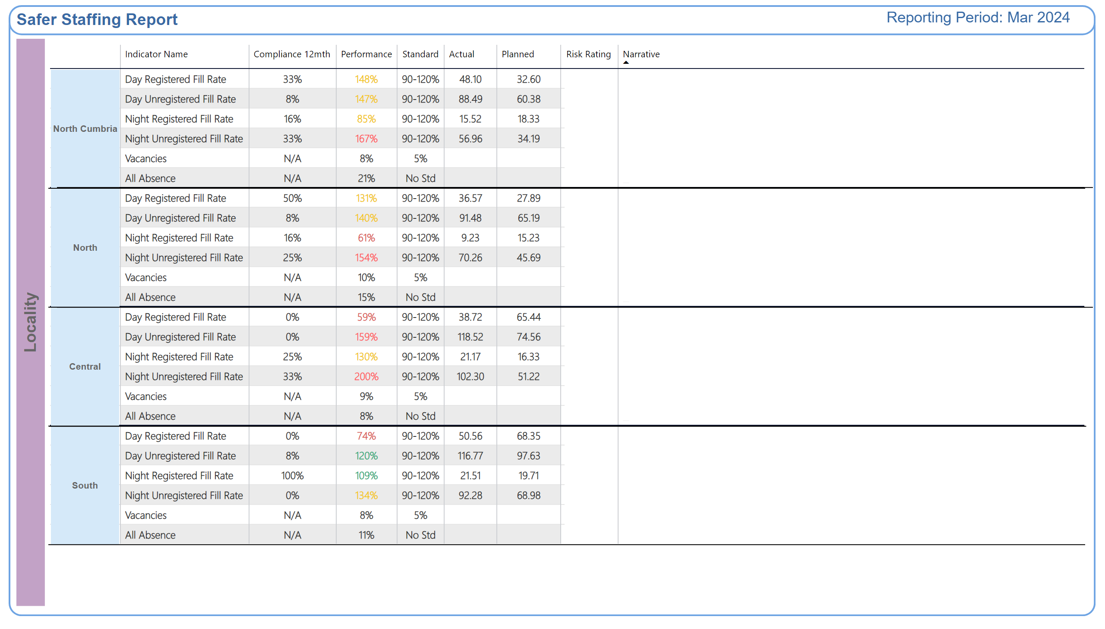
Locality
Notes:
shape
No alt text provided
TXT - Reporting Period
No alt text provided
textbox
No alt text provided
shape
No alt text provided
shape
No alt text provided
shape
No alt text provided
TBL - Commitment
No alt text provided
TBL - Commitment
No alt text provided
shape
No alt text provided
TBL - Commitment
No alt text provided
TBL - Commitment
No alt text provided
TBL - Commitment
No alt text provided
TBL - Commitment
No alt text provided
shape
No alt text provided
TBL - Commitment
No alt text provided
TBL - Commitment
No alt text provided
shape
No alt text provided
shape
No alt text provided
shape
No alt text provided
shape
No alt text provided
shape
No alt text provided
shape
No alt text provided
shape
No alt text provided
shape
No alt text provided

