Slide 1
Title
Notes:
image
No alt text provided
image
No alt text provided
textbox
No alt text provided
shape
No alt text provided
TextEnhancerByMAQ46ASG0293G65JY43S89DKJ9
No alt text provided
image
No alt text provided
image
No alt text provided

Slide 2
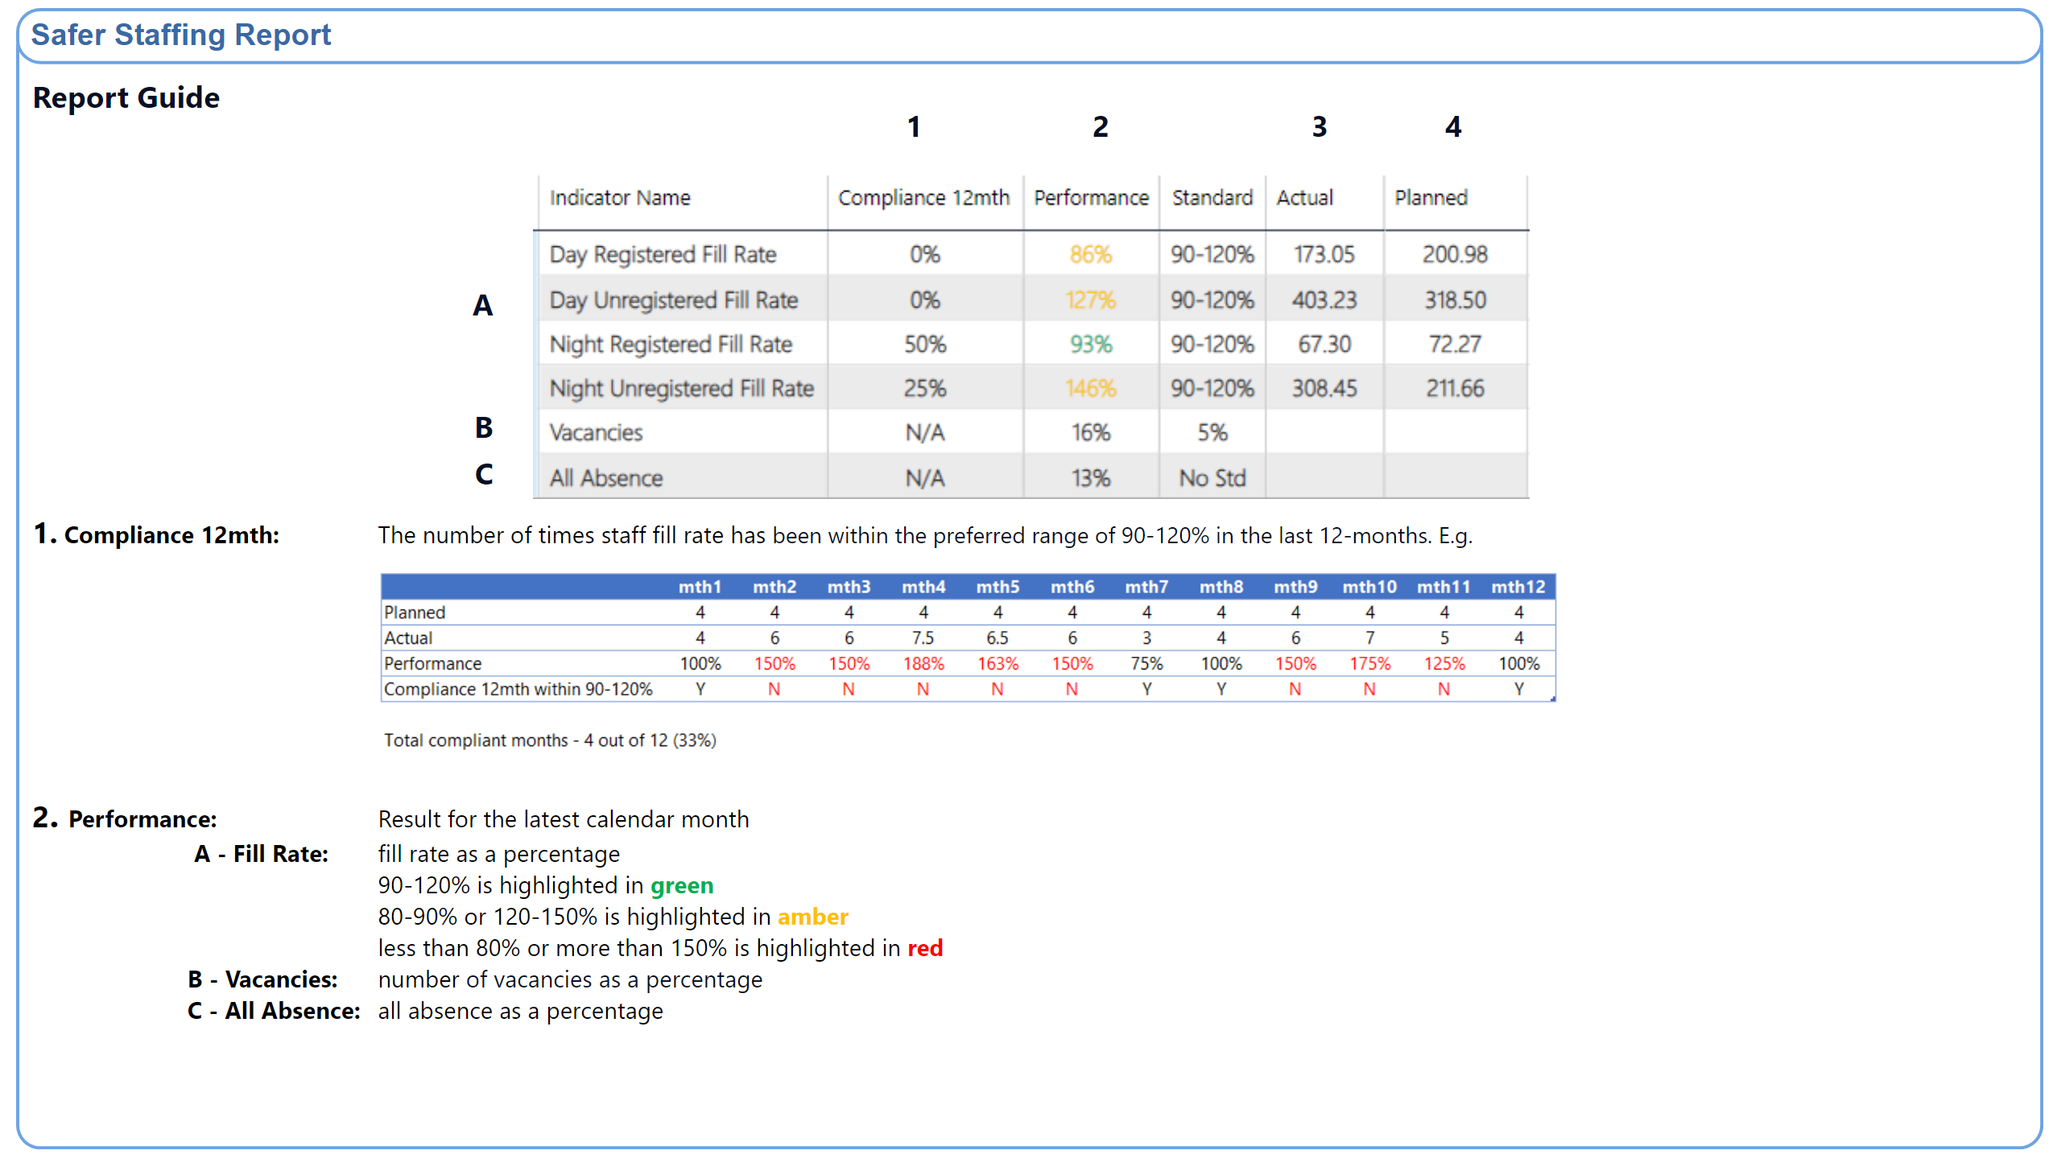
Guide
Notes:
textbox
No alt text provided
shape
No alt text provided
shape
No alt text provided
textbox
No alt text provided
textbox
No alt text provided
textbox
No alt text provided
textbox
No alt text provided
textbox
No alt text provided
textbox
No alt text provided
textbox
No alt text provided
textbox
No alt text provided
textbox
No alt text provided
image
No alt text provided
image
No alt text provided

Slide 3
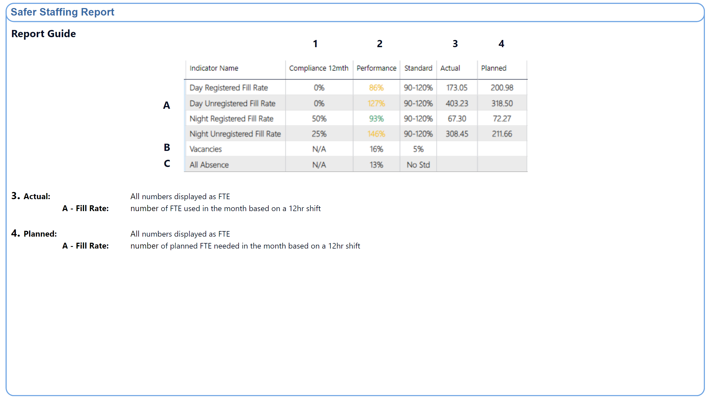
Guide 2
Notes:
textbox
No alt text provided
shape
No alt text provided
shape
No alt text provided
textbox
No alt text provided
textbox
No alt text provided
textbox
No alt text provided
textbox
No alt text provided
textbox
No alt text provided
textbox
No alt text provided
textbox
No alt text provided
textbox
No alt text provided
textbox
No alt text provided
image
No alt text provided

Slide 4
Ward Type Narrative Summary
Issues impacting on safe staffing:
A high proportion of preceptees and Internationally Educated Nurses who are unable to take charge of the ward.
An increase in the number of patients requiring an enhanced level of observation.
A high level of patient acuity, compounded by co-existing conditions and physical health needs.
An increase in the number of patients who are Clinically Ready for Discharge (CRFD)
Out of pathway patients
Staff members are redeployed across CBUs according to need, which can reduce continuity of care and job satisfaction..
Pressures relating to enabling staff training.
Overall, the registered nursing workforce is relatively inexperienced.
There is a high level of incidents involving violence and aggression; focused work is in progress with respect to Mitford..
There are specific risks associated with stand-alone units (Yewdale; Elm House; Lotus ward) and hospital sites not easily accessible by public transport (Northgate; Ferndene)
Daily level-loading of experienced registered nurses is undertaken.
Daily or twice daily staffing huddles are held to reassess safe staffing levels.
Implementation of evaluation of competence at 9 months in the preceptorship process.
Staff wellbeing meetings are held and relevant actions implemented.
Staff turnover is decreasing (Central Locality)
Work is in progress to increase the capacity of the nurse bank to address temporary staffing needs, rather than using agency workers. – Recurring B3 post advert
There is focused work in progress to promote staff wellbeing.
Mental Health Optimal Staffing Tool (MHOST) data
Inpatient Staffing Enhanced MDT
Quality Improvement Framework
Positive and safe cohort meetings
Notes:
textbox
No alt text provided
shape
No alt text provided
shape
No alt text provided
shape
No alt text provided
textbox
No alt text provided
textbox
No alt text provided
shape
No alt text provided
shape
No alt text provided
textbox
No alt text provided
shape
No alt text provided
shape
No alt text provided
textbox
No alt text provided
shape
No alt text provided
shape
No alt text provided
TextEnhancerByMAQ46ASG0293G65JY43S89DKJ9
No alt text provided
TextEnhancerByMAQ46ASG0293G65JY43S89DKJ9
No alt text provided
TextEnhancerByMAQ46ASG0293G65JY43S89DKJ9
No alt text provided
TextEnhancerByMAQ46ASG0293G65JY43S89DKJ9
No alt text provided
shape
No alt text provided

Slide 5
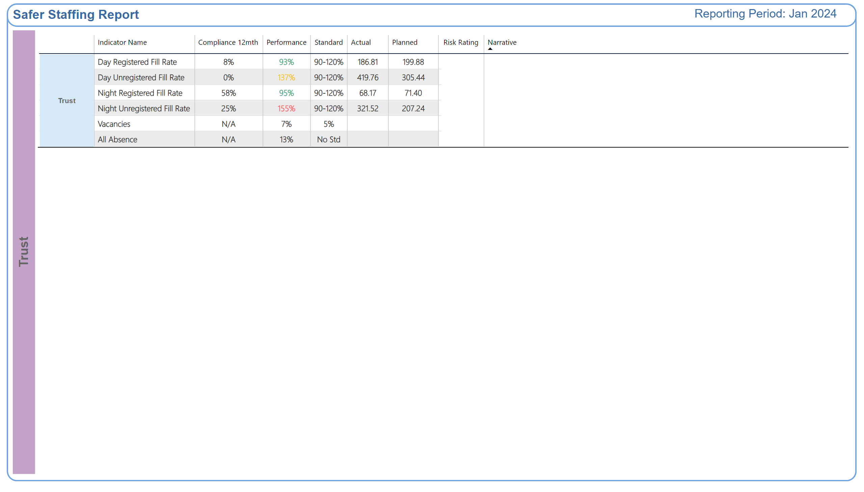
Trust
Why the risk rating is medium or high
Improvement Actions
Notes:
shape
No alt text provided
textbox
No alt text provided
shape
No alt text provided
shape
No alt text provided
shape
No alt text provided
TBL - Commitment
No alt text provided
TBL - Commitment
No alt text provided
TXT - Reporting Period
No alt text provided
shape
No alt text provided

Slide 6
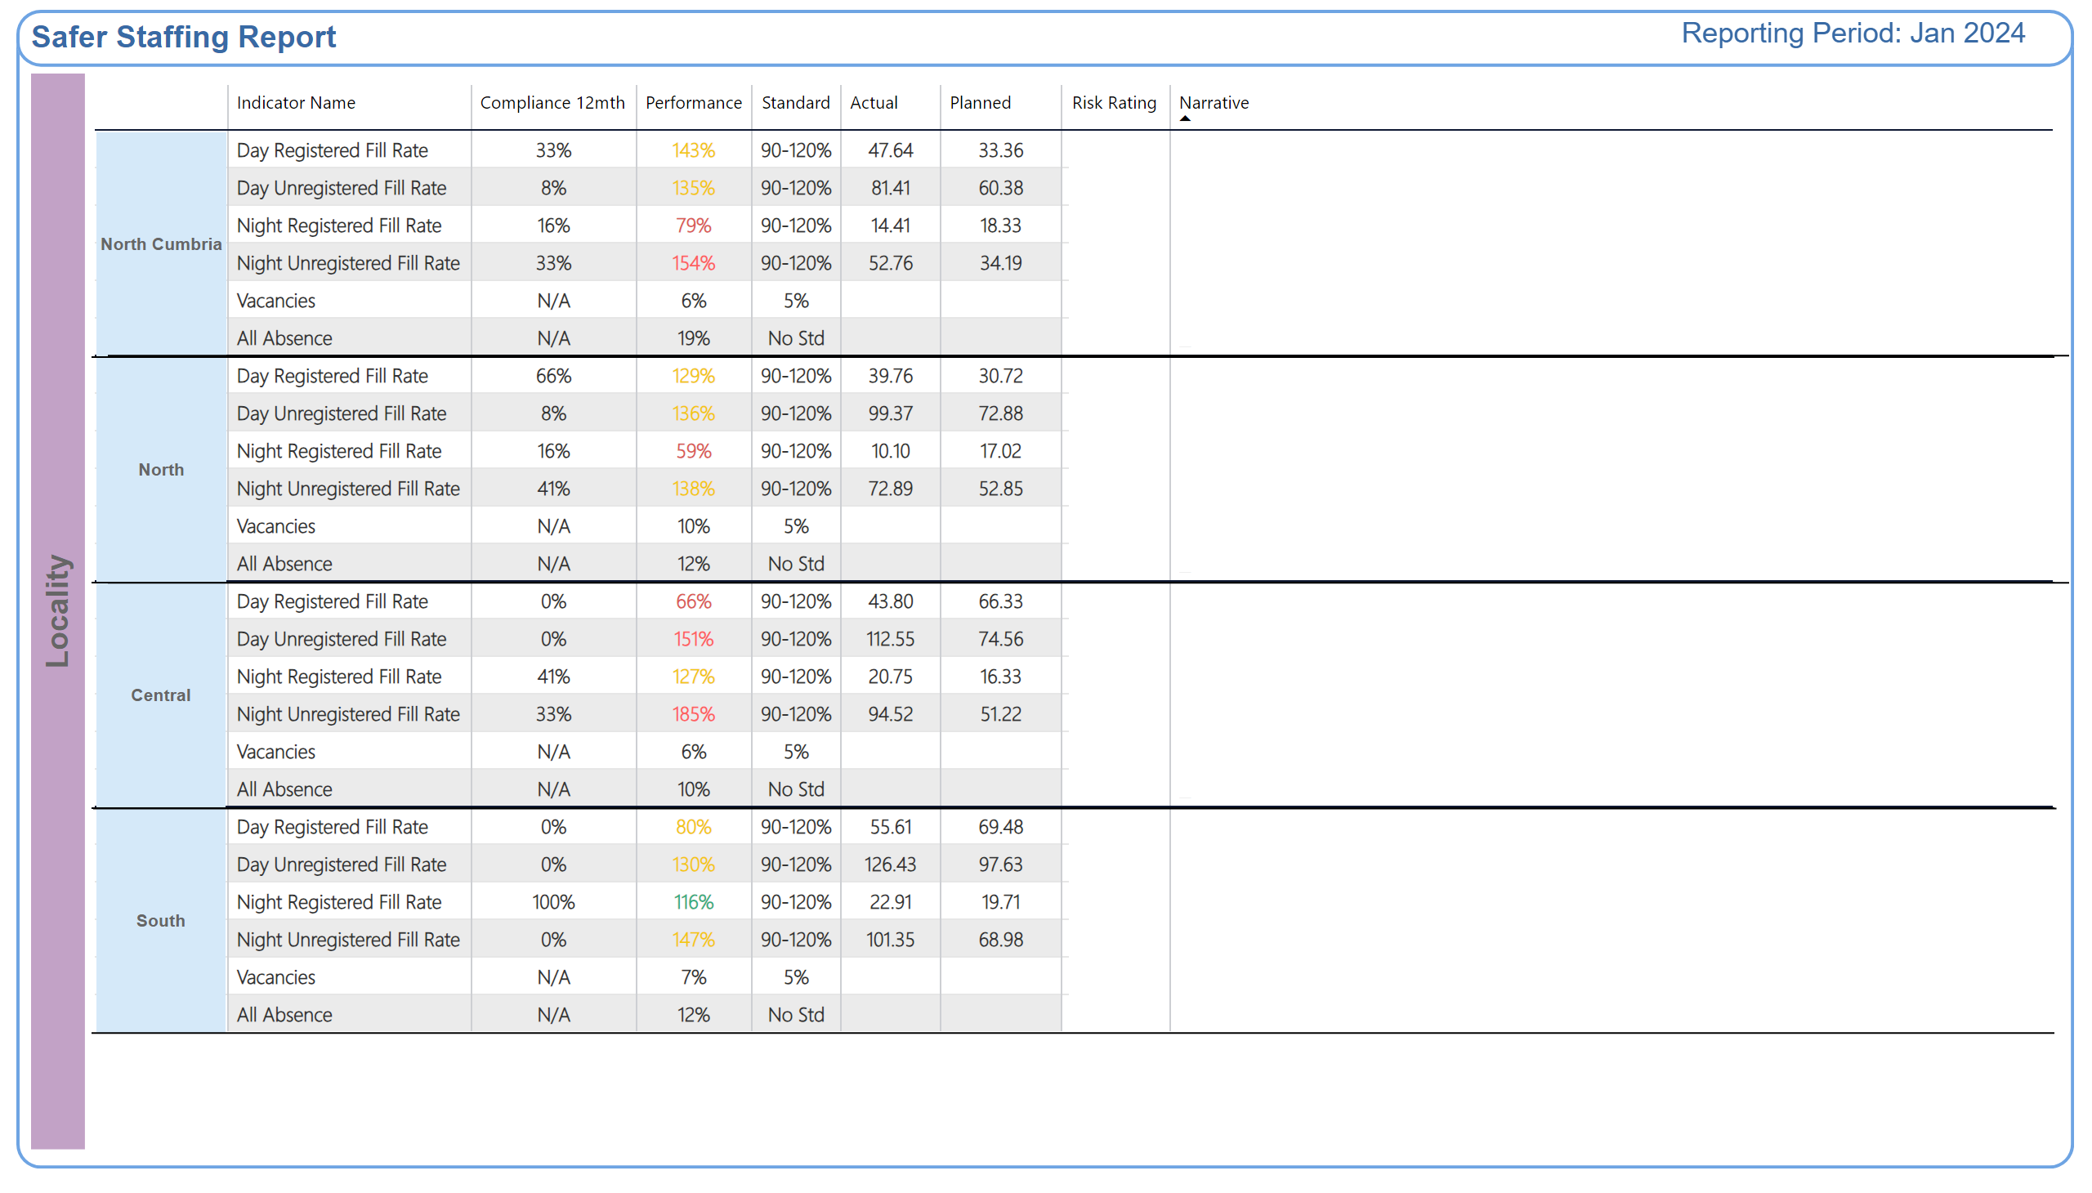
Locality
Why is the risk rating medium or high?
Improvement Actions
Why is the risk rating medium or high?
Improvement Actions
Why is the risk rating medium or high?
Improvement Actions
Why is the risk rating medium or high?
Improvement Actions
Notes:
shape
No alt text provided
TXT - Reporting Period
No alt text provided
textbox
No alt text provided
shape
No alt text provided
shape
No alt text provided
shape
No alt text provided
TBL - Commitment
No alt text provided
TBL - Commitment
No alt text provided
shape
No alt text provided
TBL - Commitment
No alt text provided
TBL - Commitment
No alt text provided
TBL - Commitment
No alt text provided
TBL - Commitment
No alt text provided
shape
No alt text provided
TBL - Commitment
No alt text provided
TBL - Commitment
No alt text provided
shape
No alt text provided
shape
No alt text provided
shape
No alt text provided
shape
No alt text provided
shape
No alt text provided
shape
No alt text provided
shape
No alt text provided
shape
No alt text provided

Slide 7
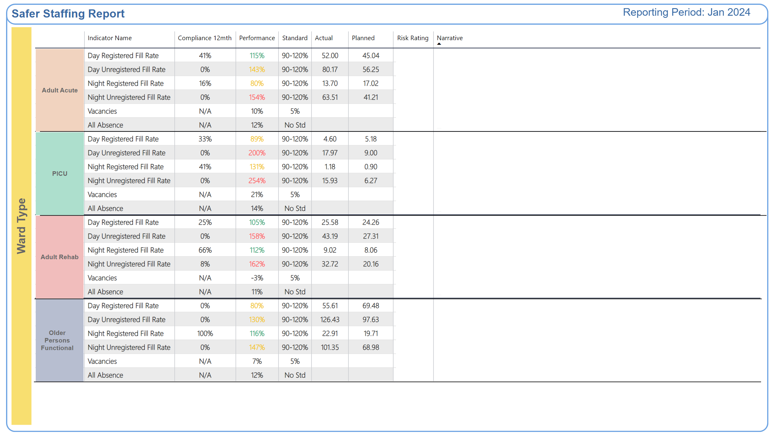
Ward Type
Why is the risk rating medium or high?
Improvement Actions
Why is the risk rating medium or high?
Improvement Actions
Why is the risk rating medium or high?
Improvement Actions
Why is the risk rating medium or high?
Improvement Actions
Notes:
shape
No alt text provided
TXT - Reporting Period
No alt text provided
textbox
No alt text provided
shape
No alt text provided
shape
No alt text provided
shape
No alt text provided
TBL - Commitment
No alt text provided
TBL - Commitment
No alt text provided
shape
No alt text provided
TBL - Commitment
No alt text provided
TBL - Commitment
No alt text provided
TBL - Commitment
No alt text provided
TBL - Commitment
No alt text provided
shape
No alt text provided
TBL - Commitment
No alt text provided
TBL - Commitment
No alt text provided
shape
No alt text provided
shape
No alt text provided
shape
No alt text provided
shape
No alt text provided
shape
No alt text provided

Slide 8
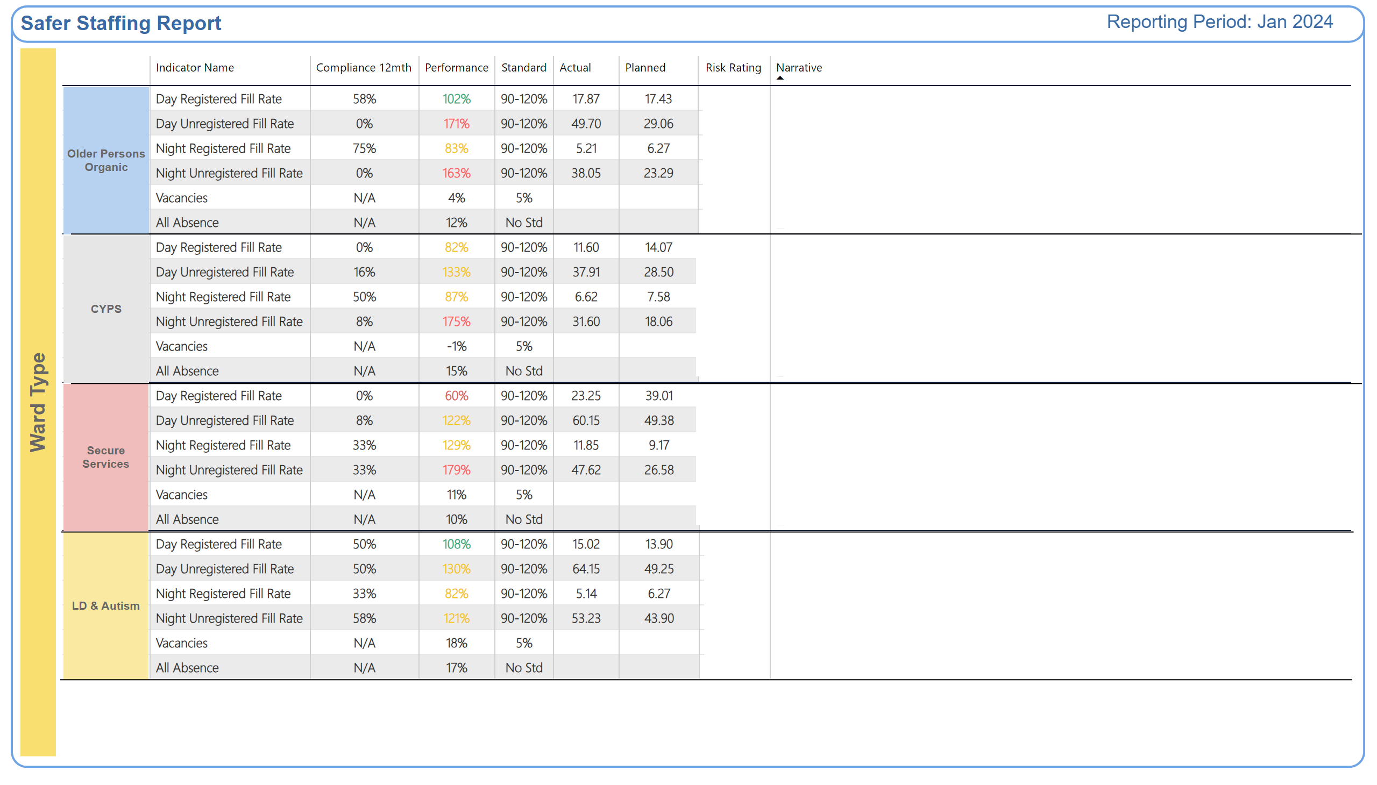
Ward Type 2
Why is the risk rating medium or high?
Improvement Actions
Why is the risk rating medium or high?
Improvement Actions
Why is the risk rating medium or high?
Improvement Actions
Why is the risk rating medium or high?
Improvement Actions
Notes:
TXT - Reporting Period
No alt text provided
textbox
No alt text provided
shape
No alt text provided
shape
No alt text provided
shape
No alt text provided
TBL - Commitment
No alt text provided
TBL - Commitment
No alt text provided
TBL - Commitment
No alt text provided
TBL - Commitment
No alt text provided
shape
No alt text provided
TBL - Commitment
No alt text provided
TBL - Commitment
No alt text provided
shape
No alt text provided
TBL - Commitment
No alt text provided
TBL - Commitment
No alt text provided
shape
No alt text provided
shape
No alt text provided
shape
No alt text provided
shape
No alt text provided
shape
No alt text provided
shape
No alt text provided

Slide 9
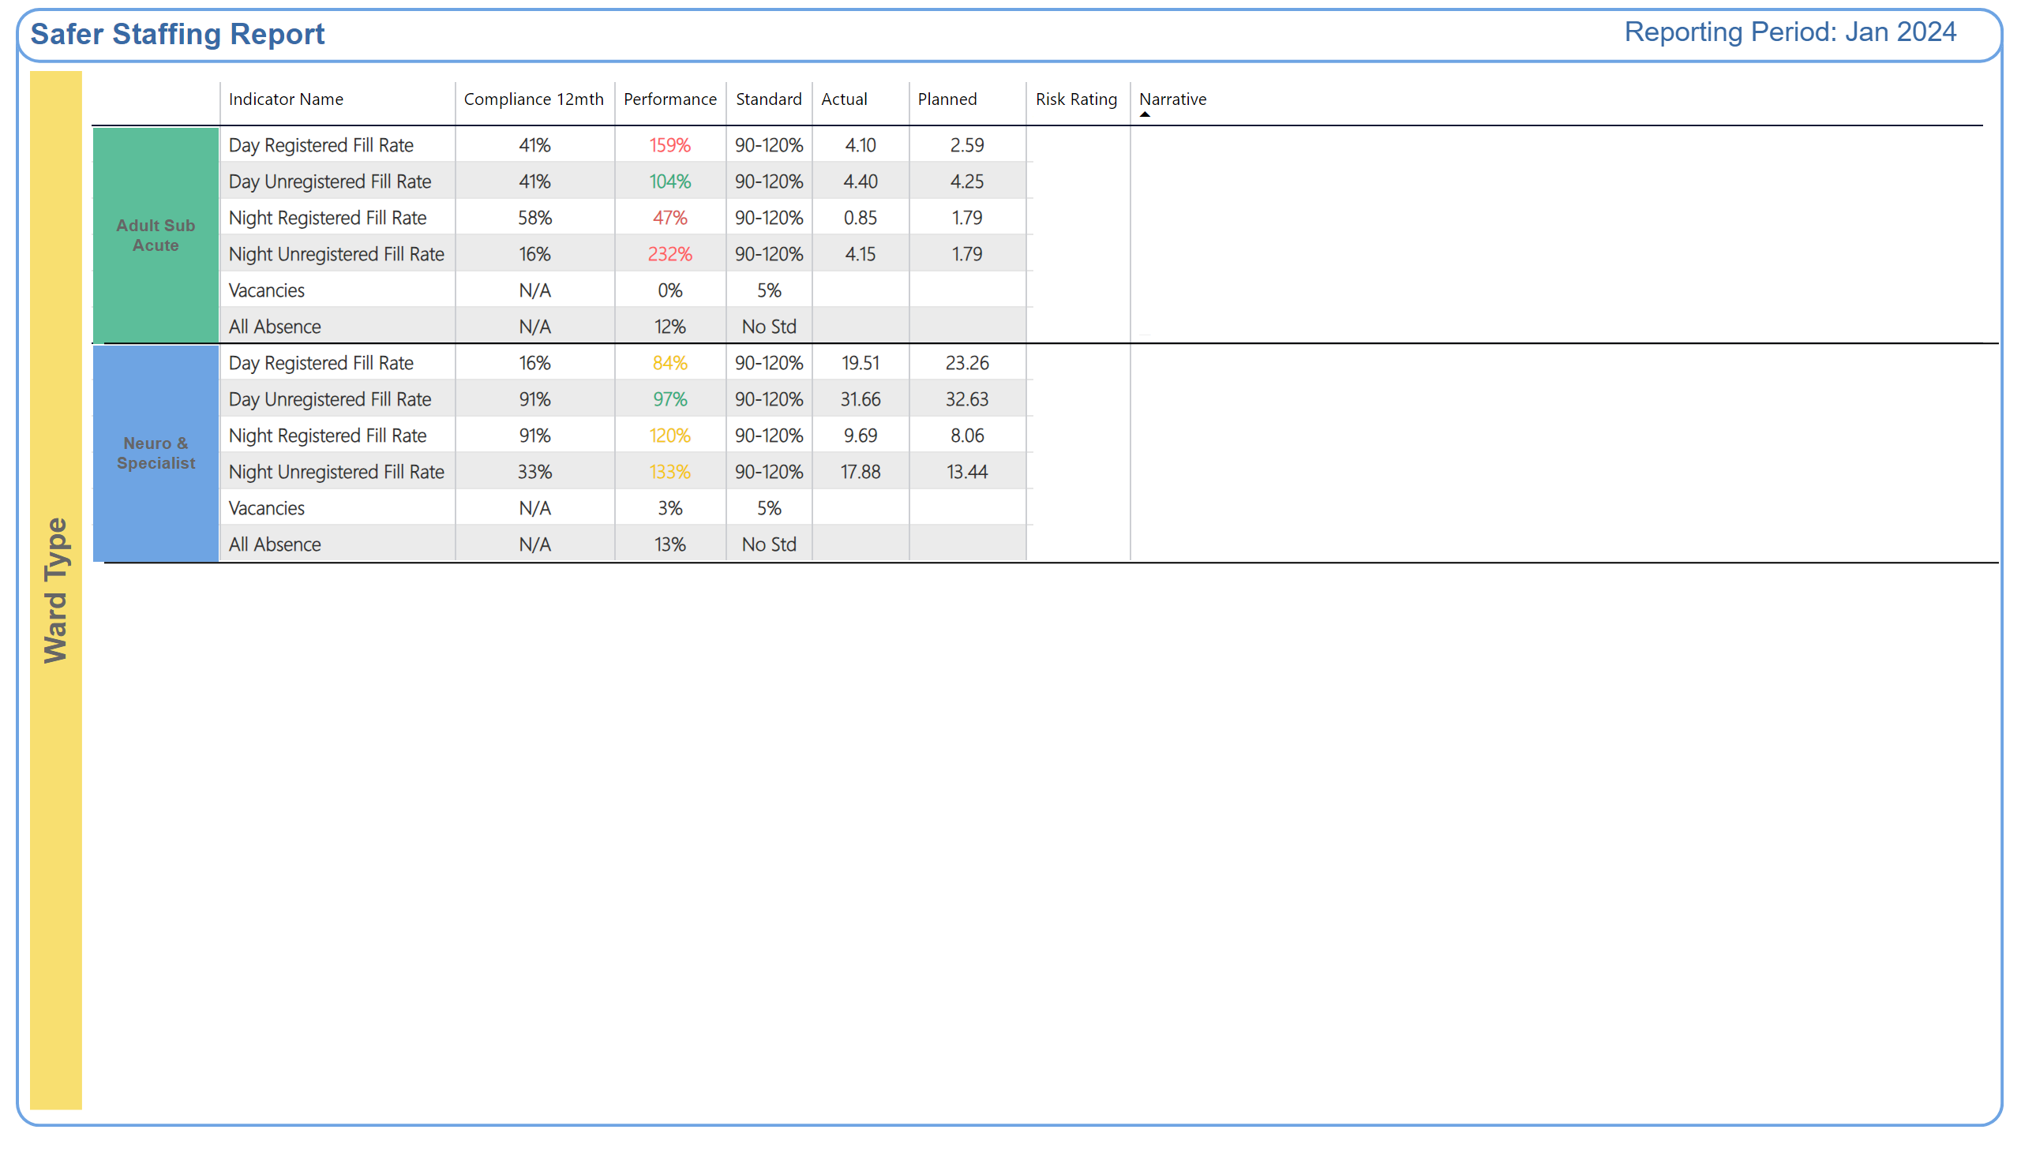
Ward Type 3
Why is the risk rating medium or high?
Improvement Actions
Why is the risk rating medium or high?
Improvement Actions
Notes:
TXT - Reporting Period
No alt text provided
textbox
No alt text provided
shape
No alt text provided
shape
No alt text provided
shape
No alt text provided
shape
No alt text provided
TBL - Commitment
No alt text provided
TBL - Commitment
No alt text provided
shape
No alt text provided
TBL - Commitment
No alt text provided
TBL - Commitment
No alt text provided
shape
No alt text provided
shape
No alt text provided

Slide 10
Skill mix information by ward: North Locality
 | Safer Staffing Registered Total | Take charge Registered | Preceptee Registered | Inter-national Educated Adult Nurse | Inter-national Educated Mental Health Nurse | Sickness/ Maternity Registered | Alternative to clinical duties Registered | Suspensions | Vacancies Registered | Total Registered (in post)
Alnmouth | 3-3-1 | 4 | 5 | 2 | 0 | 2 | 1 | 0 | 1.5 | 11.5
Bluebell Court | 2-2-1 | 5 | 1 | 2 | 1 | 1 | 0 | 0 | 0.8 | 9.2
Embleton | 3-3-1 | 6 | 4 | 1 | 0 | 1 | 1 | 0 | 3 | 11
Hauxley | 2-2-1 |  | 2 | 2 | 2 | 1 | 0 | 0 | 1 | 11.28
Kinnersley | 2-2-1 | 9 | 4 | 3 | 0 | 2 | 0 | 0 | 0 | 10
Mitford | 3-3-2 | 9 | 4 | 1 | 0 | 2 | 3 | 0 | 7 | 19
Mitford Bungalows | 0 | 0 | 0 | 0 | 0 | 0 | 0 | 0 | 0 | 0
Newton | 3-3-1 | 8 | 1 | 1 | 2 | 1 | 0 | 0 | 3 | 13
Warkworth | 3-3-1 | 5 | 3 | 3 | 0 | 1 | 0 | 0 | 3 | 13
Woodhorn | 3-3-2 | 9 | 4 | 2 | 1 | 4 | 2 | 0 | 2.4 | 14

Slide 11
Skill mix information by ward: Central Locality
 | Safer Staffing Registered Total | Take charge Registered | Preceptee Registered | International Educated Adult Nurse | International Educated Mental Health Nurse | Sickness/ Maternity Registered | Alternative to clinical duties Registered | Suspensions | Vacancies Registered | Total Registered (in post)
Akenside | 10 | 7 | 1 | 1 | 0 | 1 | 1 | 0 | 0 | 10
Bede | 12 | 6 | 5 | 1 | 0 | 0 | 0 | 0 | 0 | 12
Castleside | 11 | 7 | 1 | 2 | 0 | 0 | 1 | 0 | 0 | 11
Elm House | 10 | 7 | 0 | 0 | 0 | 2 | 1 | 0 | 0 | 10
Fellside | 11 | 7 | 2 | 1 | 0 | 0 | 1 | 0 | 0 | 11
Lamesley | 11 | 7 | 2 | 1 | 0 | 0 | 0 | 0 | 0 | 11
Lowry | 12 | 8 | 2 | 1 | 0 | 1 | 0 | 0 | 0 | 12
Willow View | 11 | 7 | 2 | 1 | 0 | 0 | 1 | 0 | 0 | 11

Slide 12
Skill mix information by ward: South Locality
Average Figures for Month | Safer Staffing Registered Total | Take charge Registered | Preceptee Registered | International Educated Adult Nurse | International Educated Mental Health Nurse | Sickness/ Maternity Registered | Alternative to clinical duties Registered | Non- Clinical | Vacancies Registered | Total Registered (in post) All Grades
Aldervale | 2 AM 2 PM 1 N/S | Band 7- 2 Band 6- 2 Band 5-6 | 1 | 2 | 0 | 2 | 0 | 1 | 0.5 | 13
Beckfield | 2 AM 2 PM 1 N/S | Band 7- 2 Band 6- 2 Band 5- 3 | 6 | 0 | 0 | 2 | 0 | 1 | 2 | 16
Bridgewell | 2 AM 2 PM 1 N/S | Band 7- 1 Band 6- 3 Band 5- 5 | 2 | 1 | 0 | 0 | 0 | 0 | 0 | 12
Brooke House | 2 AM 2 PM 1 N/S | Band 7- 1 Band 6- 1 Band 5- 5 | 1 | 1 | 0 | 1 | 0 | 1 | 0 | 9
Cleadon | 2 AM 2 PM 1 N/S | Band 7- 2 Band 6- 2 Band 5- 6 | 4 | 3 |  | 2 | 1 | 1 | 0
Clearbrook | 2 AM 2 PM 1 N/S | Band 7- 2 Band 6- 2 Band 5- 5 | 2 | 1 | 0 | 2 | 0 | 0 | 2.5 | 12
Longview | 2 AM 2 PM 1 N/S | Band 7- 2 Band 6- 2 Band 5- 3 | 2 | 0 | 0 | 1 | 0 | 0 | 3 | 10

Slide 13
Skill mix information by ward: South Locality
Average Figures for Month | Safer Staffing Registered Total | Take charge Registered | Preceptee Registered | International Educated Adult Nurse | International Educated Mental Health Nurse | Sickness/ Maternity Registered | Alternative to clinical duties Registered | Non- Clinical | Vacancies Registered | Total Registered (in post) All Grades
Mowbray | 2 AM 2 PM 1 N/S | Band 7- 1.5 Band 6- 2 Band 5- 5.5 | 1 | 1 | 0 | 0 | 0 | 0 | 1 | 11
Rose lodge | 2 AM 2 PM 1 N/S | Band 7- 2 Band 6- 3 Band 5- 4 | 3 | 1 | 0 | 0 | 1 | 2 | 0 | 16
Roker | 2 AM 2 PM 1 N/S | Band 7- 2 Band 6- 2 Band 5- 5 | 2 | 1 | 0 | 0 | 0 | 0 | 0 | 12
Shoredrift | 2 AM 2 PM 1 N/S | Band 7- 2 Band 6- 3 Band 5- 3 | 3 | 0 | 0 | 0 | 0 | 1 | 0 | 12
Springrise | 2 AM 2 PM 1 N/S | Band 7- 2 Band 6- 3 Band 5- 2 | 3 | 0 | 0 | 2 | 0 | 0 | 0 | 12

Slide 14
Skill mix information by ward: North Cumbria
North Cumbria Locality
 | Safer Staffing Registered Total | Take charge Registered | Preceptee Registered | International Educated Adult Nurse | International Educated Mental Health Nurse | Sickness/ Maternity Registered | Alternative to clinical duties Registered | Suspensions | Vacancies Registered | Total Registered (in post)
Edenwood | 1 | 7 | 3 | 1 | 2 | 0 | 0 | 0 | 0 | 10
Hadrian 1 | 2 | 4 | 4 | 2 | 1 | 1 | 0 | 0 | 2x B6 | 12
Hadrian 2 | 2 | 5 | 4 | 1 | 3 | 0 | 0 | 0 | 3x B6 | 12
Oakwood | 2 | 10 | 2 | 3 | 0 | 2 | 0 | 0 | 1x B6 | 12
Ruskin | 2 | 5 | 3 | 4 | 1 | 1x B5 1x B7 Mat leave | 1 |  | 7x B5 | 8
Yewdale | 2 | 6 | 3 | 3 | 0 | 0 | 0 | 0 | 1x B6 1x B5 | 12

Slide 15
Skill mix information by ward: Children and Young People Services (CYPS)
Children and Young Peoples Services.
 | Safer Staffing Registered Total | Take charge Registered | Preceptee Registered | International Educated Adult Nurse | International Educated Mental Health Nurse | Sickness/ Maternity Registered | Alternative to clinical duties Registered | Suspensions | Vacancies Registered | Total Registered (in post)
Lotus | 2 | 1 | 4 | 2 (preceptors) | 0 | 0 | 0 | 0 | 0 | 13
Stephenson | 11 | 9 | 2 | 0 | 0 | 1 | 0 | 0 | 0 | 11
Redburn | 13 | 10 | 3 | 0 | 0 | 1 | 0 | 0 | 0 | 13
Riding | 17 | 11 | 3 | 0 | 0 | 2 | 1 | 0 | 0 | 17

Slide 16
Skill mix information by ward: Secure Services
Secure Services
 | Safer Staffing Registered Total WTE | Take charge Registered | Preceptee Registered | International Educated Adult Nurse | International Educated Mental Health Nurse | Sickness/ Maternity Registered | Alternative to clinical duties Registered | Suspensions | Vacancies Registered | Total Registered (in post)
Alwinton | 10.28 | 9.28 | 0 | 0 | 1 | 2 | 0 | 0 | 0 | 10.28
Berwick | 9 | 5 | 4 | 0 | 1 | 0 | 0 | 0 | 0 | 9
Elsdon | 3 (+4 seconded) | 2 | 1 | 0 | 0 | 0 | 0 | 0 | 5 | 9
Harthope | 8 | 5 | 3 | 0 | 1 | 0 | 0 | 0 | 3 | 8
Linhope | 10.77 | 7 | 1 | 0 | 1 | 0 | 0 | 0 | 1 | 8
Rothbury | 8 | 4 | 4 | 0 | 1 | 1 | 0 | 0 | 1 | 8
Tweed Forensic | 11 | 10 | 2 | 1 | 0 | 2 | 1 | 0 | 0 | 11
Tweed Learning Disability | 9 | 7 | 1 | 0 | 0 | 0 | 0 | 0 | 0 | 9
Tyne Forensic | 10 | 6 | 2 | 0 | 2 | 1 | 0 | 0 | 1 | 8
Tyne Learning Disability | 7 | 5.30 | 1 | 0 | 1 (preceptor) | 1 | 0 | 0 | 0 | 5.30

Slide 17
Skill mix information by ward: Neuro and Specialist
Neurological and Specialist Services
 | Safer Staffing Registered Total | Take charge Registered | Preceptee Registered | International Educated Adult Nurse | International Educated Mental Health Nurse | Sickness/ Maternity Registered | Alternative to clinical duties Registered | Suspensions | Vacancies Registered | Total Registered (in post)
Beadnell | 8 (Not including WM or B7 SpN) | 5 (Not including WM or B7 SpN) | 3 | 1 (one of preceptors) | 0 | 0 | 0 | 0 | 2 – both appointed – waiting for start dates | 10 including ward manager and B7 specialist nurse
Gibside | 10 (not including WM and B7 CL) | 7 (not including WM and CL) | 0 | 1 | 0 | 2 | 1 (but on sick so counted there too) | 0 | 0 | 12 (including WM and B7 CL)
Ward 31A | 10 (not including WM and band 6 CNL) | 9 (not including WM) | 2 | 1 | 0 | 3 | 0 | 0 | 0 | 12 (including WM and band 6 CNL)
Ward 1 | 13 | 10 | 3 | 0 | 1 | 2 | 0 | 0 | 0 | 13
Ward 2 | 11 | 7 | 4 | 0 | 1 | 3 | 0 | 0 | 1 | 11
Ward 3 | 17 | 13 | 4 | 2 | 0 | 3 | 0 | 0 | 0 | 17
Ward 4 | 17 | 14 | 3 | 2 | 0 | 3 | 0 | 0 | 0 | 17

Slide 18
Adult Acute Summary
Issues impacting on safe staffing:
A high proportion of preceptees and Internationally Educated Nurses who are unable to take charge of the ward; Ward Managers are included in the staffing numbers when needed, which reduces the overall ward management capacity.
An increased number of patients on the forensic pathway; patients who are out of pathway; Care cluster 8 patients; patients with autism; patients with a learning disability.
An increase in the number of patients requiring an enhanced level of observation.
A high level of patient acuity, compounded by co-existing conditions.
An increase in the number of patients who are Clinically Ready for Discharge (CRFD)
A high patient flow rate (admissions and discharges).
The impact of registered nurse attendance at meetings and patient Tribunals; undertaking the administration of medication; daily reviews.
Band 5 preceptees are progressing to band 6 posts out-with the in-patient CBU on completion of preceptorship,
Providing some cover for junior doctors’ strike.
Staff members are redeployed across CBUs according to need, which can reduce continuity of care and job satisfaction.; staff members required to change shift at short notice and to work when annual leave has been booked.
There continues to be a registered nurse vacancy issue (North Locality); registered nurses are not always available via the nurse bank.
Pressures relating to enabling staff training.
Overall, the registered nursing workforce is relatively inexperienced.
There is a high level of incidents involving violence and aggression.
Yewdale: standalone unit is at significant distance from other Trust hospital sites. There is an increased use of agency and a significant vacancy rate.
Daily level-loading of experienced registered nurses is undertaken.
Implementation of evaluation of competence at 9 months in the preceptorship process.
Daily or twice daily staffing huddles are held to reassess safe staffing levels.
Weekly meetings are held to review registered nurse availability the following week (North Locality).
Acting up arrangements are in place for registered nurses where required (band 5 to 6; band 6 to 7).
Staff wellbeing meetings are held and relevant actions implemented.
Yewdale: senior oversight is in place to ensure responsiveness to staffing issues; all admissions are screened and no admissions are accepted after 3pm; the s.136 suite is temporarily closed.
Staff turnover is decreasing (Central Locality)
A preceptorship rotation is planned to help reduce the impact of redeployment (Central).
Notes:
textbox
No alt text provided
shape
No alt text provided
shape
No alt text provided
shape
No alt text provided
textbox
No alt text provided
textbox
No alt text provided
shape
No alt text provided
shape
No alt text provided
textbox
No alt text provided
shape
No alt text provided
shape
No alt text provided
textbox
No alt text provided
shape
No alt text provided
shape
No alt text provided
TextEnhancerByMAQ46ASG0293G65JY43S89DKJ9
No alt text provided
TextEnhancerByMAQ46ASG0293G65JY43S89DKJ9
No alt text provided
TextEnhancerByMAQ46ASG0293G65JY43S89DKJ9
No alt text provided
TextEnhancerByMAQ46ASG0293G65JY43S89DKJ9
No alt text provided
shape
No alt text provided

Slide 19
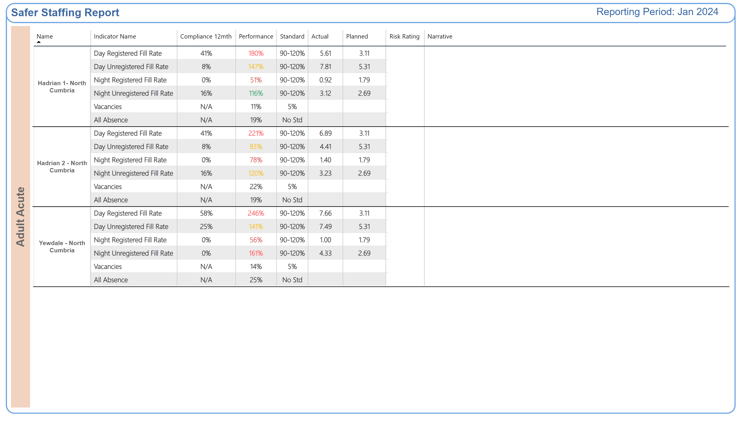
Adult Acute
Why is the risk rating medium or high?
Improvement Actions
Why is the risk rating medium or high?
Improvement Actions
Why is the risk rating medium or high?
Improvement Actions
Notes:
shape
No alt text provided
textbox
No alt text provided
shape
No alt text provided
shape
No alt text provided
shape
No alt text provided
TBL - Commitment
No alt text provided
TBL - Commitment
No alt text provided
TXT - Reporting Period
No alt text provided
shape
No alt text provided
shape
No alt text provided
shape
No alt text provided
shape
No alt text provided
shape
No alt text provided

Slide 20
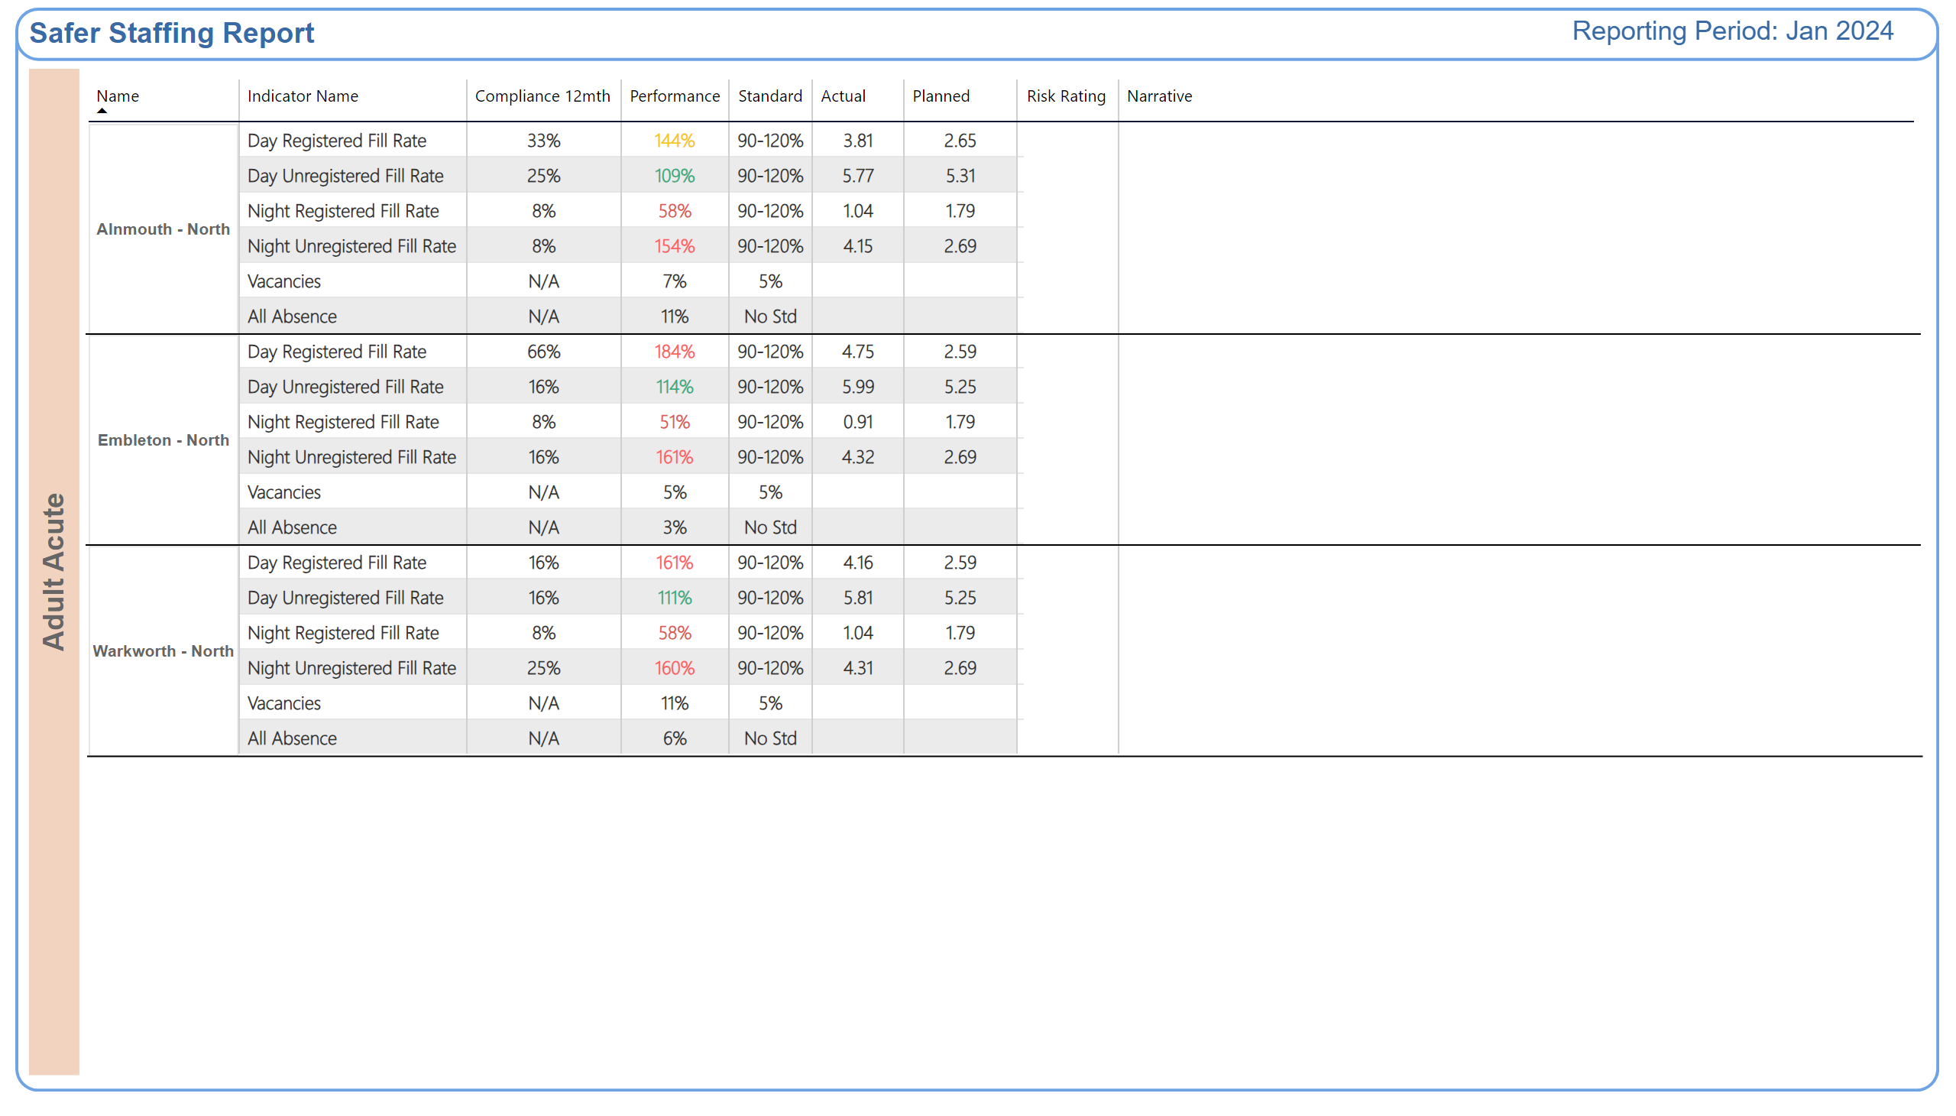
Adult Acute 2
Why is the risk rating medium or high?
Improvement Actions
Why is the risk rating medium or high?
Improvement Actions
Why is the risk rating medium or high?
Improvement Actions
Notes:
shape
No alt text provided
textbox
No alt text provided
shape
No alt text provided
shape
No alt text provided
shape
No alt text provided
TBL - Commitment
No alt text provided
TBL - Commitment
No alt text provided
TXT - Reporting Period
No alt text provided
shape
No alt text provided
shape
No alt text provided
shape
No alt text provided
shape
No alt text provided
shape
No alt text provided

Slide 21
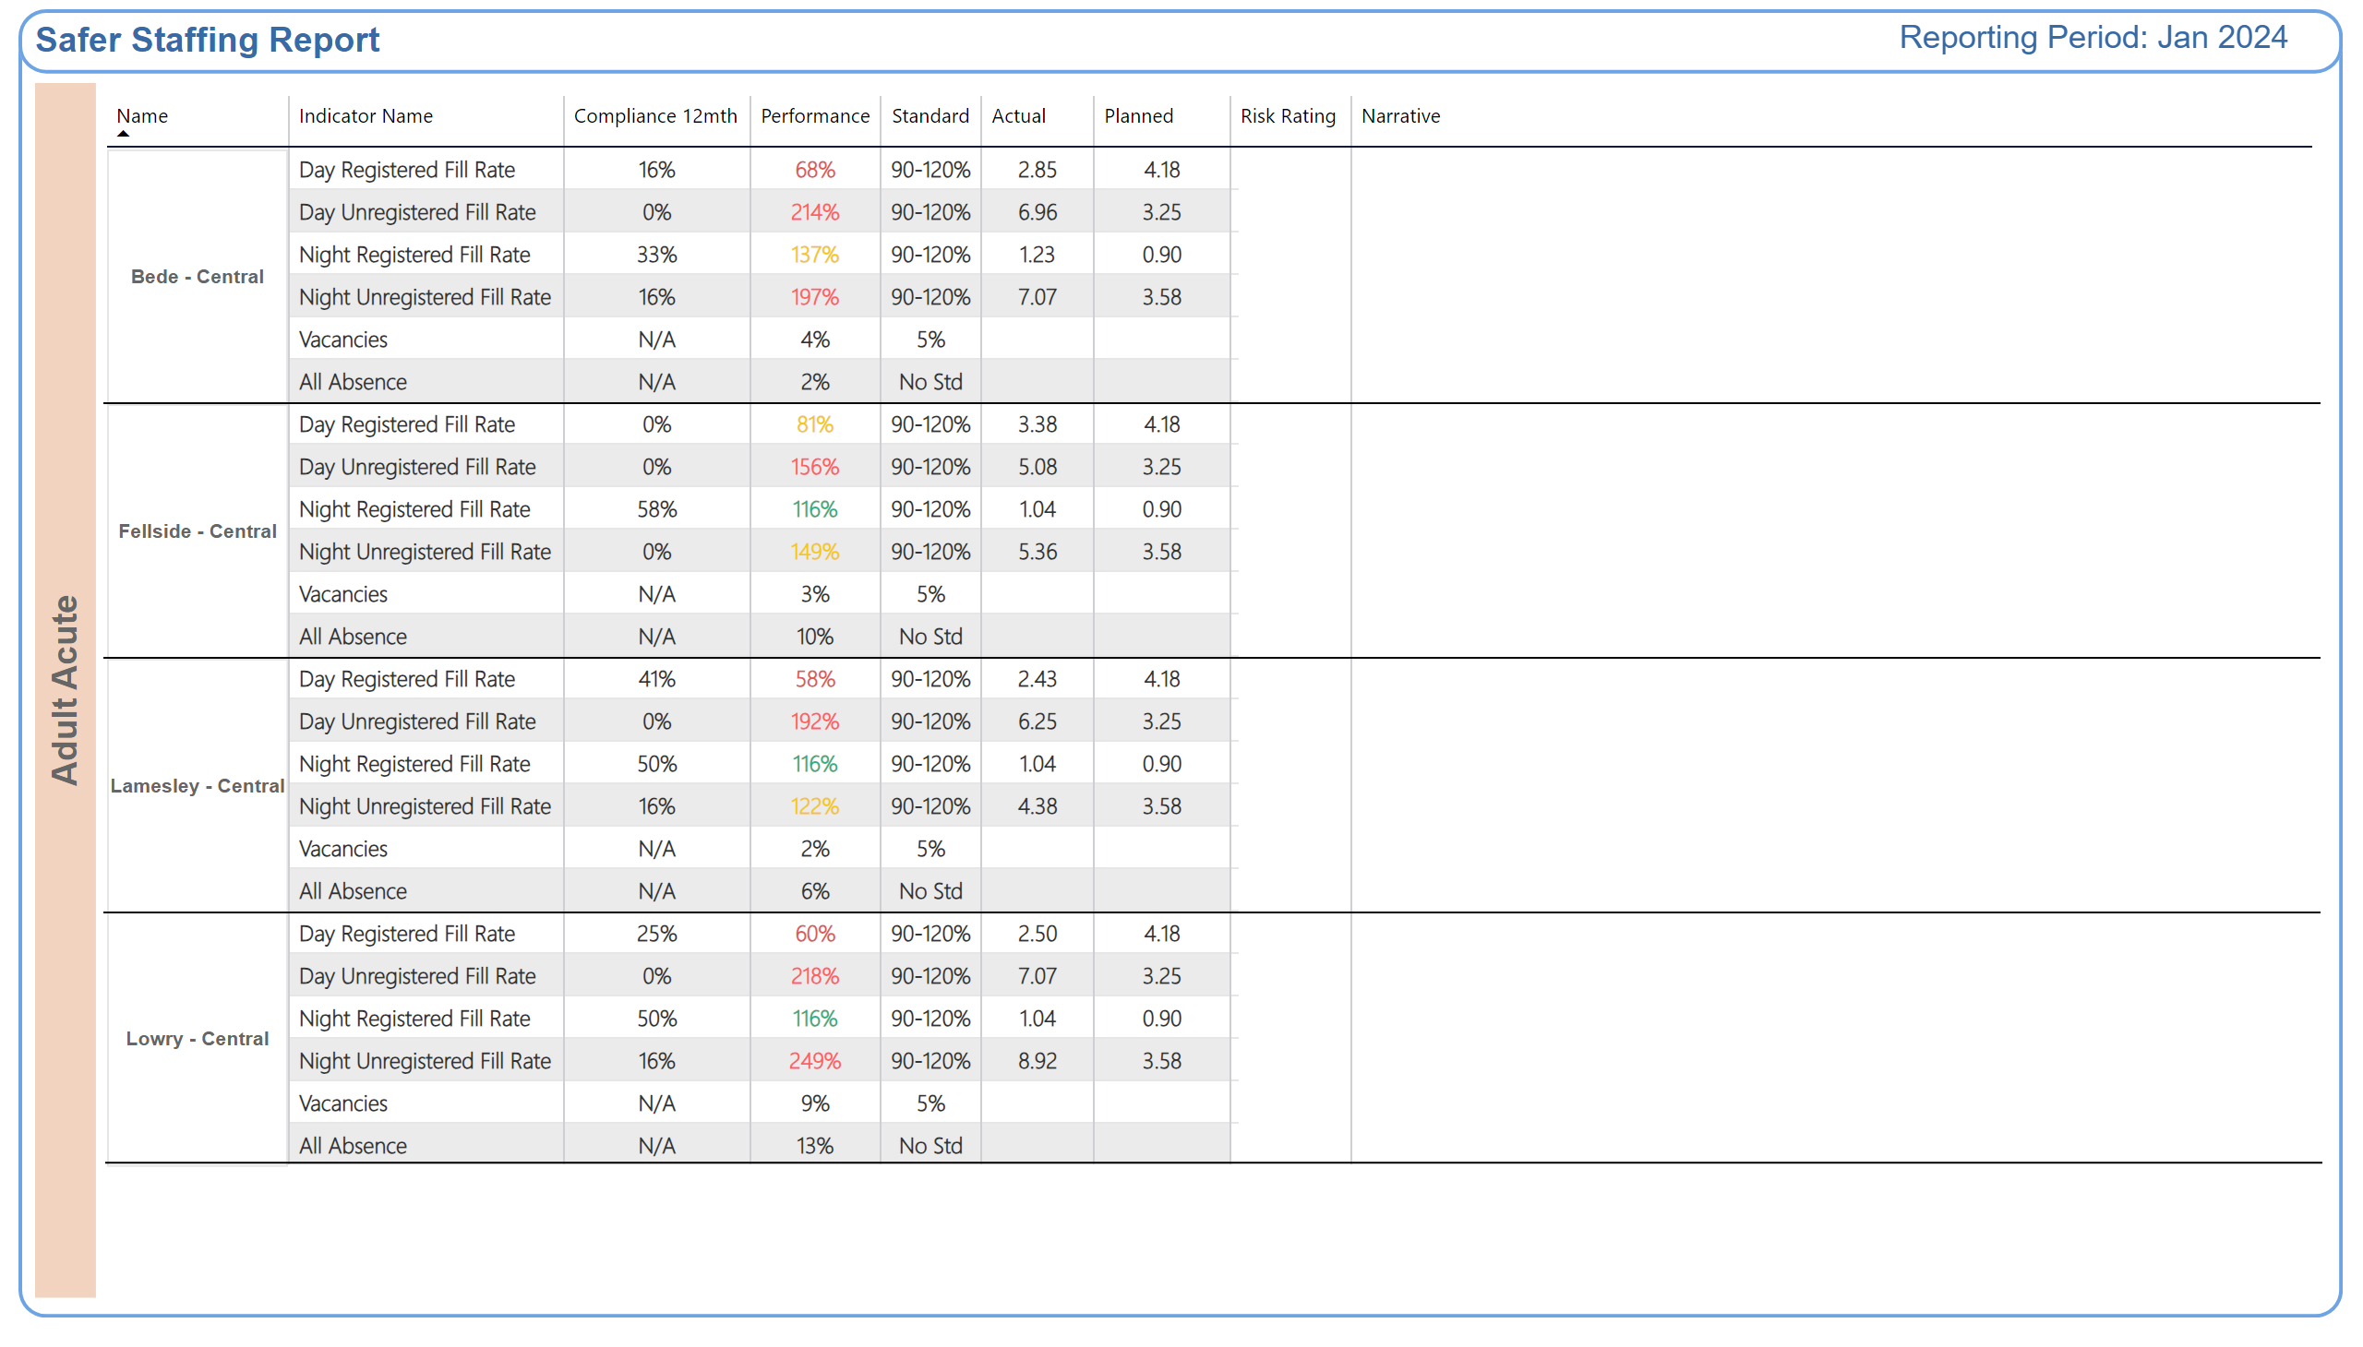
Adult Acute 3
Why is the risk rating medium or high?
Improvement Actions
Why is the risk rating medium or high?
Improvement Actions
Why is the risk rating medium or high?
Improvement Actions
Why is the risk rating medium or high?
Improvement Actions
Notes:
shape
No alt text provided
textbox
No alt text provided
shape
No alt text provided
shape
No alt text provided
shape
No alt text provided
TBL - Commitment
No alt text provided
TBL - Commitment
No alt text provided
TXT - Reporting Period
No alt text provided
shape
No alt text provided
shape
No alt text provided
shape
No alt text provided
shape
No alt text provided
shape
No alt text provided
shape
No alt text provided
shape
No alt text provided

Slide 22
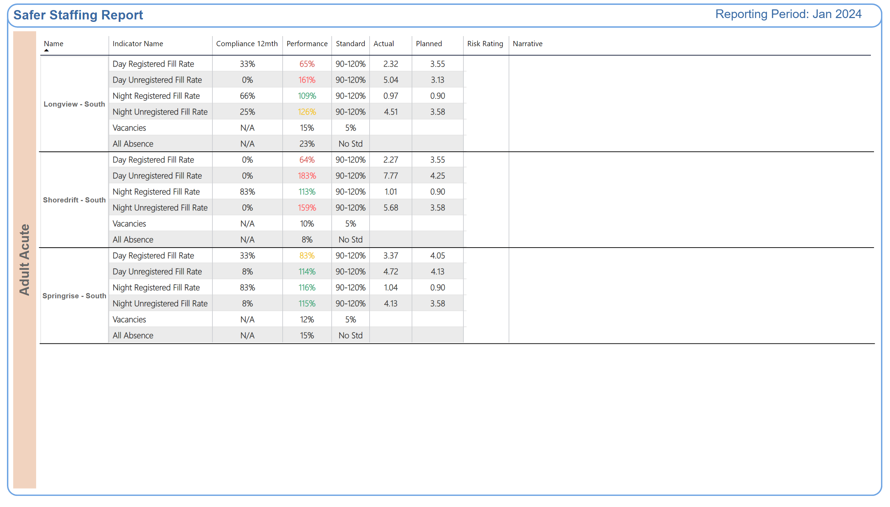
Adult Acute 4
Why is the risk rating medium or high?
Improvement Actions
Why is the risk rating medium or high?
Improvement Actions
Why is the risk rating medium or high?
Improvement Actions
Notes:
shape
No alt text provided
textbox
No alt text provided
shape
No alt text provided
shape
No alt text provided
shape
No alt text provided
TBL - Commitment
No alt text provided
TBL - Commitment
No alt text provided
TXT - Reporting Period
No alt text provided
shape
No alt text provided
shape
No alt text provided
shape
No alt text provided
shape
No alt text provided
shape
No alt text provided

Slide 23
PICU Summary
Issues impacting on safe staffing:
A high proportion of preceptees who are unable to take charge of the ward.
A high number of patients on the forensic pathway.
A high number of patients requiring an enhanced level of observation.
A high level of patient acuity and co-existing conditions; the related risk.
An increase in the number of patients who are Clinically Ready for Discharge (CRFD)
Staff pressures requiring the use of temporary staffing.
There is a high level of incidents involving violence and aggression.
Pressures relating to enabling staff training.
Band 5 preceptees are progressing to band 6 posts out-with the in-patient CBU on completion of preceptorship,
Implementation of evaluation of competence at 9 months in the preceptorship process.
Daily or twice daily staffing huddles are held to reassess safe staffing levels, with senior oversight.
There is a robust authorisation process in place for temporary staffing.
External recruitment to band 3 posts.
There is focused work in progress to promote staff wellbeing.
The nurse bank is being used whenever possible to address temporary staffing requirements, to keep agency usage at a minimum.
Notes:
textbox
No alt text provided
shape
No alt text provided
shape
No alt text provided
shape
No alt text provided
textbox
No alt text provided
textbox
No alt text provided
shape
No alt text provided
shape
No alt text provided
textbox
No alt text provided
shape
No alt text provided
shape
No alt text provided
textbox
No alt text provided
shape
No alt text provided
shape
No alt text provided
TextEnhancerByMAQ46ASG0293G65JY43S89DKJ9
No alt text provided
TextEnhancerByMAQ46ASG0293G65JY43S89DKJ9
No alt text provided
TextEnhancerByMAQ46ASG0293G65JY43S89DKJ9
No alt text provided
TextEnhancerByMAQ46ASG0293G65JY43S89DKJ9
No alt text provided
shape
No alt text provided

Slide 24
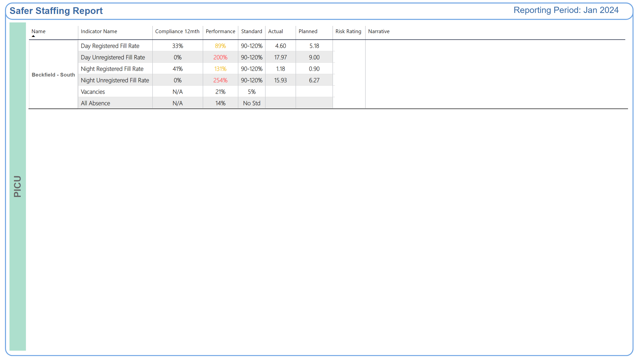
PICU
Why is the risk rating medium or high?
Improvement Actions
Notes:
shape
No alt text provided
textbox
No alt text provided
shape
No alt text provided
shape
No alt text provided
TBL - Commitment
No alt text provided
TBL - Commitment
No alt text provided
TXT - Reporting Period
No alt text provided
shape
No alt text provided
shape
No alt text provided

Slide 25
Adult Rehab Summary
Issues impacting on safe staffing:
A high proportion of preceptees and Internationally Educated Nurses who are unable to take charge of the ward.
A high level of maternity leave and pregnancy (North Locality).
There is a pressure on registered nurse cover overnight (North Locality).
An increased number of patients on the forensic pathway; patients with autism; patients with a learning disability.
An increase in the number of patients requiring an enhanced level of observation.
A high level of patient acuity, compounded by co-existing conditions and the need for Long-term Segregation.
An increase in the number of patients who are Clinically Ready for Discharge (CRFD).
Increased staffing requirements at mealtimes due to the dysphagia risk.
Stand-alone unit (Elm House): impact of high staff sickness level.
Staff members are redeployed according to need, which can reduce continuity of care and job satisfaction.
Pressures relating to enabling staff training, including priority Learning Disability and Autism training
There is a high level of incidents involving violence and aggression.
There is a lack of options for ongoing support for patients following discharge (accommodation; care and support).
Implementation of evaluation of competence at 9 months in the preceptorship process.
Daily or twice daily staffing huddles are held to reassess safe staffing levels.
Focused work is undertaken to promote staff wellbeing.
Working in an enhanced Multidisciplinary team model (South Locality).
Staff turnover is decreasing (Central Locality)
A preceptorship rotation is planned to help reduce the impact of redeployment (Central Locality).
Using the nurse bank to address temporary staffing needs, rather than agency.
There is focused work in progress to promote staff wellbeing.
Notes:
textbox
No alt text provided
shape
No alt text provided
shape
No alt text provided
shape
No alt text provided
textbox
No alt text provided
textbox
No alt text provided
shape
No alt text provided
shape
No alt text provided
textbox
No alt text provided
shape
No alt text provided
shape
No alt text provided
textbox
No alt text provided
shape
No alt text provided
shape
No alt text provided
TextEnhancerByMAQ46ASG0293G65JY43S89DKJ9
No alt text provided
TextEnhancerByMAQ46ASG0293G65JY43S89DKJ9
No alt text provided
TextEnhancerByMAQ46ASG0293G65JY43S89DKJ9
No alt text provided
TextEnhancerByMAQ46ASG0293G65JY43S89DKJ9
No alt text provided
shape
No alt text provided

Slide 26
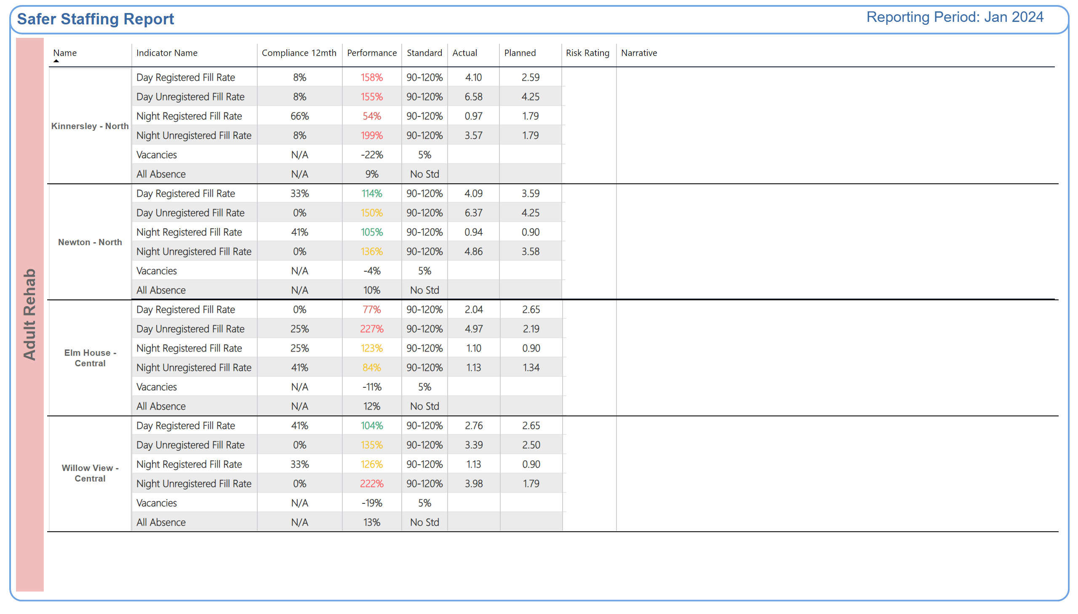
Adult Rehab
Why is the risk rating medium or high?
Improvement Actions
Why is the risk rating medium or high?
Improvement Actions
Why is the risk rating medium or high?
Improvement Actions
Why is the risk rating medium or high?
Improvement Actions
Notes:
shape
No alt text provided
textbox
No alt text provided
shape
No alt text provided
shape
No alt text provided
TXT - Reporting Period
No alt text provided
TBL - Commitment
No alt text provided
TBL - Commitment
No alt text provided
TBL - Commitment
No alt text provided
TBL - Commitment
No alt text provided
shape
No alt text provided
shape
No alt text provided
shape
No alt text provided
shape
No alt text provided
shape
No alt text provided
shape
No alt text provided
shape
No alt text provided
shape
No alt text provided

Slide 27
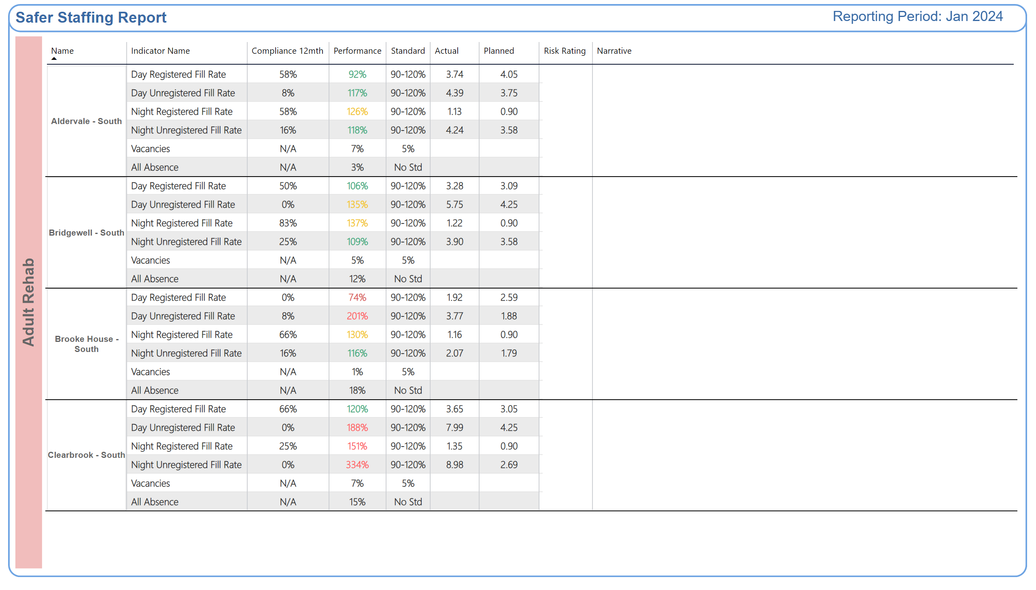
Adult Rehab 2
Why is the risk rating medium or high?
Improvement Actions
Why is the risk rating medium or high?
Improvement Actions
Why is the risk rating medium or high?
Improvement Actions
Why is the risk rating medium or high?
Improvement Actions
Notes:
shape
No alt text provided
textbox
No alt text provided
shape
No alt text provided
shape
No alt text provided
TXT - Reporting Period
No alt text provided
TBL - Commitment
No alt text provided
TBL - Commitment
No alt text provided
shape
No alt text provided
shape
No alt text provided
shape
No alt text provided
shape
No alt text provided
shape
No alt text provided
shape
No alt text provided
shape
No alt text provided
shape
No alt text provided

Slide 28
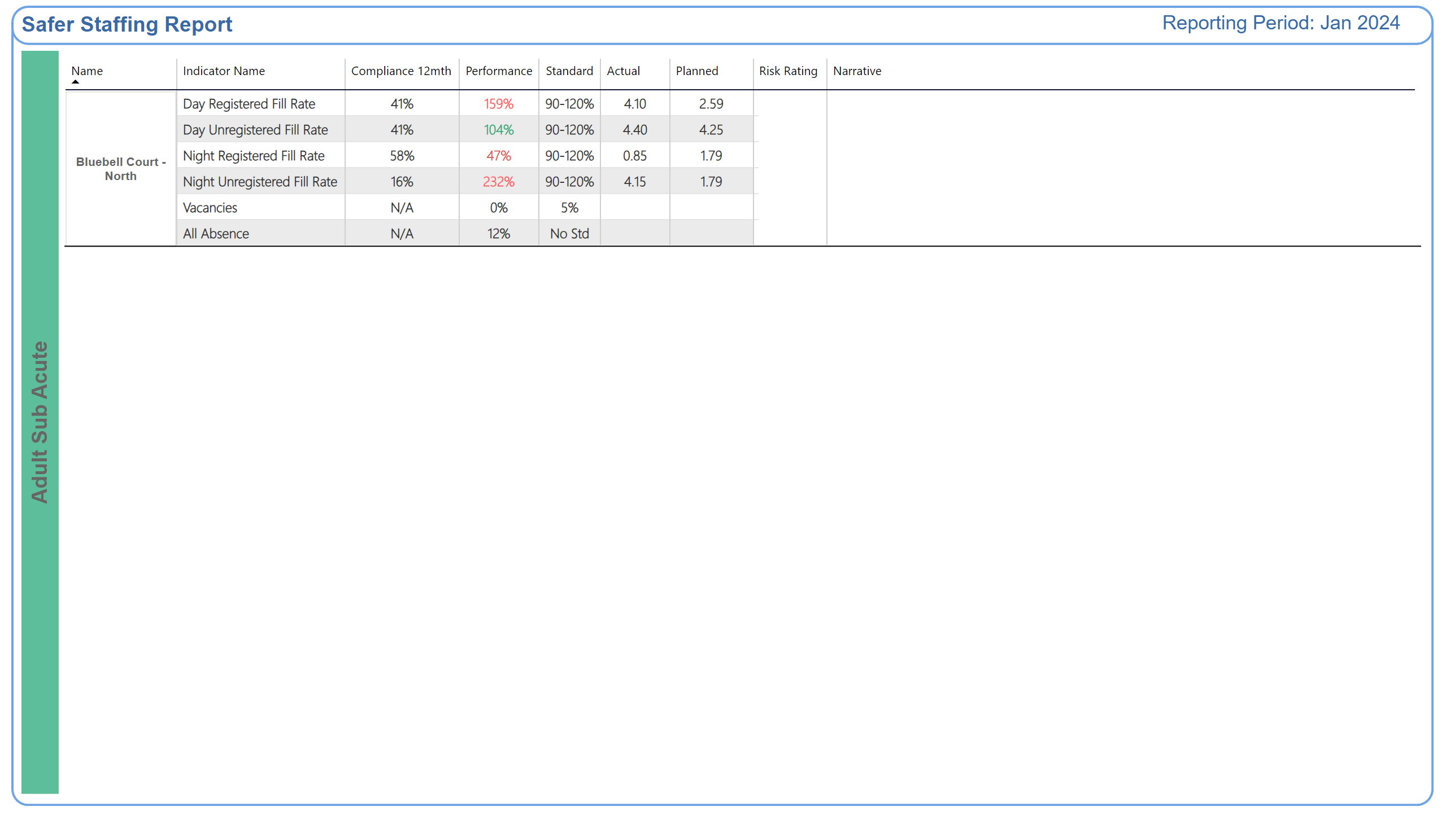
Adult Sub Acute
Why is the risk rating medium or high?
Improvement Actions
Notes:
shape
No alt text provided
textbox
No alt text provided
shape
No alt text provided
shape
No alt text provided
TXT - Reporting Period
No alt text provided
TBL - Commitment
No alt text provided
TBL - Commitment
No alt text provided
shape
No alt text provided
shape
No alt text provided

Slide 29
Older Persons Summary
Issues impacting on safe staffing:
A high proportion of preceptees and Internationally Educated Nurses who are unable to take charge of the ward; Ward Managers are included in the staffing numbers/ working long days when needed, which reduces the overall ward management capacity; specialist nurse is working into the staffing numbers (North).
A high level of patient acuity,
A high number of patients requiring complex physical care, including nasogastric nutrition and the administration of subcutaneous fluids.
Increased staffing requirements at mealtimes due to the dysphagia risk.
Staff members are redeployed according to need, which can reduce continuity of care and job satisfaction.
Pressures relating to enabling staff training.
There is a high level of incidents involving violence and aggression.
Daily level-loading of experienced registered nurses is undertaken.
Implementation of evaluation of competence at 9 months in the preceptorship process.
Daily or twice daily staffing huddles are held to reassess safe staffing levels.
Staff wellbeing meetings are held and relevant actions implemented.
There is a robust authorisation process in place for temporary staffing.
External recruitment to band 3 posts.
Leadership team readily accessible to provide responsive support where required as the second qualified nurse. The management team provides Mental Health Nurse cover to support preceptees and Adult Nurses nurses when required (Carleton Clinic).
Staff turnover is decreasing (Central Locality)
A preceptorship rotation is planned to help reduce the impact of redeployment (Central).
Notes:
textbox
No alt text provided
shape
No alt text provided
shape
No alt text provided
shape
No alt text provided
textbox
No alt text provided
textbox
No alt text provided
shape
No alt text provided
shape
No alt text provided
textbox
No alt text provided
shape
No alt text provided
shape
No alt text provided
textbox
No alt text provided
shape
No alt text provided
shape
No alt text provided
TextEnhancerByMAQ46ASG0293G65JY43S89DKJ9
No alt text provided
TextEnhancerByMAQ46ASG0293G65JY43S89DKJ9
No alt text provided
TextEnhancerByMAQ46ASG0293G65JY43S89DKJ9
No alt text provided
TextEnhancerByMAQ46ASG0293G65JY43S89DKJ9
No alt text provided
shape
No alt text provided
shape
No alt text provided

Slide 30
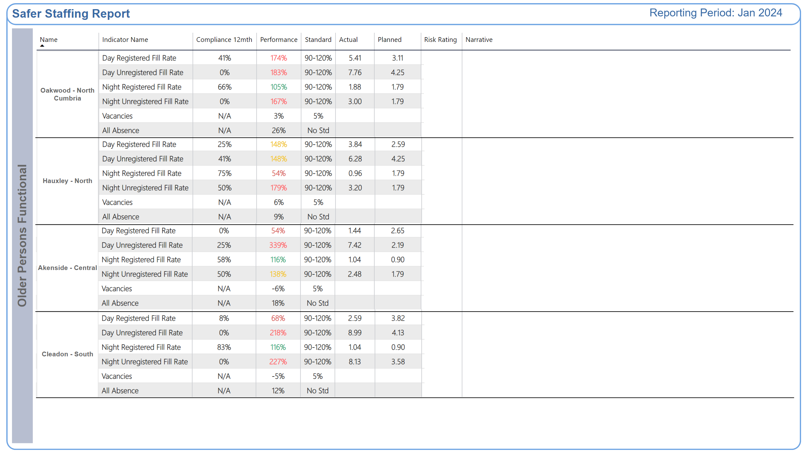
Older Persons Functional
Why is the risk rating medium or high?
Improvement Actions
Why is the risk rating medium or high?
Improvement Actions
Why is the risk rating medium or high?
Improvement Actions
Why is the risk rating medium or high?
Improvement Actions
Notes:
shape
No alt text provided
textbox
No alt text provided
shape
No alt text provided
shape
No alt text provided
TBL - Commitment
No alt text provided
TBL - Commitment
No alt text provided
TBL - Commitment
No alt text provided
TBL - Commitment
No alt text provided
TXT - Reporting Period
No alt text provided
TBL - Commitment
No alt text provided
TBL - Commitment
No alt text provided
TBL - Commitment
No alt text provided
TBL - Commitment
No alt text provided
shape
No alt text provided
shape
No alt text provided
shape
No alt text provided
shape
No alt text provided
shape
No alt text provided
shape
No alt text provided
shape
No alt text provided
shape
No alt text provided

Slide 31
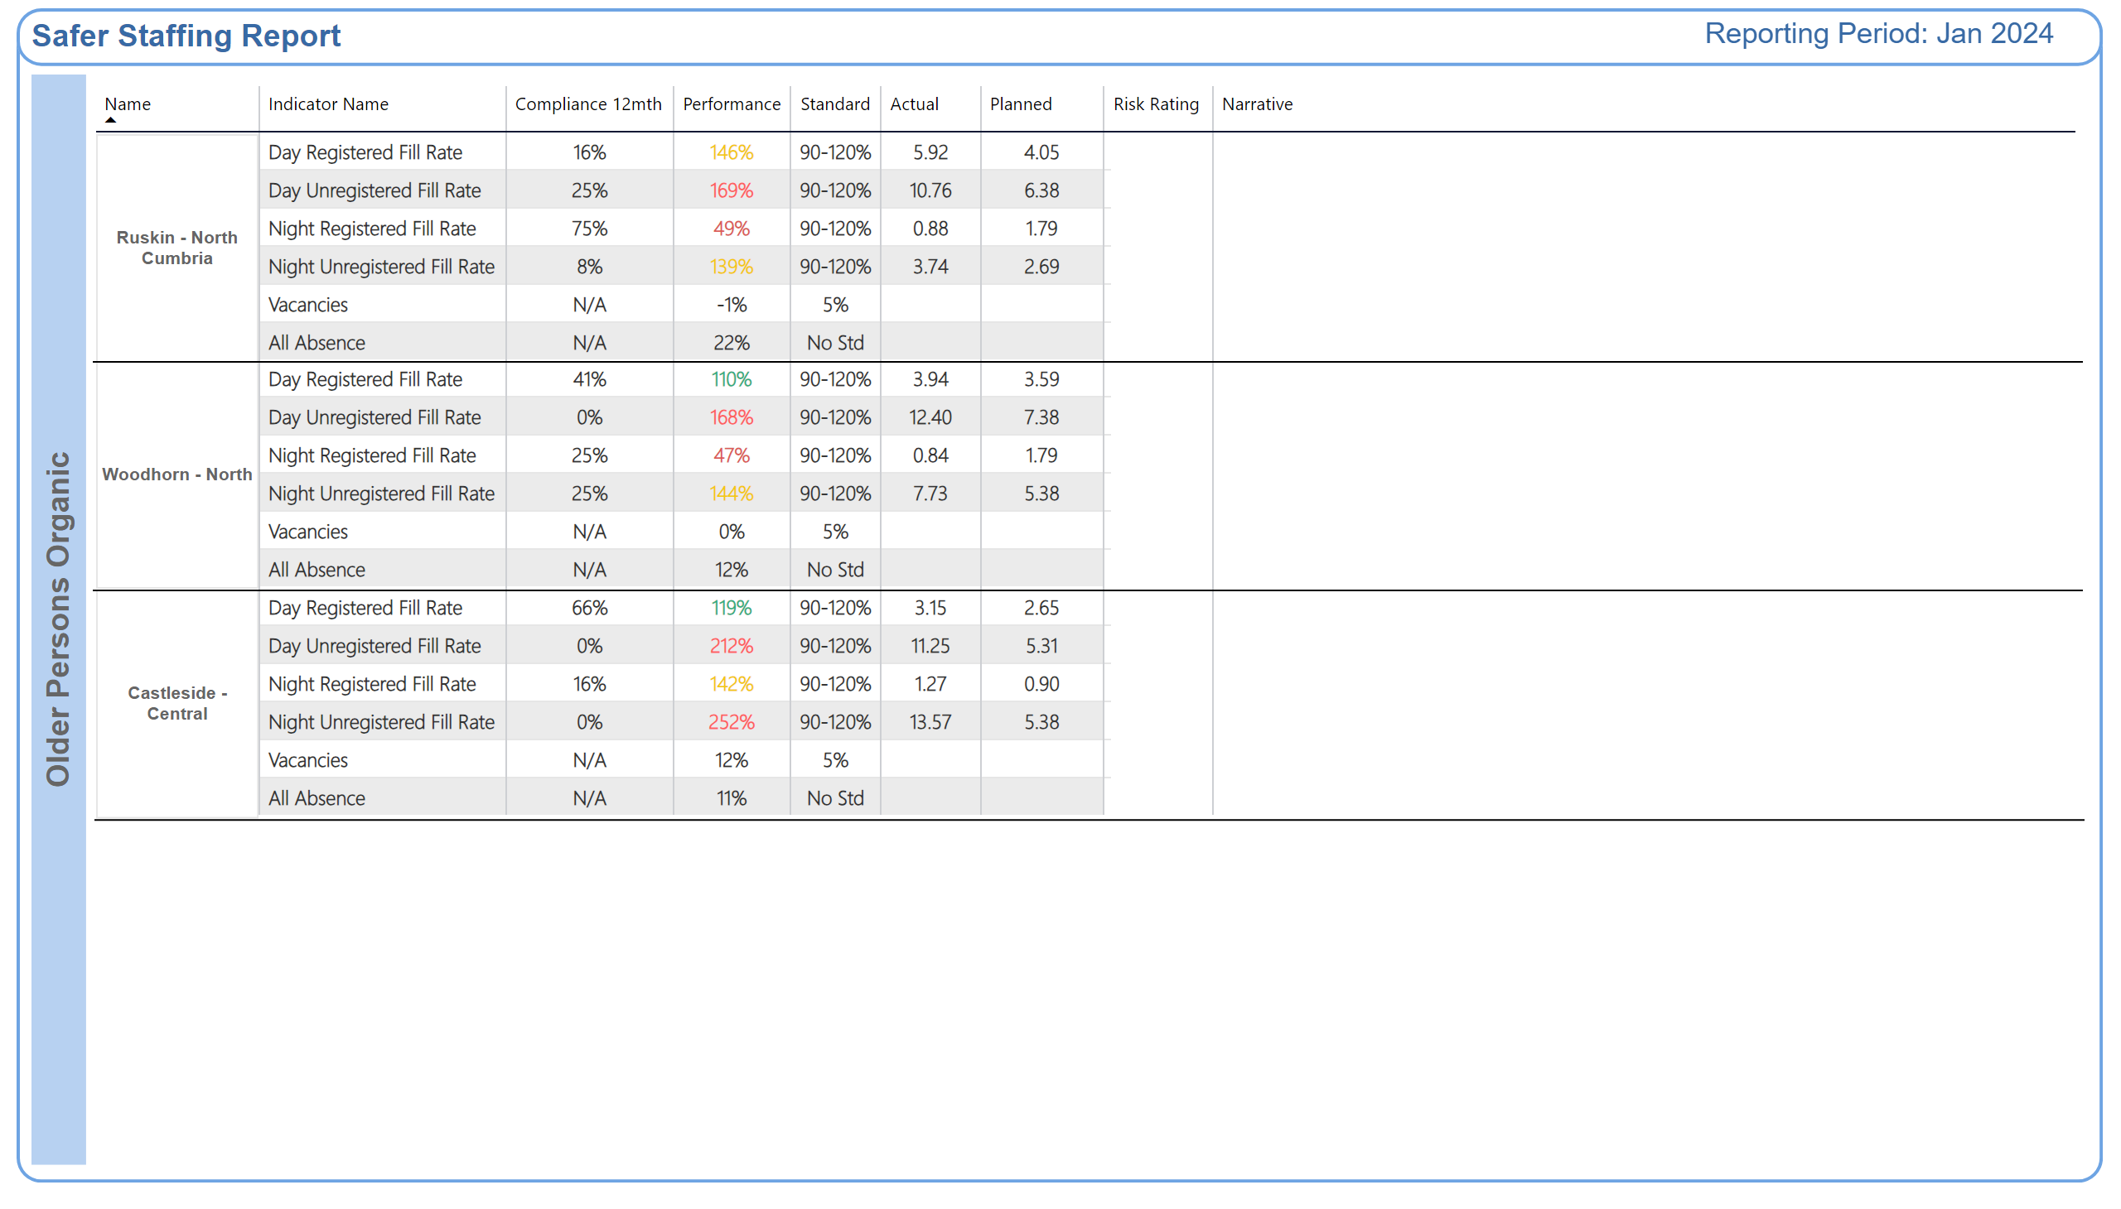
Older Persons Organic
Why is the risk rating medium or high?
Improvement Actions
Why is the risk rating medium or high?
Improvement Actions
Why is the risk rating medium or high?
Improvement Actions
Notes:
shape
No alt text provided
textbox
No alt text provided
shape
No alt text provided
shape
No alt text provided
TXT - Reporting Period
No alt text provided
TBL - Commitment
No alt text provided
TBL - Commitment
No alt text provided
TBL - Commitment
No alt text provided
TBL - Commitment
No alt text provided
TBL - Commitment
No alt text provided
TBL - Commitment
No alt text provided
shape
No alt text provided
shape
No alt text provided
shape
No alt text provided
shape
No alt text provided
shape
No alt text provided
shape
No alt text provided

Slide 32
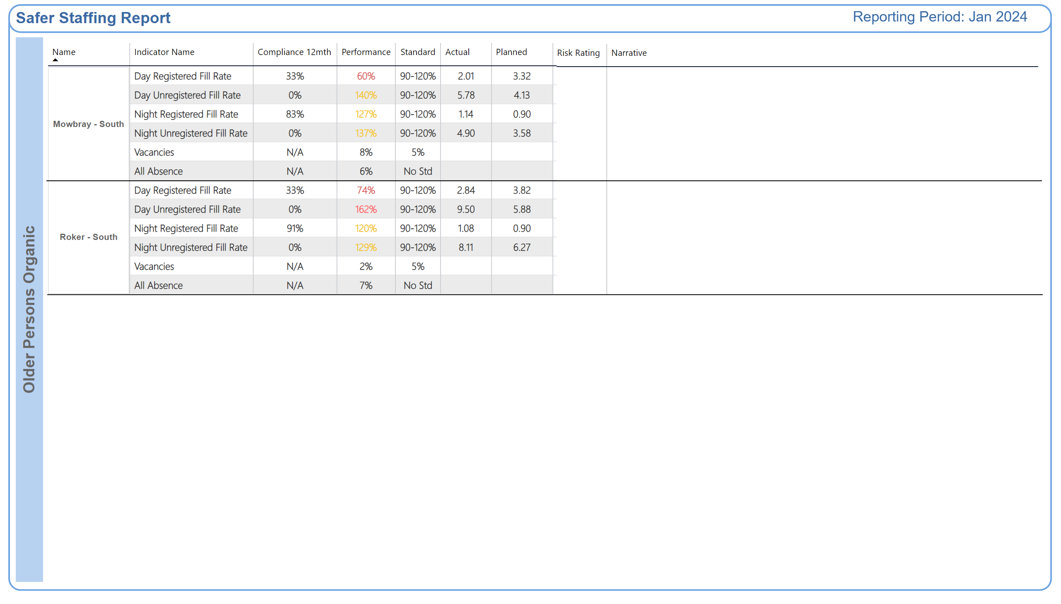
Older Persons Organic 2
Why is the risk rating medium or high?
Improvement Actions
Why is the risk rating medium or high?
Improvement Actions
Notes:
shape
No alt text provided
textbox
No alt text provided
shape
No alt text provided
shape
No alt text provided
TXT - Reporting Period
No alt text provided
TBL - Commitment
No alt text provided
TBL - Commitment
No alt text provided
shape
No alt text provided
shape
No alt text provided
shape
No alt text provided
shape
No alt text provided

Slide 33
CYPS Summary
Issues impacting on safe staffing:
An increase in the number of patients requiring an enhanced level of observation.
Impact on flow of discharges due to needs of patients requiring longer stays.
Patients with high acuity and complexity of need requiring enhanced staffing levels.
A high level of patient need relating to Seclusion.
An increase in the number of patients who are Clinically Ready for Discharge (CRFD).
Patients over 18 years old on CYPS wards requiring additional staffing to ensure safeguarding.
Patients being nursed in acute hospital settings requiring high levels of support from staff.
The impact on staffing levels of sick leave, maternity leave and staff members on non-clinical duties.
The impact of the CEDAR project: Ferndene is currently a ‘live’ building site, which impacts on service delivery.
Redburn ward is working at reduced bed capacity, with increased clinical need due to patients on the Eating Disorder pathway.
Lotus ward continues to provide challenges relating to being a stand-alone unit.
Pressures relating to enabling staff training.
Daily or twice daily staffing huddles are held to reassess safe staffing levels.
Focused CYPS recruitment is in progress.
Planning discharges early in the patient’s satay.
Development of band 5 and 6 nurses is being prioritised.
There has been a reduction in incidents (Stephenson ward).
Temporary staffing use is focused on the Locality, reducing worker travel from Newcastle and Sunderland.
There has been a reduction in agency usage.
Staff members redeployed from Stephenson ward are returning in April 2024.
Notes:
textbox
No alt text provided
shape
No alt text provided
shape
No alt text provided
shape
No alt text provided
textbox
No alt text provided
textbox
No alt text provided
shape
No alt text provided
shape
No alt text provided
textbox
No alt text provided
shape
No alt text provided
shape
No alt text provided
textbox
No alt text provided
shape
No alt text provided
shape
No alt text provided
TextEnhancerByMAQ46ASG0293G65JY43S89DKJ9
No alt text provided
TextEnhancerByMAQ46ASG0293G65JY43S89DKJ9
No alt text provided
TextEnhancerByMAQ46ASG0293G65JY43S89DKJ9
No alt text provided
TextEnhancerByMAQ46ASG0293G65JY43S89DKJ9
No alt text provided
shape
No alt text provided

Slide 34
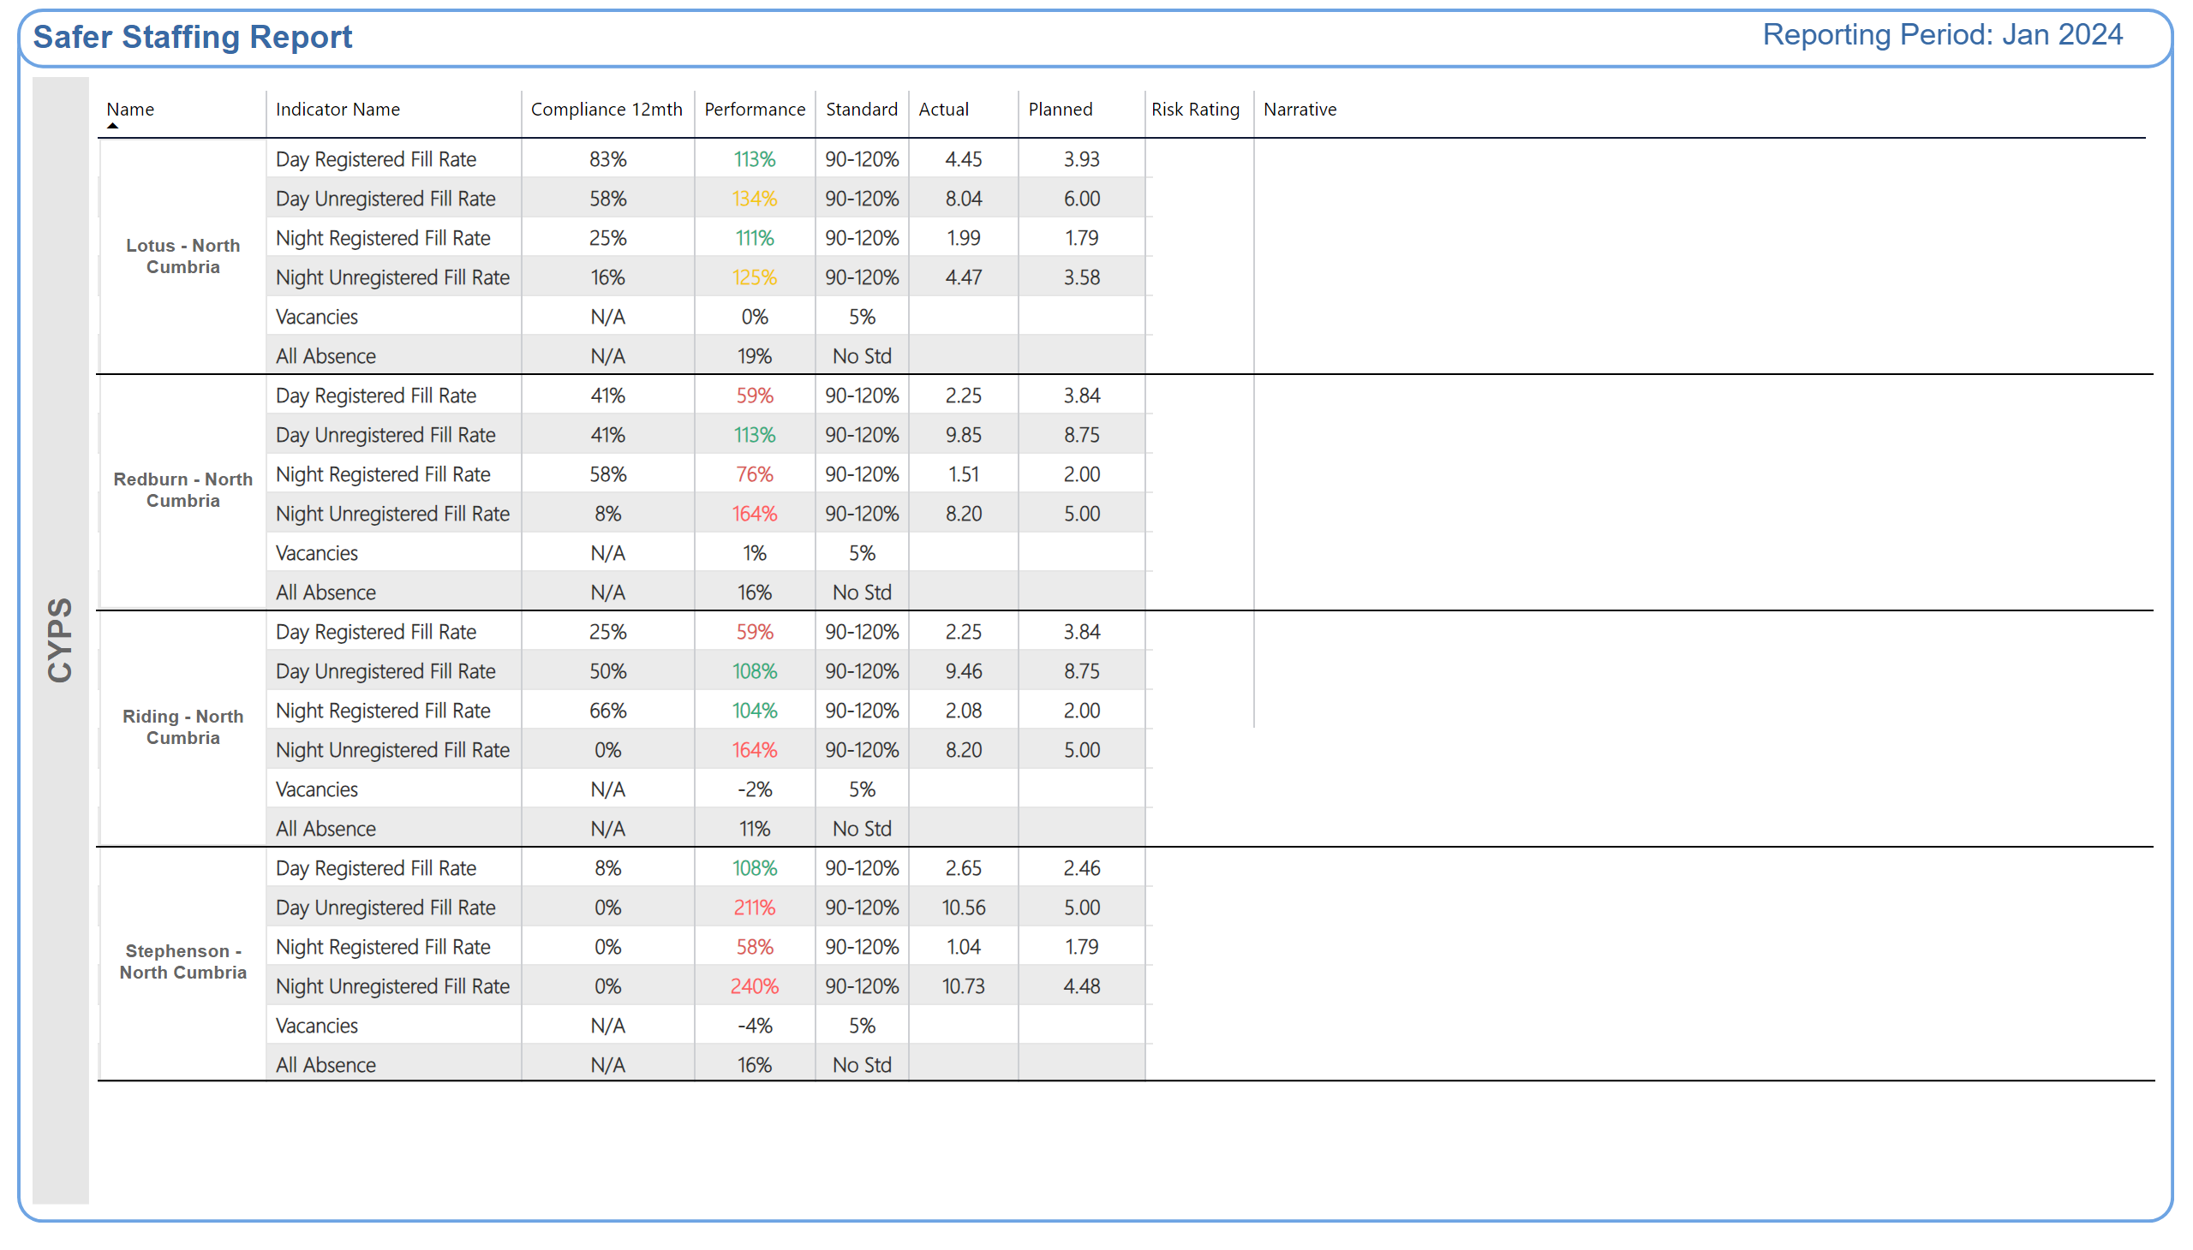
CYPS
Why is the risk rating medium or high?
Improvement Actions
Why is the risk rating medium or high?
Improvement Actions
Why is the risk rating medium or high?
Improvement Actions
Why is the risk rating medium or high?
Improvement Actions
Notes:
shape
No alt text provided
textbox
No alt text provided
shape
No alt text provided
shape
No alt text provided
TBL - Commitment
No alt text provided
TBL - Commitment
No alt text provided
TXT - Reporting Period
No alt text provided
shape
No alt text provided
shape
No alt text provided
shape
No alt text provided
shape
No alt text provided
shape
No alt text provided
shape
No alt text provided
shape
No alt text provided
shape
No alt text provided

Slide 35
Secure Services Summary
There is a High level of clinical acuity, including:
Two patients in Long Term Segregation.
The impact of Seclusions
Individualised Care Package with 6:1 nursing
Retention is affected by the theme of travel to Northgate Park
The impact of the vacancy rate and sickness absence
7/10 wards with sickness absence over 5%
Vacancies
Retention
Agency use rose to 22 WTE above Secure Target of 20 WTE
Daily staffing huddles held led by Clinical Managers, attended to identify and forecast any shortfalls
Shortfalls are covered via changes in staffing rota, redeploying resource from other Secure wards, deployment of pool nurses, ward managers and clinical managers working into staffing numbers, staff working extra hours (accruing time-owing or being paid overtime), the use of bank staff and, as a final resort, the use of agency staff
Night coordinators are ward-based.
Out of hours via On Call Point of Contact to manage any staffing deficits occurring at short notice
Vacancy Control Process
Level - loading of annual leave
Exit interviews undertaken with leavers
Exit interviews are undertaken to inform retention; offered by AND to leavers (commenced December 2023)
Comprehensive staff inductions.
Continued monitoring of agency use.
Notes:
textbox
No alt text provided
shape
No alt text provided
shape
No alt text provided
shape
No alt text provided
textbox
No alt text provided
textbox
No alt text provided
shape
No alt text provided
shape
No alt text provided
textbox
No alt text provided
shape
No alt text provided
shape
No alt text provided
textbox
No alt text provided
shape
No alt text provided
shape
No alt text provided
TextEnhancerByMAQ46ASG0293G65JY43S89DKJ9
No alt text provided
TextEnhancerByMAQ46ASG0293G65JY43S89DKJ9
No alt text provided
TextEnhancerByMAQ46ASG0293G65JY43S89DKJ9
No alt text provided
TextEnhancerByMAQ46ASG0293G65JY43S89DKJ9
No alt text provided
shape
No alt text provided

Slide 36
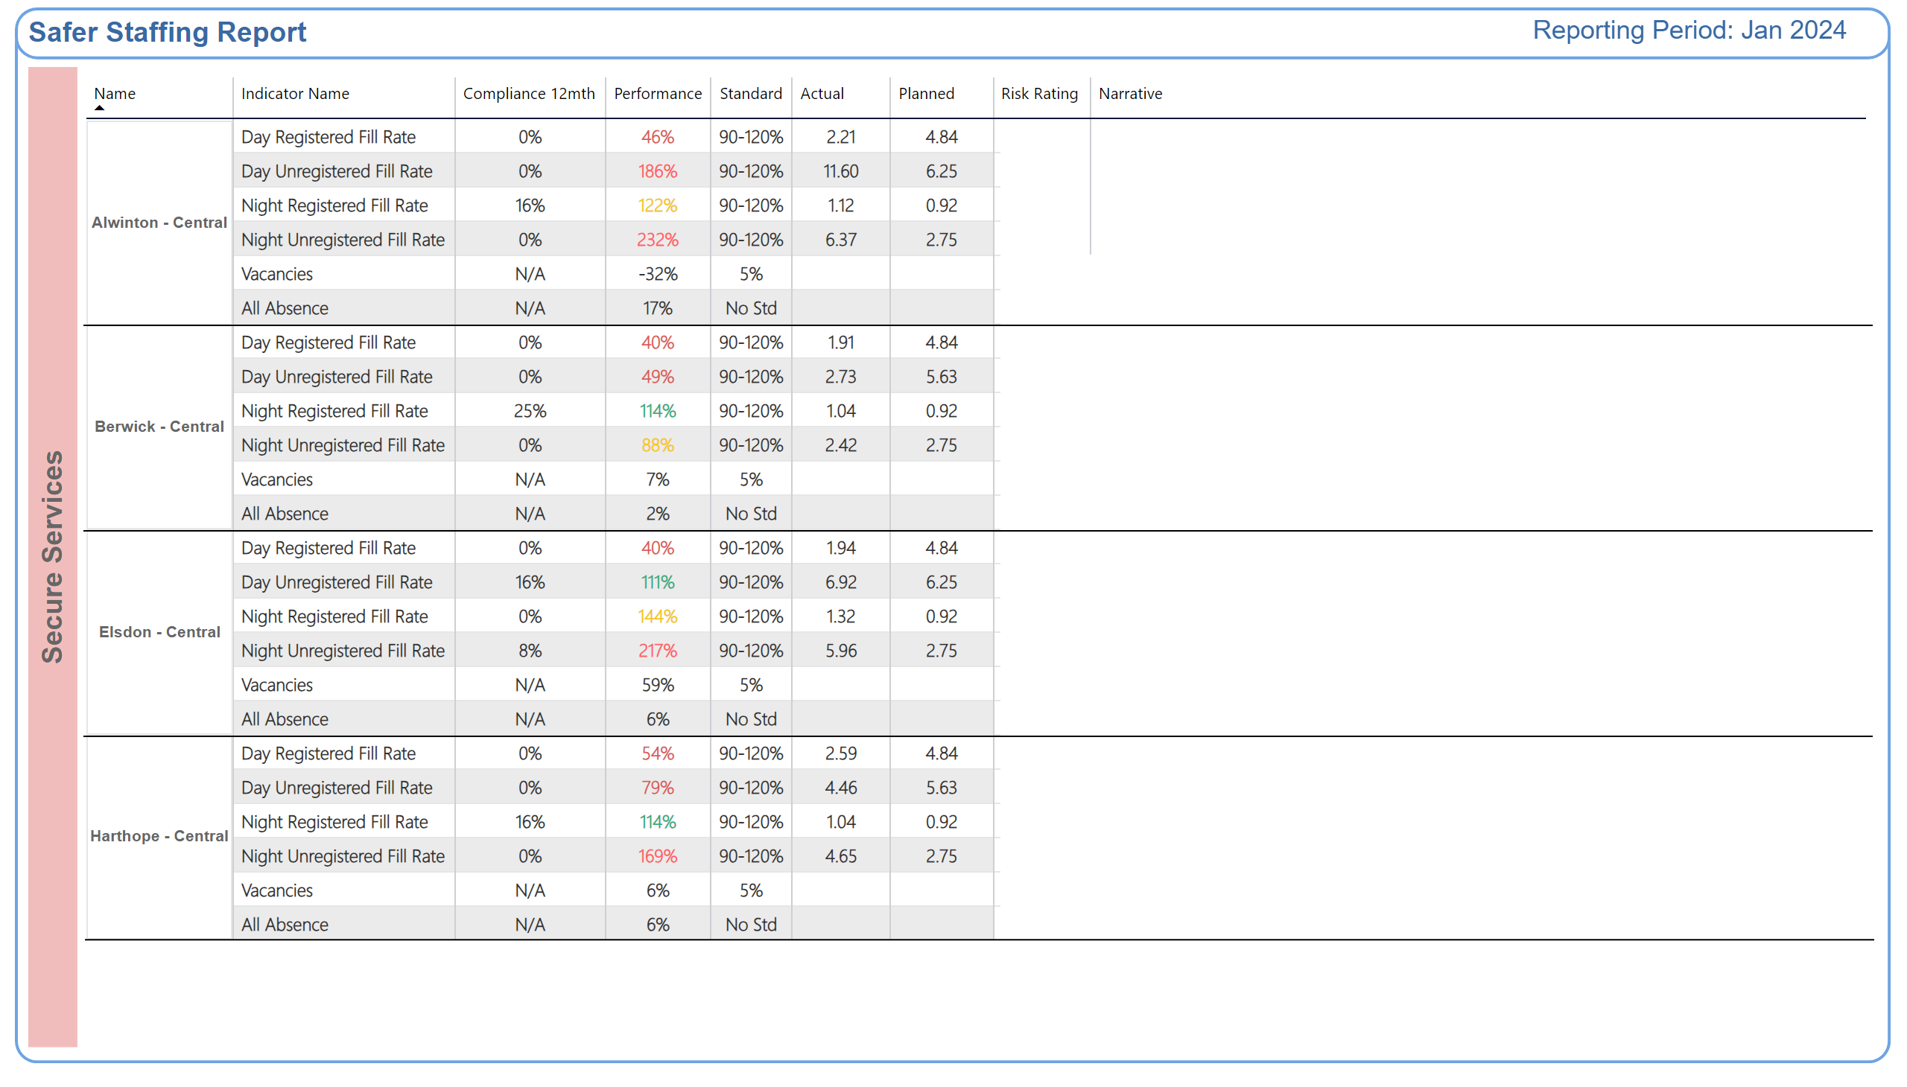
Secure
Why is the risk rating medium or high?
Improvement Actions
Why is the risk rating medium or high?
Improvement Actions
Why is the risk rating medium or high?
Improvement Actions
Why is the risk rating medium or high?
Improvement Actions
Notes:
shape
No alt text provided
textbox
No alt text provided
shape
No alt text provided
shape
No alt text provided
TXT - Reporting Period
No alt text provided
TBL - Commitment
No alt text provided
TBL - Commitment
No alt text provided
shape
No alt text provided
shape
No alt text provided
shape
No alt text provided
shape
No alt text provided
shape
No alt text provided
shape
No alt text provided
shape
No alt text provided
shape
No alt text provided

Slide 37
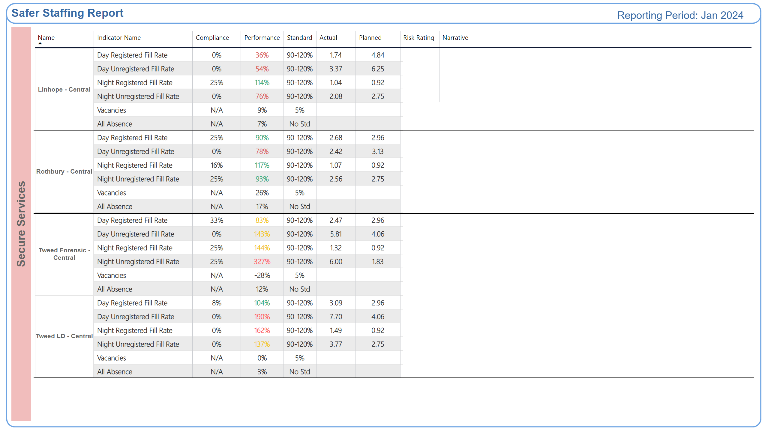
Secure 2
Why is the risk rating medium or high?
Improvement Actions
Why is the risk rating medium or high?
Improvement Actions
Why is the risk rating medium or high?
Improvement Actions
Why is the risk rating medium or high?
Improvement Actions
Notes:
shape
No alt text provided
TXT - Reporting Period
No alt text provided
textbox
No alt text provided
shape
No alt text provided
shape
No alt text provided
TBL - Commitment
No alt text provided
TBL - Commitment
No alt text provided
shape
No alt text provided
shape
No alt text provided
shape
No alt text provided
shape
No alt text provided
shape
No alt text provided
shape
No alt text provided
shape
No alt text provided
shape
No alt text provided

Slide 38
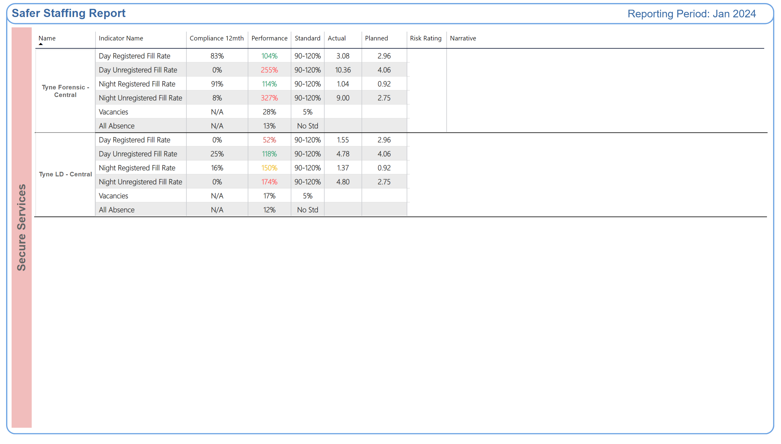
Secure 3
Why is the risk rating medium or high?
Improvement Actions
Why is the risk rating medium or high?
Improvement Actions
Notes:
shape
No alt text provided
TXT - Reporting Period
No alt text provided
textbox
No alt text provided
shape
No alt text provided
shape
No alt text provided
TBL - Commitment
No alt text provided
TBL - Commitment
No alt text provided
shape
No alt text provided
shape
No alt text provided
shape
No alt text provided
shape
No alt text provided

Slide 39
LD Autism Summary
Issues impacting on safe staffing:
A high proportion of preceptees and Internationally Educated Nurses who are unable to take charge of the ward.
An increase in the number of patients requiring an enhanced level of observation.
An increase in the number of patients who are Clinically Ready for Discharge (CRFD).
Recruitment and retention difficulties (Mitford Unit).
Pressures relating to enabling staff training, including priority Learning Disability and Autism training
There is a high level of incidents involving violence and aggression; focused work is in progress with respect to Mitford.
There is a lack of options for ongoing support for patients following discharge (accommodation; care and support).
Daily level-loading of experienced registered nurses is undertaken.
Daily or twice daily staffing huddles are held to reassess safe staffing levels.
Implementation of evaluation of competence at 9 months in the preceptorship process.
Staff wellbeing meetings are held and relevant actions implemented.
There is a robust authorisation process in place for temporary staffing.
Using the nurse bank to address temporary staffing needs, rather than agency.
There is focused work in progress to promote staff wellbeing.
Notes:
textbox
No alt text provided
shape
No alt text provided
shape
No alt text provided
shape
No alt text provided
textbox
No alt text provided
textbox
No alt text provided
shape
No alt text provided
shape
No alt text provided
textbox
No alt text provided
shape
No alt text provided
shape
No alt text provided
textbox
No alt text provided
shape
No alt text provided
shape
No alt text provided
TextEnhancerByMAQ46ASG0293G65JY43S89DKJ9
No alt text provided
TextEnhancerByMAQ46ASG0293G65JY43S89DKJ9
No alt text provided
TextEnhancerByMAQ46ASG0293G65JY43S89DKJ9
No alt text provided
TextEnhancerByMAQ46ASG0293G65JY43S89DKJ9
No alt text provided
shape
No alt text provided

Slide 40
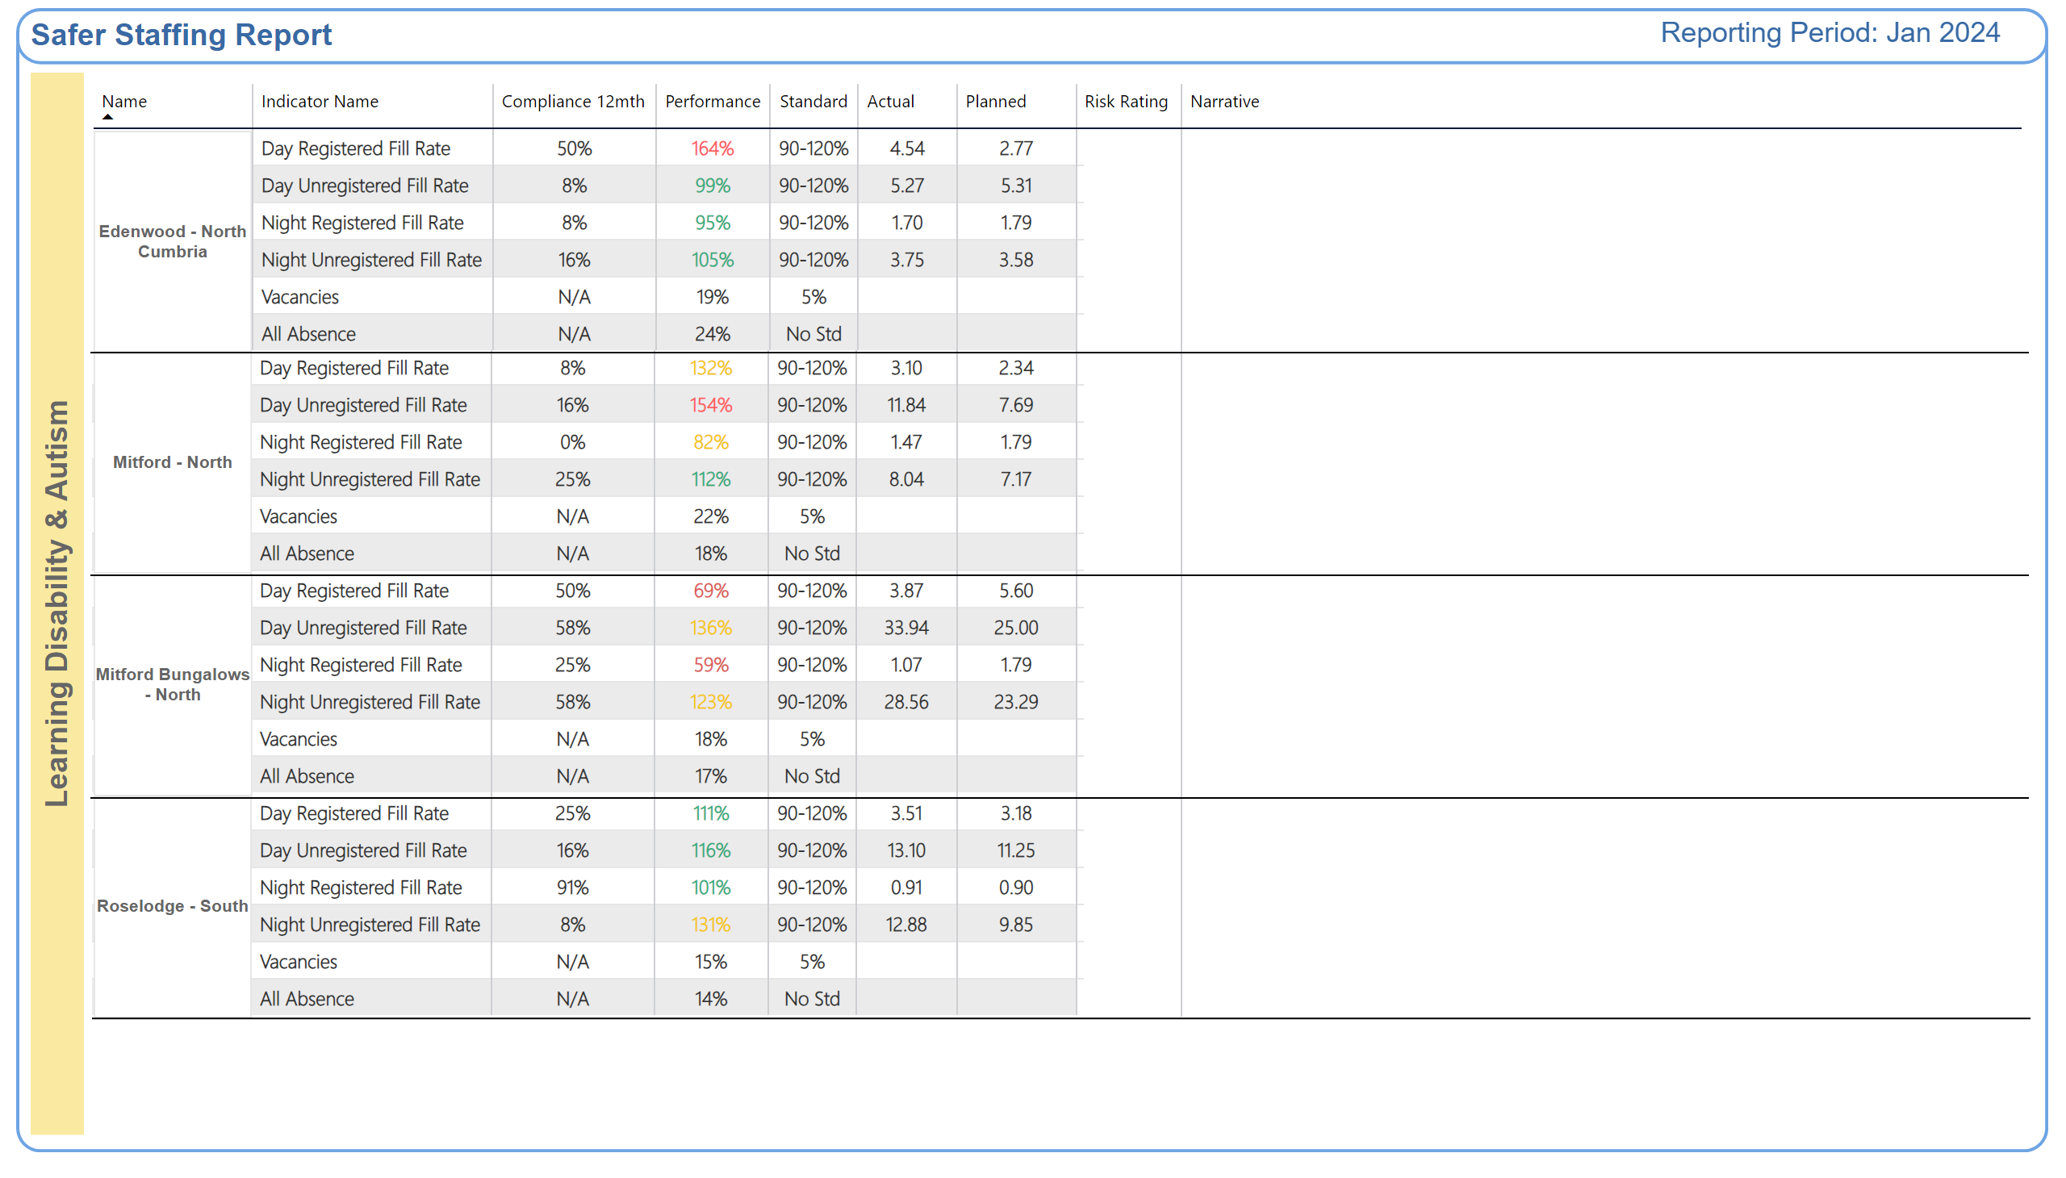
LD Autism
Why is the risk rating medium or high?
Improvement Actions
Why is the risk rating medium or high?
Improvement Actions
Why is the risk rating medium or high?
Improvement Actions
Why is the risk rating medium or high?
Improvement Actions
Notes:
shape
No alt text provided
textbox
No alt text provided
shape
No alt text provided
shape
No alt text provided
TXT - Reporting Period
No alt text provided
TBL - Commitment
No alt text provided
TBL - Commitment
No alt text provided
TBL - Commitment
No alt text provided
TBL - Commitment
No alt text provided
TBL - Commitment
No alt text provided
TBL - Commitment
No alt text provided
shape
No alt text provided
shape
No alt text provided
shape
No alt text provided
shape
No alt text provided
shape
No alt text provided
shape
No alt text provided
shape
No alt text provided
shape
No alt text provided

Slide 41
Neuro Specialist Summary
High levels of sickness, out with trust target of 5%
Gibside = 9.87%
31a = 14.39%
Ward 1 = 8.46%
Ward 2 = 14.41%
Ward 3 = 11.98%
Ward 4 = 7.58%
Increased acuity on several wards across the CBU
High numbers of preceptees, who unable to take charge of ward
Sudden change in clinical activity resulting in having to recall Mother and Baby Unit (MBU) staff, impacting other services where temporarily support had been agreed.
Work is ongoing to reduce sickness levels and support people back to work with reasonable adjustments where required
Matching staff skills to other areas they can support for periods of reduced clinical activity on Beadnell to help support staff morale.
Some clinical cases requiring senior oversight to support discharge planning due to system challenges
CBU staffing huddle is held twice per week to review clinical activity/sickness and level-load resources where possible.
Appropriate escalation to Clinical Manager/Point of Contact (POC) to support staffing levels as and when needed
Regular liaison with Workforce to support long term sickness cases and proactive approach to sickness management
Proactive recruitment: vacancies are advertised promptly following weekly vacancy control meetings
Proposed Band 3 recruitment at Walkergate Park Hospital
Acuity: regular reviews by the MDT and AD oversight where required to support discharge planning
Proactive management of disciplinary cases to minimise impact on clinical services whilst maintaining safety
Beadnell sickness is under target at 1.29%
Beadnell is able to support level-loading across the CBU, which has strengthened relationships and opportunities for learning
Lower numbers of vacancies in comparison to other parts of Trust.
Notes:
textbox
No alt text provided
shape
No alt text provided
shape
No alt text provided
shape
No alt text provided
textbox
No alt text provided
textbox
No alt text provided
shape
No alt text provided
shape
No alt text provided
textbox
No alt text provided
shape
No alt text provided
shape
No alt text provided
textbox
No alt text provided
shape
No alt text provided
shape
No alt text provided
TextEnhancerByMAQ46ASG0293G65JY43S89DKJ9
No alt text provided
TextEnhancerByMAQ46ASG0293G65JY43S89DKJ9
No alt text provided
TextEnhancerByMAQ46ASG0293G65JY43S89DKJ9
No alt text provided
TextEnhancerByMAQ46ASG0293G65JY43S89DKJ9
No alt text provided
shape
No alt text provided

Slide 42
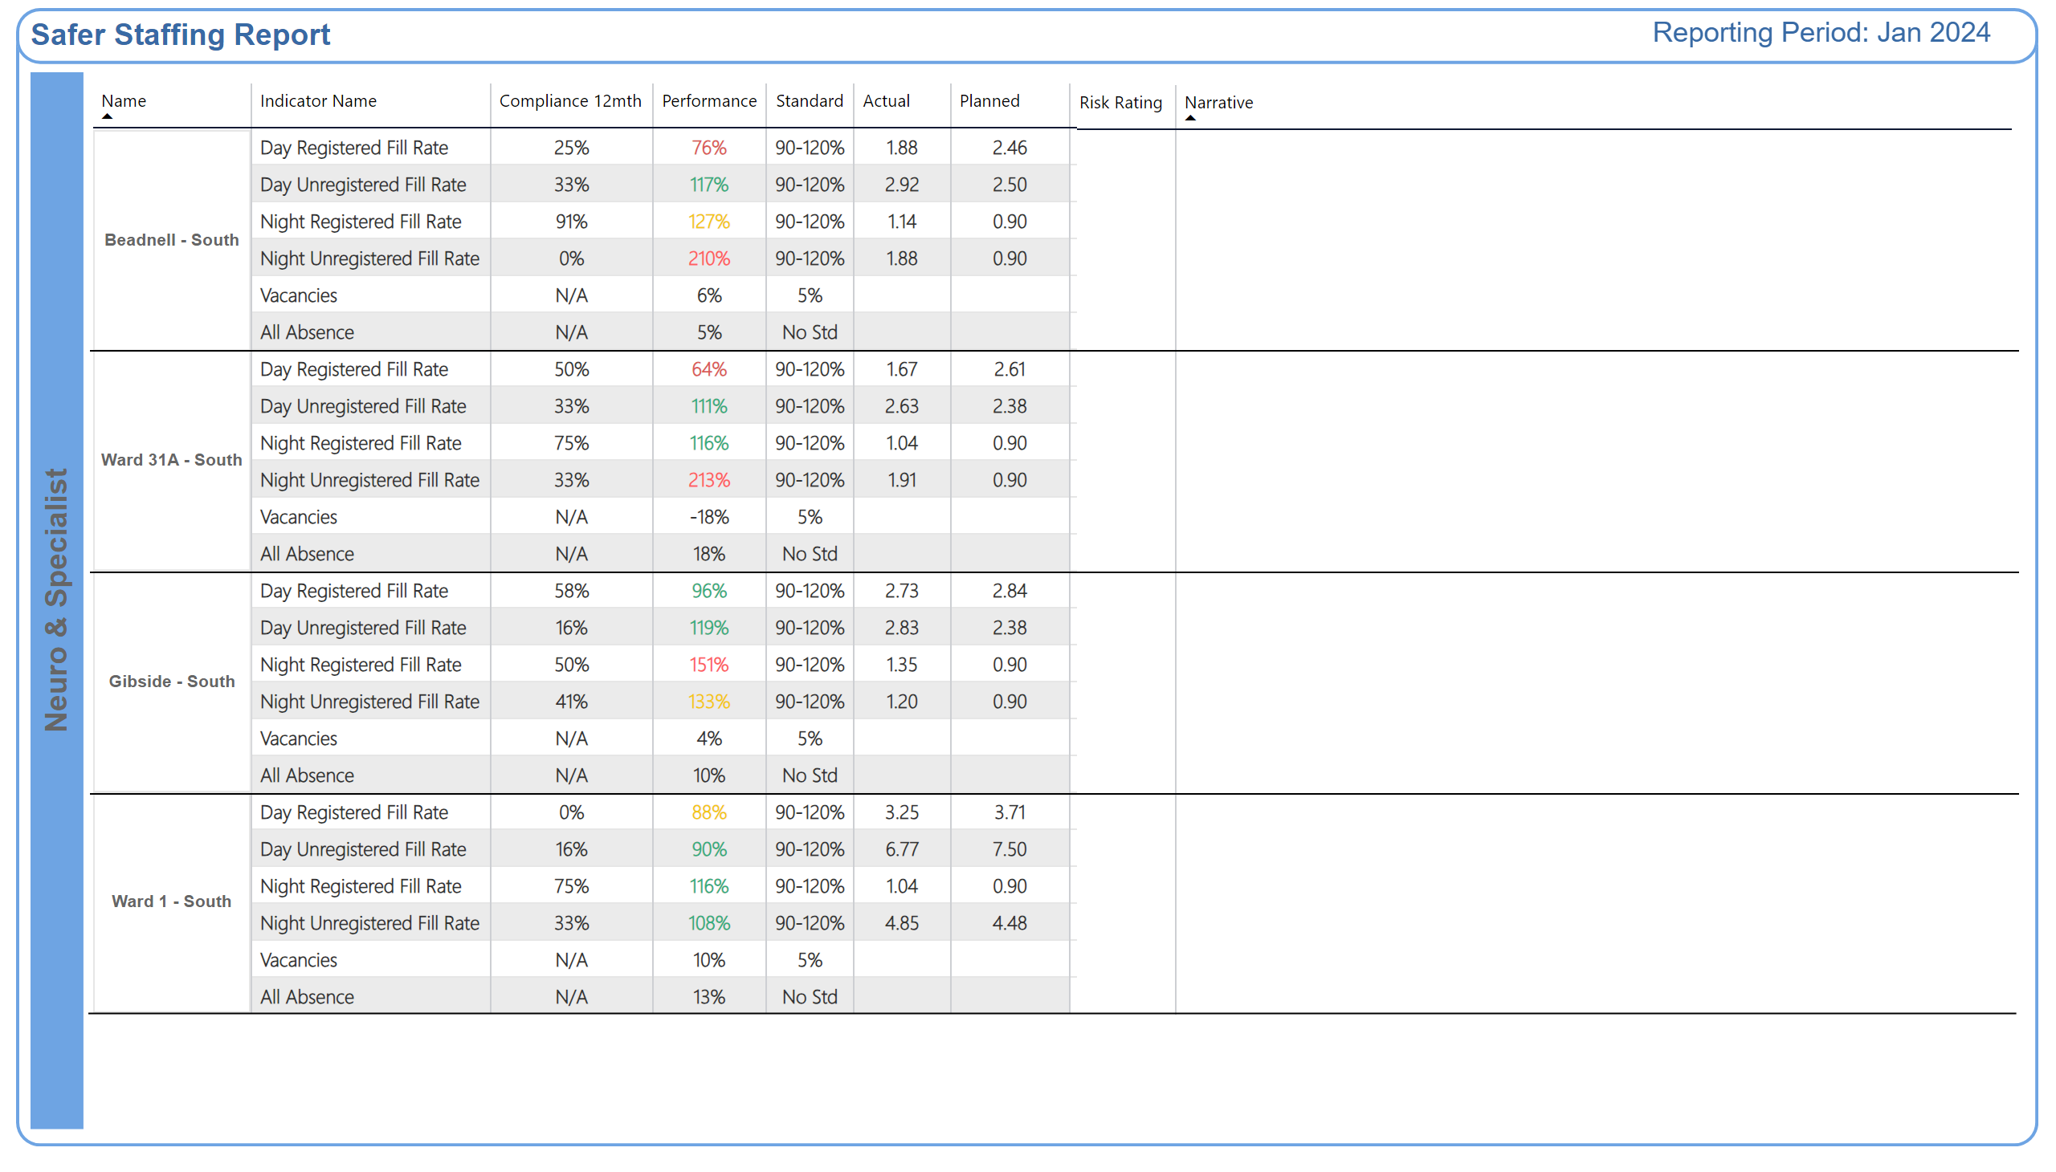
Neuro Specialist
Why is the risk rating medium or high?
Improvement Actions
Why is the risk rating medium or high?
Improvement Actions
Why is the risk rating medium or high?
Improvement Actions
Why is the risk rating medium or high?
Improvement Actions
Notes:
shape
No alt text provided
textbox
No alt text provided
shape
No alt text provided
shape
No alt text provided
TXT - Reporting Period
No alt text provided
TBL - Commitment
No alt text provided
TBL - Commitment
No alt text provided
shape
No alt text provided
shape
No alt text provided
shape
No alt text provided
shape
No alt text provided
shape
No alt text provided
shape
No alt text provided
shape
No alt text provided
shape
No alt text provided

Slide 43
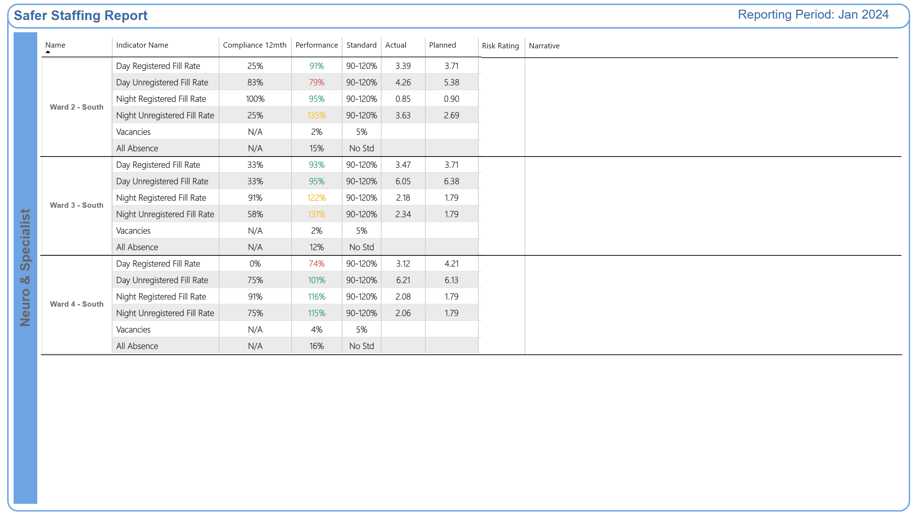
Neuro Specialist 2
Why is the risk rating medium or high?
Improvement Actions
Why is the risk rating medium or high?
Improvement Actions
Why is the risk rating medium or high?
Improvement Actions
Notes:
shape
No alt text provided
textbox
No alt text provided
shape
No alt text provided
shape
No alt text provided
TBL - Commitment
No alt text provided
TBL - Commitment
No alt text provided
shape
No alt text provided
shape
No alt text provided
shape
No alt text provided
TXT - Reporting Period
No alt text provided
shape
No alt text provided
shape
No alt text provided
shape
No alt text provided

