Slide 1
Title
Notes:
image
No alt text provided
image
No alt text provided
textbox
No alt text provided
shape
No alt text provided
TextEnhancerByMAQ46ASG0293G65JY43S89DKJ9
No alt text provided
image
No alt text provided
image
No alt text provided

Slide 2
Narrative Summary
Issues impacting on safe staffing:
Although the registered nurse vacancy rate is not significant, a high proportion of preceptees who are unable to take charge of the ward results in experienced registered nurse staffing pressures; Preceptees continue to be supported and assessed as competent in a timely way; 18 newly registered nurses have been appointed and will take up post in January 2025.
The Influenza and Covid-19 vaccination campaign has been in progress since October 2024 and impacts on registered nurse staffing levels.
The impact of staff sickness, maternity leave and staff members whose duties are restricted due to investigations is noted.
A high number of patients requiring an enhanced level of observation.
A high level of patient acuity, compounded by co-existing conditions and physical health needs.
Palliative care requirements on older people’s wards.
Outreach support to care homes to support leave arrangements or discharge.
The need for patient seclusion and segregation.
A high number of patients who are Clinically Ready for Discharge (CRFD) with no identified arrangements for ongoing care and support.
Out of pathway patients and out of area patients on children and young people’s wards.
A high incidence of violence and aggression and of self-harm.
Discussions are in progress to explore the development of a male only PICU.
Focused work is in progress to promote safer staffing on the Mitford Unit.
Standalone units continue to cause particular concern, requiring additional safeguards; taxi costs are incurred for temporary staff transport to Yewdale ward.
Staff members are redeployed across CBUs according to need, which can reduce continuity of care and job satisfaction.
Pressures relating to enabling staff training.
Overall, the registered nursing workforce is relatively inexperienced.
There is a high level of incidents involving violence and aggression and self-harm.
There are specific risks associated with stand-alone units (Yewdale; Elm House; Rose Lodge; Lotus ward; Mitford unit) and hospital sites not easily accessible by public transport (Northgate; Ferndene).
There is increasing incidence and complexity of physical health and palliative care needs.
Allied Health Professions staffing at Walkergate Park is identified as not meeting the guidelines of the British Society of Rehabilitative Medicine.
Overtime and agency support is utilised to ensure safe staffing levels.
Daily level-loading of experienced registered nurses is undertaken.
Daily or twice daily staffing huddles are held to reassess safe staffing levels.
Implementation of evaluation of competence at 9 months in the preceptorship process.
Staff wellbeing meetings are held, and relevant actions implemented.
A robust authorisation process is in place for temporary staff utilisation.
Engagement in the Vacancy Control Process to provide evidence of need to recruit to clinical vacancies.
Use of Occupational Health to support staff returning to work.
Senior clinical staff members are supporting clinical teams, including providing Registered Mental Health Nurse cover when required.
There is focused work in progress to promote staff wellbeing.
Work is being undertaken on Rose Lodge and Mitford to improve patient and staff experience.
Safer staffing tools continue to be used to provide evidence of staffing levels (Mental Health Optimal Staffing Tool; Safer Nursing Care Tool). Planning for the next 6-monthly review of staffing establishments is in progress.
The Enhanced Multidisciplinary Team model is being implemented in Acute Inpatient services, including Occupational Therapy in the first instance.
Notes:
textbox
No alt text provided
shape
No alt text provided
shape
No alt text provided
shape
No alt text provided
textbox
No alt text provided
textbox
No alt text provided
shape
No alt text provided
shape
No alt text provided
textbox
No alt text provided
shape
No alt text provided
shape
No alt text provided
textbox
No alt text provided
shape
No alt text provided
shape
No alt text provided
TextEnhancerByMAQ46ASG0293G65JY43S89DKJ9
No alt text provided
TextEnhancerByMAQ46ASG0293G65JY43S89DKJ9
No alt text provided
TextEnhancerByMAQ46ASG0293G65JY43S89DKJ9
No alt text provided
TextEnhancerByMAQ46ASG0293G65JY43S89DKJ9
No alt text provided
shape
No alt text provided
TXT - Reporting Period
No alt text provided

Slide 3
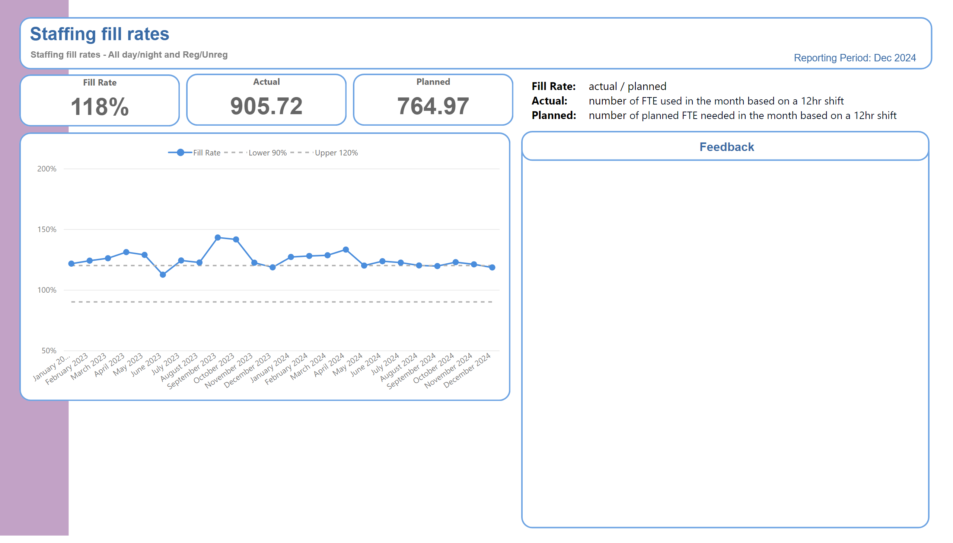
Trust Overview
Daily level-loading of experienced registered nurses is undertaken.
Daily or twice daily staffing huddles are held to reassess safe staffing levels.
Implementation of evaluation of competence at 9 months in the preceptorship process.
A robust authorisation process is in place for temporary staff utilisation.
Notes:
BOX - Header
No alt text provided
TXT - Indicator Name
No alt text provided
TXT - Indicator Definition
No alt text provided
shape
No alt text provided
PBI_CV_885EF3C3_31C1_4745_B2B9_20771D5AD196
No alt text provided
shape
No alt text provided
PBI_CV_885EF3C3_31C1_4745_B2B9_20771D5AD196
No alt text provided
shape
No alt text provided
PBI_CV_885EF3C3_31C1_4745_B2B9_20771D5AD196
No alt text provided
shape
No alt text provided
TXT - Reporting Period
No alt text provided
Planned
No alt text provided
BOX - Performance
No alt text provided
Actual
No alt text provided
BOX - Performance
No alt text provided
textbox
No alt text provided
SPC Chart
No alt text provided
BOX - Feedback Title
No alt text provided
BOX - Feedback body
No alt text provided
TXT - Feedback title
No alt text provided
BOX - SPCChart
No alt text provided
textbox
No alt text provided
textbox
No alt text provided
tableEx
No alt text provided
cardVisual
No alt text provided
cardVisual
No alt text provided
cardVisual
No alt text provided
textbox
No alt text provided
textbox
No alt text provided
TextEnhancerByMAQ46ASG0293G65JY43S89DKJ9
No alt text provided
shape
No alt text provided
TextEnhancerByMAQ46ASG0293G65JY43S89DKJ9
No alt text provided
TextEnhancerByMAQ46ASG0293G65JY43S89DKJ9
No alt text provided
TextEnhancerByMAQ46ASG0293G65JY43S89DKJ9
No alt text provided
TextEnhancerByMAQ46ASG0293G65JY43S89DKJ9
No alt text provided
TextEnhancerByMAQ46ASG0293G65JY43S89DKJ9
No alt text provided
TextEnhancerByMAQ46ASG0293G65JY43S89DKJ9
No alt text provided
TextEnhancerByMAQ46ASG0293G65JY43S89DKJ9
No alt text provided
textbox
No alt text provided
Fill Rate
No alt text provided
BOX - Performance
No alt text provided

Slide 4
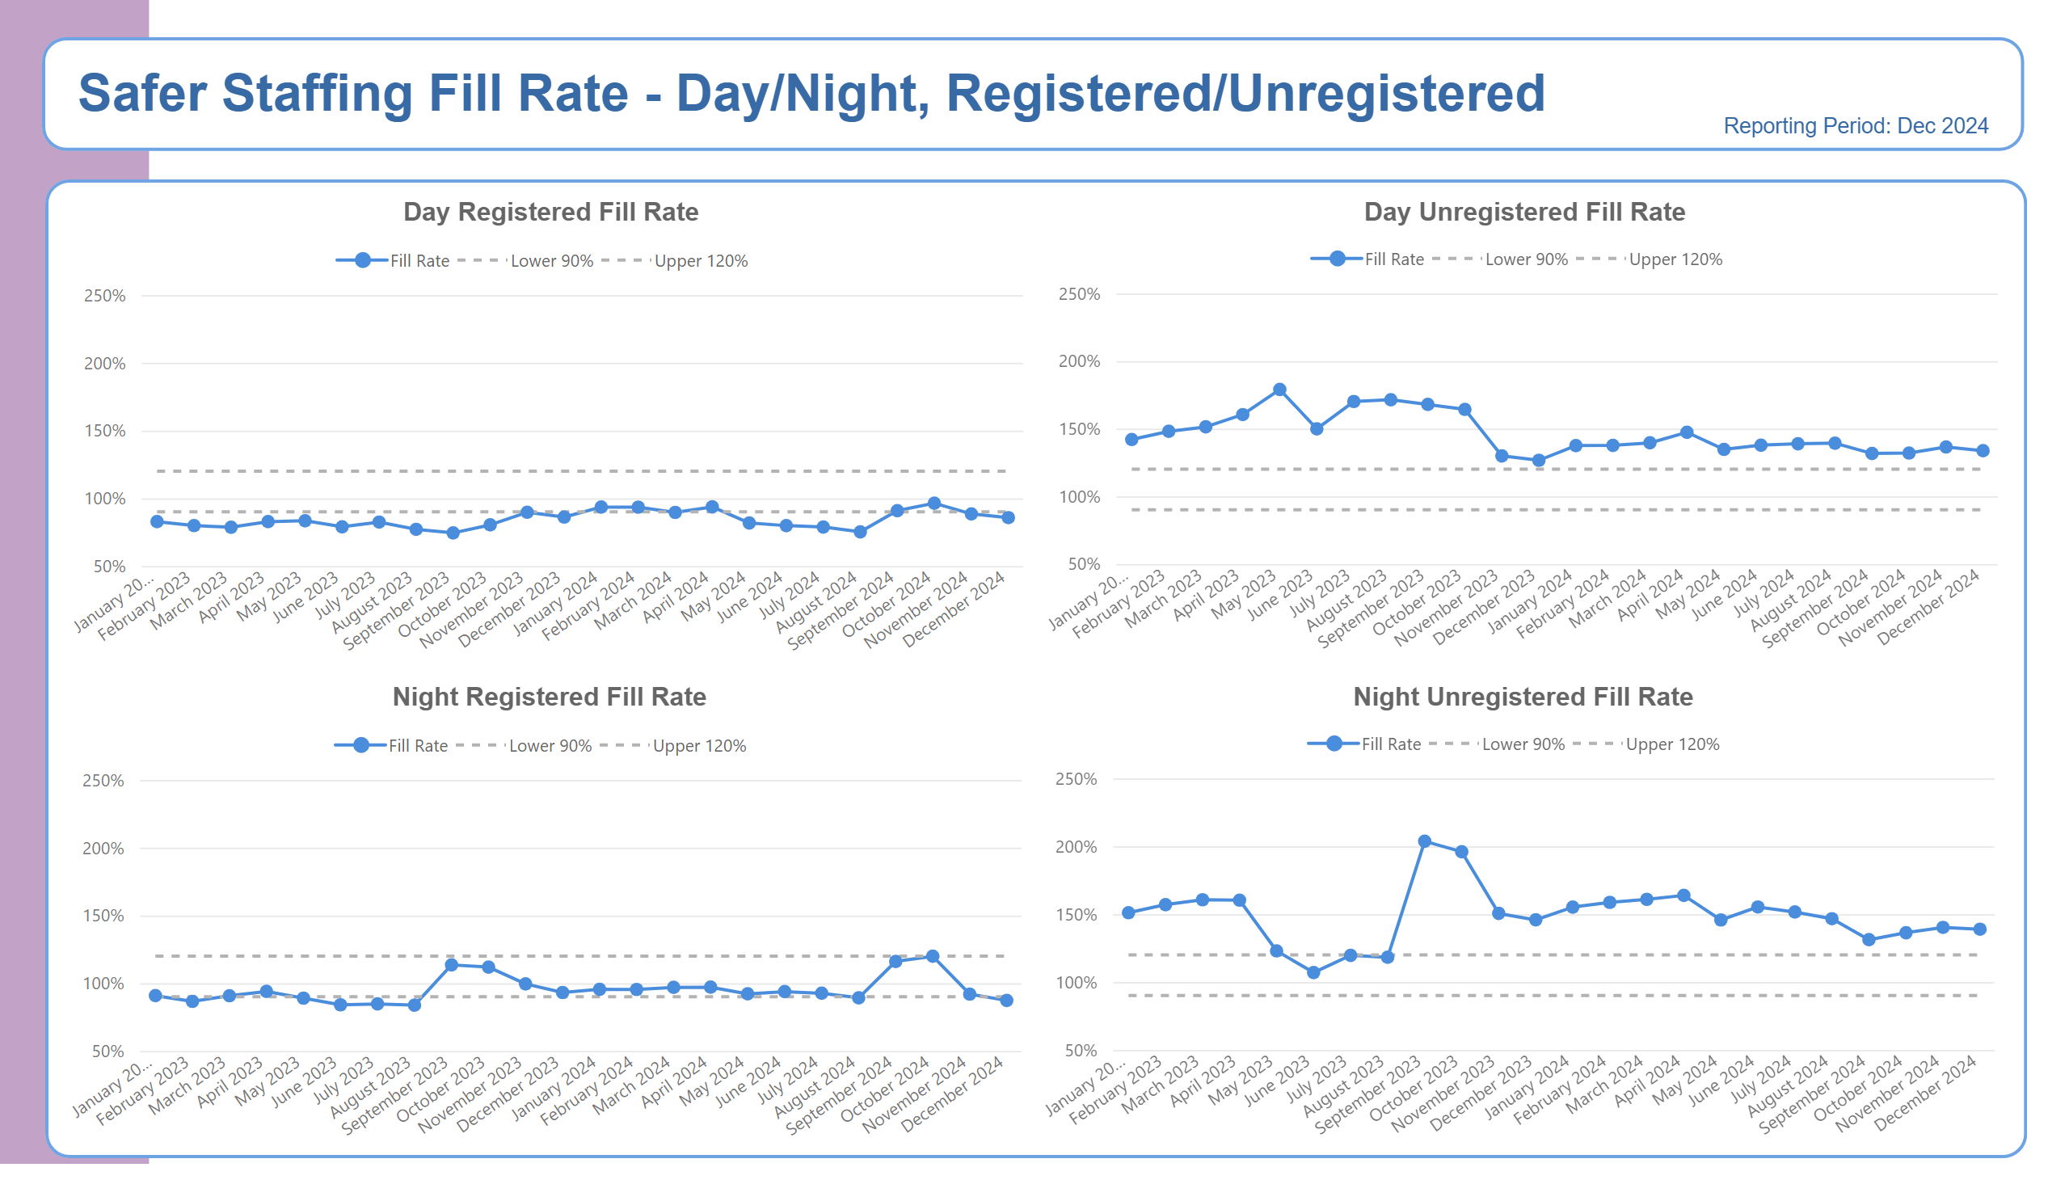
Fill Rate Graphs
Notes:
BOX - Header
No alt text provided
BOX - Background
No alt text provided
TXT - Page Heading
No alt text provided
TXT - Reporting Period
No alt text provided
shape
No alt text provided
TXT - Indicator Title
No alt text provided
SPC Chart
No alt text provided
TXT - Indicator Title
No alt text provided
SPC Chart
No alt text provided
TXT - Indicator Title
No alt text provided
SPC Chart
No alt text provided
TXT - Indicator Title
No alt text provided
SPC Chart
No alt text provided

Slide 5
Bank Agency Staff Use
Notes:
BOX - Header
No alt text provided
BOX - Background
No alt text provided
TXT - Page Heading
No alt text provided
TXT - Reporting Period
No alt text provided
shape
No alt text provided
TXT - Indicator Title
No alt text provided
SPC Chart
No alt text provided
TXT - Indicator Title
No alt text provided
SPC Chart
No alt text provided
TextEnhancerByMAQ46ASG0293G65JY43S89DKJ9
No alt text provided
lineChart
No alt text provided
TextEnhancerByMAQ46ASG0293G65JY43S89DKJ9
No alt text provided
lineChart
No alt text provided

Slide 6
Adult Acute Summary
High numbers of preceptees who cannot take charge, adding pressure to those who can (South, Central and North Inpatient CBU: Embleton and Alnmouth).
High levels of acuity requiring enhanced engagement and observations to manage patient acuity and risk (South, Central, North and North Cumbria Inpatient CBU); 3 patients requiring 2:1 care; 1 patient requiring 2-3:1 care (North Inpatient CBU).
Patients who are clinically ready for discharge with no identified arrangements for ongoing care and support (South and Central Inpatient CBU)
Use of temporary workforce to support vacancies, enhanced engagement, sickness and other absences.
Seclusion required within both male and female pathways has increased and resulted in staffing pressures (Central, North and North Cumbria Inpatient CBU); difficulties managing challenging incidents due to a lack of seclusion facilities (North Cumbria Inpatient CBU: Yewdale).
High level of physical health acuity, including the requirement for nasogastric nutrition; high levels of escorts to acute general wards across all acute wards, with acute wards having at least one ongoing escort to NSECH (South Inpatient CBU; North Inpatient CBU)
Bed utilisation above capacity, e.g., the beds of patients at NSECH being filled by new admissions, including seclusion beds (North Inpatient CBU).
Number of staff required to undertake statutory and mandatory training: PMVA, Learning Disability, Autism, Narrative Risk (North Inpatient CBU).
Increase in short-term and long-term sickness: some sickness resulting from assaults by patients (North Cumbria Inpatient CBU; North Inpatient CBU; South Inpatient CBU).
Yewdale is an isolated unit 80 mins approx. from next CNTW site, resulting in difficulties in ensuring safe staffing levels; taxi costs for bank and agency workers often have to be agreed (North Cumbria Inpatient CBU).
There is an ongoing need to redeploy staff members to wards other than their base ward, reducing continuity of care (South Inpatient CBU); some staff members resist redeployment (North Inpatient CBU).
Difficulties with retaining registered nurses after completion of preceptorship (South Inpatient CBU).
Pressures resulting from implementation of the Enhanced Multidisciplinary Team model: management and professional engagement and change management.
Essential staff training is not being achieved: difficulties releasing staff members due to staffing pressures (South and Central Inpatient CBU).
Safer staffing levels are based on number of Within Eyesight Observation, which does not include the staffing resource to provide escort to other Trusts (North Inpatient CBU).
Patients who are clinically ready for discharge with no identified arrangements for ongoing care and support, including social care.
Management and clinical supervision: improvement plans are in place (North Inpatient CBU; North Cumbria CBU)
In patient care group locality staffing huddles to manage resource gaps, with senior overview to support pressures; admin support has been introduced in North Inpatient CBU to support record keeping.
Enhanced Multidisciplinary Team working inclusion of Occupational Therapists; planning involvement of wider professions is in progress..
Staff wellbeing meetings are held.
Use of temporary staffing is only when all other options have been explored or related to essential training requirements.
Vacancies are being recruited to.
Bed flow meetings are in progress to support timely discharge of patients (North Inpatient CBU)
Focused work on staff wellbeing is in progress.: Feel Good Friday and Wednesday respectively implemented; 1:1 wellbeing conversations are offered and the uptake is high (North Inpatient CBU and North Cumbria CBU).
Improvement in team morale (South Inpatient CBU).
Notes:
textbox
No alt text provided
shape
No alt text provided
shape
No alt text provided
shape
No alt text provided
textbox
No alt text provided
textbox
No alt text provided
shape
No alt text provided
shape
No alt text provided
textbox
No alt text provided
shape
No alt text provided
shape
No alt text provided
textbox
No alt text provided
shape
No alt text provided
shape
No alt text provided
TextEnhancerByMAQ46ASG0293G65JY43S89DKJ9
No alt text provided
TextEnhancerByMAQ46ASG0293G65JY43S89DKJ9
No alt text provided
TextEnhancerByMAQ46ASG0293G65JY43S89DKJ9
No alt text provided
TextEnhancerByMAQ46ASG0293G65JY43S89DKJ9
No alt text provided
shape
No alt text provided

Slide 7
PICU Summary
There is a lack of substantive experienced post- preceptorship Band 5 staff.
High acuity: patients often have a forensic need/risk; this can be compounded by co-existing conditions, such as autism, and substance misuse.
Use of restrictive practice to support clinical need and safety (Seclusion).
Out of pathway patients.
Patients who are clinically ready for discharge, with no identified arrangements for ongoing care and support.
Enhanced Engagement and Observation levels.
Essential staff training not being achieved as not able to release staff members.
Use of temporary workforce to support vacancies, due to enhanced engagement, sickness and other absences.
Complex Physical Health needs.
Staff members unable to fulfil clinical role due to ongoing investigations is creating staffing pressures.
Daily difficulties level-loading of substantive post-preceptorship Band 5 nurses.
Use of temporary workforce.
Band 5 preceptees following completion of preceptorship progress to Band 6 posts out with inpatient CBU.
Working to achieve parity of esteem (physical and mental health).
Authorisation process for temporary workforce.
The Physical Health offer is being reviewed, in line with the Physical Health Strategy.
Male only admissions currently with a view to exploring a reduced capacity PICU environment.
Clinical Band 7 work in the numbers, including weekends and night shift, to assist with leadership and quality.
Loan of experienced Band 6 and Band 5 nurses from more established teams has bolstered the nursing team.
Use of temporary workers: Bank worker numbers are increasing, reducing the need for agency.
Focused work on staff wellbeing is in progress.
Realignment Physical Health Champions.
Notes:
textbox
No alt text provided
shape
No alt text provided
shape
No alt text provided
shape
No alt text provided
textbox
No alt text provided
textbox
No alt text provided
shape
No alt text provided
shape
No alt text provided
textbox
No alt text provided
shape
No alt text provided
shape
No alt text provided
textbox
No alt text provided
shape
No alt text provided
shape
No alt text provided
TextEnhancerByMAQ46ASG0293G65JY43S89DKJ9
No alt text provided
TextEnhancerByMAQ46ASG0293G65JY43S89DKJ9
No alt text provided
TextEnhancerByMAQ46ASG0293G65JY43S89DKJ9
No alt text provided
TextEnhancerByMAQ46ASG0293G65JY43S89DKJ9
No alt text provided
shape
No alt text provided

Slide 8
Adult Rehab Summary
All wards report a high number of patients who require enhanced engagement and observation. This can also relate to patients who have physical health and frailty need. 4 patients 2:1 support (North Inpatient CBU).
Essential staff training is not being achieved as it is not possible to release staff, due to patient acuity and staffing levels.
Due to physical health needs, patients receive care within the acute Trust, which results in staff support to attend appointments/treatment.
Elm House and Willow View have several patients with dysphagia, which is a significant risk and requires additional one to one support (Central Inpatient CBU).
The continued use of agency staff who are often unfamiliar with patients, to support vacancies, enhanced engagement and observations, sickness and other staffing issues (Central Inpatient CBU)
Increase in registered staff sickness and maternity leave (North Inpatient CBU); impact of long-term sickness and vacancies (South Inpatient CBU).
Bridgewell staff supporting Clearbrook temporarily; vacancies at Brooke House and the impact of the requirement for 2:1 support for escort from Aldervale.
Pressures relating to meeting training needs; there is a continued focus on staff competing PMVA training.
Pressures due to escorting patients to other hospital sites and services.
High incidence of sickness absence both long-term and short-term (South and North Inpatient CBU).
There is still a need to redeploy staff to wards which is not their base ward, reducing continuity of care.
In patient care group locality staffing huddles to manage resource gaps, with senior overview to support pressures (daily or twice daily).
Use of temporary staffing is only when all other options have been explored; there is an authorisation process for the use of temporary workforce.
Monitoring and staff support to improve sickness.
Wider Multidisciplinary team is utilised when possible (South Inpatient CBU).
Bank being used rather than Agency.
Using the wider Multi- Disciplinary Team to support patient care.
Frequent reviews of needs, including physical health, to ensure appropriateness of support; relevant professional advice sought for safe and effective treatment; HOPE(S) team and Long-term seclusion support (South Inpatient CBU).
Notes:
textbox
No alt text provided
shape
No alt text provided
shape
No alt text provided
shape
No alt text provided
textbox
No alt text provided
textbox
No alt text provided
shape
No alt text provided
shape
No alt text provided
textbox
No alt text provided
shape
No alt text provided
shape
No alt text provided
textbox
No alt text provided
shape
No alt text provided
shape
No alt text provided
TextEnhancerByMAQ46ASG0293G65JY43S89DKJ9
No alt text provided
TextEnhancerByMAQ46ASG0293G65JY43S89DKJ9
No alt text provided
TextEnhancerByMAQ46ASG0293G65JY43S89DKJ9
No alt text provided
TextEnhancerByMAQ46ASG0293G65JY43S89DKJ9
No alt text provided
shape
No alt text provided

Slide 9
Older Persons Summary
High numbers of preceptees and who cannot take charge (adding pressure to those who can).
High levels of acuity requiring enhanced engagement and observations to manage patient acuity and risk, particularly on Woodhorn ward (North Inpatient CBU).
Increase in physical Health needs including palliative care (North and North Cumbria Inpatient CBUs).
Prolonged outreach support to care homes to support leave arrangements or discharge.
Use of temporary workforce to support vacancies, enhanced engagement, sickness and other absences.
Essential staff training is not being achieved as it is not possible to release staff, due to patient acuity and staffing levels.
Reduced ward leadership support on Woodhorn ward due to long-term sickness of clinical lead (North Inpatient CBU).
There is an ongoing need to redeploy staff members to wards other than their base ward, reducing continuity of care.
Daily difficulties level-loading of substantive post-preceptorship Band 5 nurses on the wards.
Focused support is required for preceptee nurses and internationally educated nurses.
Essential staff training is not being achieved: difficulties releasing staff members due to staffing pressures.
The impact of incidents relating to violence and aggression, including on staff wellbeing.
In patient care group locality staffing huddles to manage resource gaps, with senior overview to support pressures.
Staff wellbeing meetings are being held.
Use of temporary staffing is only when all other options have been explored; there is an authorisation process for the use of temporary workforce.
The Physical Health offer has been strengthened in line with Trust Physical Health Strategy.
Redeployment of staff across site to support safer staffing levels.
Flexibility of Specialist Nurse/Ward Manager to cover and support safer staffing levels on the wards.
Focused attention on completion of appraisals and sickness management to support staff wellbeing; ‘Tartan rug’ integrated spreadsheet in use for holistic monitoring (North Cumbria Inpatient CBU).
Bank being used rather than Agency where possible.
Using the wider Multi-Disciplinary Team to support patient care.
Focused work on staff wellbeing is in progress.
Positive feedback from relatives of patient/carer experience.
Monitoring to identify sickness absence patterns or themes.
Notes:
textbox
No alt text provided
shape
No alt text provided
shape
No alt text provided
shape
No alt text provided
textbox
No alt text provided
textbox
No alt text provided
shape
No alt text provided
shape
No alt text provided
textbox
No alt text provided
shape
No alt text provided
shape
No alt text provided
textbox
No alt text provided
shape
No alt text provided
shape
No alt text provided
TextEnhancerByMAQ46ASG0293G65JY43S89DKJ9
No alt text provided
TextEnhancerByMAQ46ASG0293G65JY43S89DKJ9
No alt text provided
TextEnhancerByMAQ46ASG0293G65JY43S89DKJ9
No alt text provided
TextEnhancerByMAQ46ASG0293G65JY43S89DKJ9
No alt text provided
shape
No alt text provided
shape
No alt text provided

Slide 10
CYPS Summary
Staffing pressures resulting from:
A high level of preceptees who are unable to take charge of wards.
Increased sickness in registered and non-registered staff.
Clinically Ready for Discharge patients on all wards.
Out of pathway and out of area patients.
High levels of acuity and complex packages of care requiring enhanced engagement and observation levels.
High levels of enhanced observations to support Eating disorder cohort.
Continued high levels of Violence and Aggression towards staff.
Increased levels of self-harm and need for restrictions.
Poor Wi-Fi signal having an impact on 1 x patient: increased
The proportion of preceptees to experienced B5 nurses.
High levels of acuity, in particular Violence and Aggression for individual young people:
Lotus 112 Incidents
Riding 38 Incidents
Stephenson 12 Incidents
Redburn 76 Incidents
Daily staffing huddles to review staffing levels with Ward Managers and Clinical Managers.
Level loading of skill mix within service, including temporary redeployment of staff to support.
Discharge planning meeting in place: delays in discharges escalated to increase focus on ensuring patients is being nursed in the correct pathway, dependent on level of risk or treatment need.
Regular workforce support in place for managing staff sickness.
CYPS Inpatient Pathway Meeting.
Preceptee induction and support; band 5 fixed term recruitment to support preceptees.
Successful recruitment to band 3 posts via the fast-track process to recruit temporary staff members.
Daily staff wellbeing drop-in sessions with ward manager.
Senior leadership accessibility and monthly drop-ins.
Positive feedback from a family regarding patient care and treatment.
Notes:
textbox
No alt text provided
shape
No alt text provided
shape
No alt text provided
shape
No alt text provided
textbox
No alt text provided
textbox
No alt text provided
shape
No alt text provided
shape
No alt text provided
textbox
No alt text provided
shape
No alt text provided
shape
No alt text provided
textbox
No alt text provided
shape
No alt text provided
shape
No alt text provided
TextEnhancerByMAQ46ASG0293G65JY43S89DKJ9
No alt text provided
TextEnhancerByMAQ46ASG0293G65JY43S89DKJ9
No alt text provided
TextEnhancerByMAQ46ASG0293G65JY43S89DKJ9
No alt text provided
TextEnhancerByMAQ46ASG0293G65JY43S89DKJ9
No alt text provided
shape
No alt text provided

Slide 11
Secure Services Summary
Staffing pressures resulting from:
High levels of enhanced observations on Alwinton; 2 patients requiring 3:1; escorts required to facilitate Section 17 leave; 2:1 ratio and gender specific.
Prolonged seclusion on Elsdon; individualised care package staffing 6:1
There is a total of 18 preceptees across services which puts pressure on actual number of sole registrants.
Continued ‘hotspots’ of acuity
68 incidents of Violence and Aggression (V&A), however there has been a reduction of V&A on each ward overall.
High level total incident data by ward:
16 Alwinton
11 Rothbury
8 Elsdon
8 Tweed Hospital Based Rehab
7 Tyne Mental Health Low Secure
Daily Staffing Huddles to level – load, with reference to experience, temporary staffing and any gender-specific observations.
Recruitment into vacant posts.
Group directors authorise agency requests.
Ongoing monthly sickness absence clinics supported by workforce.
Recruitment managed via Director Vacancy Control
Newly appointed Registered nurses have taken up post.
Some of the preceptees are close to being signed off as sole registrants.
Reduced number of vacancies
Sickness absence has reduced to 4.02%, with a reduction in the number of staff on long-term absence
Reduction in bank and agency use
Notes:
textbox
No alt text provided
shape
No alt text provided
shape
No alt text provided
shape
No alt text provided
textbox
No alt text provided
textbox
No alt text provided
shape
No alt text provided
shape
No alt text provided
textbox
No alt text provided
shape
No alt text provided
shape
No alt text provided
textbox
No alt text provided
shape
No alt text provided
shape
No alt text provided
TextEnhancerByMAQ46ASG0293G65JY43S89DKJ9
No alt text provided
TextEnhancerByMAQ46ASG0293G65JY43S89DKJ9
No alt text provided
TextEnhancerByMAQ46ASG0293G65JY43S89DKJ9
No alt text provided
TextEnhancerByMAQ46ASG0293G65JY43S89DKJ9
No alt text provided
shape
No alt text provided

Slide 12
LD Autism Summary
High numbers of preceptees who cannot take charge (adding pressure to those who can).
High levels of acuity requiring enhanced engagement and observations to manage patient acuity and risk.
Patients who are clinically ready for discharge with no identified arrangements for ongoing care and support.
Essential staff training is not being achieved: difficulties releasing staff members due to staffing pressures.
Use of temporary workforce to support vacancies, enhanced engagement, sickness and other absences.
Rose Lodge is limited to an internal response team, due to being standalone unit.
Rose Lodge: currently supporting a patient in long tern seclusion (this commenced mid-July 2024).
Increase in the number of debriefs required needing staff attendance, taking staff away from clinical area (Mitford Unit)
Clinical supervision target not achieved due to ongoing clinical pressures (Mitford Unit).
Overtime usage and those opting out of the Working Time Directive is high within Mitford.
Releasing staff to engage in the HCSW development programme results in staffing pressure the last week of each month; temporary workforce support is required (Mitford Unit).
Edenwood: continues to experience high levels of acuity pertaining to 2 patients.
In patient care group locality staffing huddles to manage resource gaps, with senior overview to support pressures.
Utilisation of the wider multidisciplinary team where possible (Mitford).
Weekly staff-side drop-in support to promote staff wellbeing on Rose Lodge; fortnightly Assistant Director and staff-side drop-in support on Mitford.
Staff Wellbeing/Team meetings for Mitford staff are held and relevant actions progressed.
A robust authorisation process is in place for temporary workforce engagement.
Observation levels and risk mitigation form part of a daily assessment of need within the daily and clinical reviews on Mitford.
Weekly reports at safety meeting of any incident of moderate or severe harm or RIDDOR that will impact on staff safety (Mitford Unit).
Specialist Care Group Violence and Aggression and Reducing Restrictive Interventions Group established, led by Group Directors and attended by CBU members.
Service supported by IMG to review service improvement actions (Mitford).
Pause to admissions to Mitford unit continues; staffing requirements have reduced following the discharge of a patient (Mitford).
HCSW programme to be rolled out to support and provide skills and knowledge (Mitford).
Recovery plan in place for Clinical Supervision (Specialist Care Group CBU).
Daily difficulties level-loading of substantive post-preceptorship Band 5 nurses on the wards; the impact of an inexperienced Healthcare Support Worker workforce.
Essential staff training not being achieved.
Levels of incidents relating to violence, aggression and assaults on staff and how this impacts staff wellbeing (Rose Lodge and the Mitford Unit).
Patients who are clinically ready for discharge with no identified arrangements for ongoing care and support.
Increase in staff incidents leading to RIDDOR reporting.
The ability to give staff focused time for involvement with staff debriefs (Mitford Unit).
Financial pressure of vacancies to care packages: a meeting is now in place with the finance team to monitor staffing need against discharges (Mitford Unit).
Safer staffing levels increased safely to support acuity (Edenwood).
Clinical Band 7 on wards work in the numbers including weekends and night shift to assist with leadership and quality (Rose Lodge)..
Bank and overtime being used rather than Agency (Mitford).
Work on Mitford with the National HOPE(S) team is in progress to support patients.
Robust system in place to report RIDDOR and provide updates as required (Mitford Unit).
Increase in specialist clinical nursing resource (Mitford).
Reduction in Long-Term Sickness cases with staff returning on phased returns (Mitford Unit).
Planned meeting with commissioning ICBs for patients Clinically Ready For Discharge (Mitford).
Specialist nurse covering ward manager post (Edenwood).
Notes:
textbox
No alt text provided
shape
No alt text provided
shape
No alt text provided
shape
No alt text provided
textbox
No alt text provided
textbox
No alt text provided
shape
No alt text provided
shape
No alt text provided
textbox
No alt text provided
shape
No alt text provided
shape
No alt text provided
textbox
No alt text provided
shape
No alt text provided
shape
No alt text provided
TextEnhancerByMAQ46ASG0293G65JY43S89DKJ9
No alt text provided
TextEnhancerByMAQ46ASG0293G65JY43S89DKJ9
No alt text provided
TextEnhancerByMAQ46ASG0293G65JY43S89DKJ9
No alt text provided
TextEnhancerByMAQ46ASG0293G65JY43S89DKJ9
No alt text provided
shape
No alt text provided

Slide 13
Neuro Specialist Summary
Staffing pressures resulting from:
6 Wards have high levels of sickness over the Trust target of 5%:
Ward 2: 12.35% increased from previous month.
Ward 3: 7.15% increase from previous month
Ward 4: 8.13% decrease from previous month.
Gibside: 7.52% increase from previous month
Eating disorders: 13.05% increase from previous month
Beadnell: 7.37% decrease from previous month
Sickness is predominantly non-registered workforce, with a high proportion of long-term sickness, appropriately managed in conjunction with Workforce.
Clinical acuity of Gibside with increase of violence and aggression to staff and patients linked to 1 patient
Allied Health Professions staffing levels at Walkergate Park do not meet the British Society of Rehabilitative Medicine. guidelines for Level 1 Rehabilitation providers, which impacts service provision.
Recruitment is an issue for all Bands, due to potential candidates not having the right to work. Vacancies are being capped with adverts closing very quickly after opening, leading to reduced options for applications with ability to take up posts in a timely way.
Gibside has increased staffing numbers in order to provide a site response at SNH, following closure and movement of other wards. Clinical acuity on the ward has increased and this has resulted in increased use of temporary staff.
CBU staffing huddle held twice weekly to review clinical activity/sickness and level-load staffing resources where possible.
Acuity: regular reviews by the Multi-Disciplinary Team and Associate Director oversight where required to support discharge planning.
Acuity of admissions considered weekly to ensure patient safety for planned admissions.
Appropriate escalation to Clinical Manager/Point of Contact (POC) to support staffing levels as and when needed.
Regular liaison with Workforce to support long-term sickness cases and proactive approach to sickness management.
Proactive recruitment: vacancies are advertised promptly following group vacancy control meetings.
Proactive management of disciplinary cases to minimise impact on clinical services whilst maintaining safety.
Staff wellbeing support associated with clinical acuity increased
New staff in post.
Lower numbers of vacancies in comparison to other parts of Trust.
Lower incidence of violence and aggression in comparison to other parts of Trust.
Several long-term sickness cases closed
Notes:
textbox
No alt text provided
shape
No alt text provided
shape
No alt text provided
shape
No alt text provided
textbox
No alt text provided
textbox
No alt text provided
shape
No alt text provided
shape
No alt text provided
textbox
No alt text provided
shape
No alt text provided
shape
No alt text provided
textbox
No alt text provided
shape
No alt text provided
shape
No alt text provided
TextEnhancerByMAQ46ASG0293G65JY43S89DKJ9
No alt text provided
TextEnhancerByMAQ46ASG0293G65JY43S89DKJ9
No alt text provided
TextEnhancerByMAQ46ASG0293G65JY43S89DKJ9
No alt text provided
TextEnhancerByMAQ46ASG0293G65JY43S89DKJ9
No alt text provided
shape
No alt text provided

