Slide 1

Evaluating the Use of Patient Experience Data to Improve the Quality of Inpatient Mental Health Care (EURIPIDES)
Professor Scott Weich

Slide 2
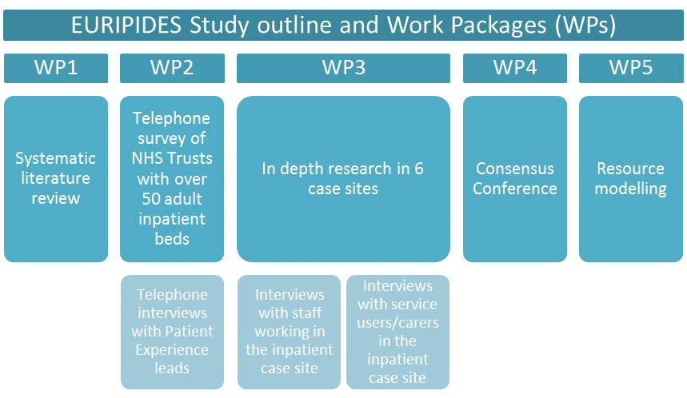

Slide 3
Work Package 2: National survey in Trusts with over 50 adult inpatient beds
Objectives of WP2
To survey Patient Experience leads in NHS Mental Health Trusts in England
To use survey results to guide case site selection for the next phase of the EURIPIDES study
Method
There were three types of data collected from each Trust in the national survey:
A semi-structured telephone interview with patient experience lead(s);
A short questionnaire to gather data on characteristics of each Trust and;
The collection of ‘best-practice’ or strategy documents on patient experience work, identified and provided by Trusts.

Slide 4
42 NHS Providers representing 78% of eligible NHS Trusts took part in the survey
Turnover rates amongst PE lead staff in Trusts during recruitment to WP2:
Number of PE leads who have left post or been replaced during identification phase for recruitment April-July (2016) | 15
Number of PE leads who have left post or been replaced during the subsequent recruitment period July (2016) - March (2017) | 1
Number of PE leads who are in interim posts or covering short term during the recruitment period April (2016) -March (2017) | 3
Total PE Leads who left post during the first year of the EURIPIDES study | 16
Total interim PE Leads during the first year of the EURIPIDES study | 3
Total turnover of PE Leads (leavers and interim workers) during the first year of the EURIPIDES study | 19
As a % of 57 providers | 33%
As a % of 54 providers (post subsequent mergers) | 35%

Slide 5
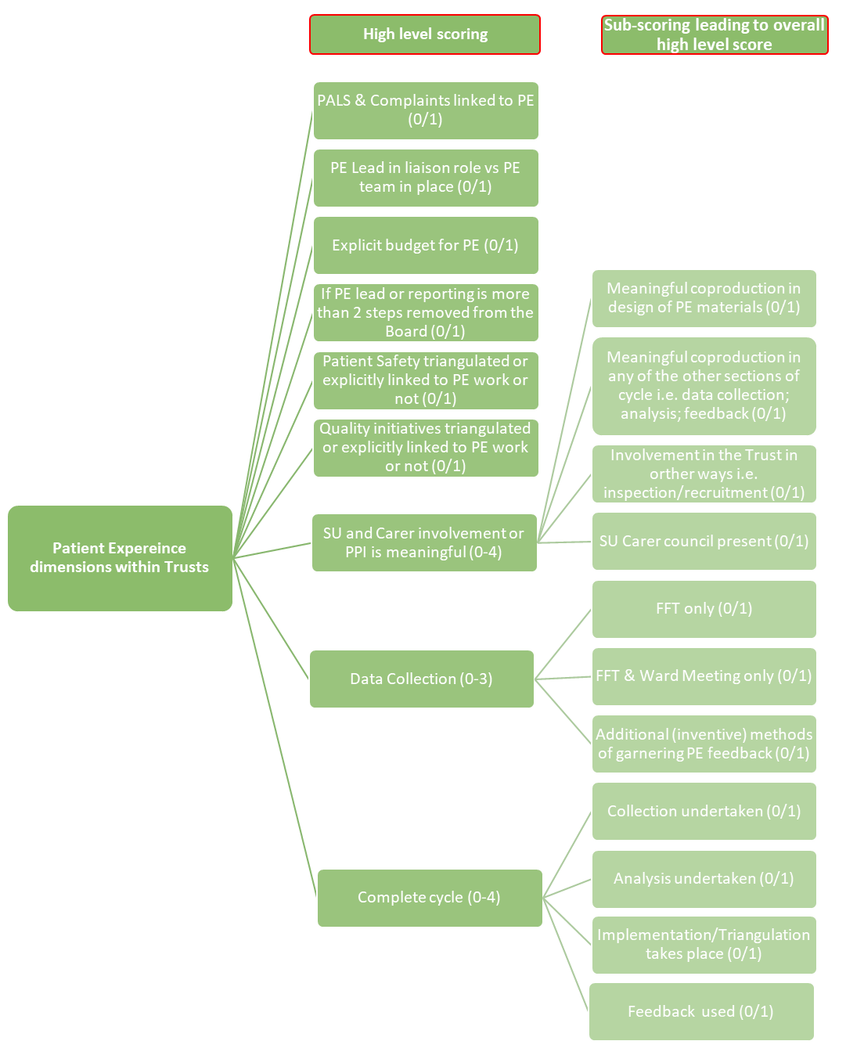
Trusts were scored according to evidence about (1) the patient experience data collected; (2) analysis of these data; (3) change taking place as a result of patient feedback; and (4) feedback to patients and/or staff.
Analysis
1. Data collected
2. Analysis of data
3. Change taking place
4. Feedback to patients and staff
Figure 3: Scoring questions and feedback cycle

Slide 6
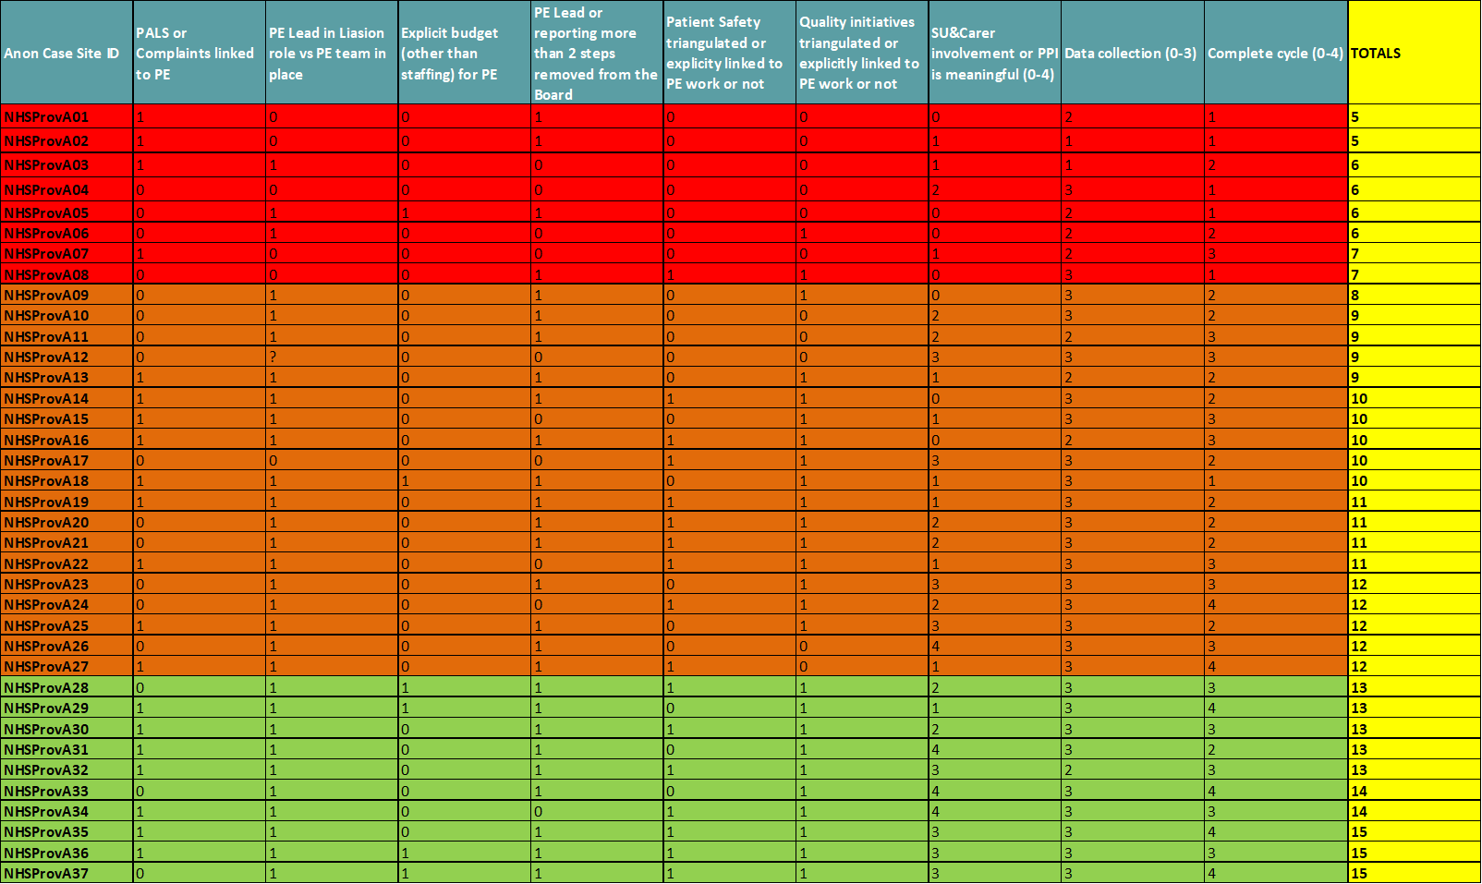
Scoring
Figure 4: Matrix of RAG rated scores

Slide 7

Key findings from WP2
Collection of Patient Experience data in NHS Trusts took place using broadly similar tools, however, who collects this data and how often varies both within and between Trusts
Resources for Patient Experience work vary between Trusts from individual workers, to teams, or no formal roles.
Analysis of Patient Experience data was the weakest area of activity across all Trusts
Implementation and Change was taking place based on PE data, however this was more likely to lead to environmental rather than cultural change in Trusts
Research funding
The Evaluating the Use of Patient Experience Data to Improve the Quality of Inpatient Mental Health Care (EURIPIDES) study is funded by the National Institute for Health Research's Health Services and Delivery Research Programme.

Slide 8
6 case sites were selected from WP2 data
Anon Case Site ID | PALS or Complaints linked to PE | PE Lead in Liaison role vs PE team in place | Explicit budget (other than staffing) for PE | PE Lead or reporting more than 2 steps removed from the Board | Patient Safety triangulated or explicitly linked to PE work or not | Quality initiatives triangulated or explicitly linked to PE work or not | SU & Carer involvement or PPI is meaningful (0-4) | Data collection (0-3) | Complete cycle (0-4) | TOTALS
NHSProvA09 | 0 | 1 | 0 | 1 | 0 | 1 | 0 | 3 | 2 | 8
NHSProvA13 | 1 | 1 | 0 | 1 | 0 | 1 | 1 | 2 | 2 | 9
NHSProvA27 | 1 | 1 | 0 | 1 | 1 | 0 | 1 | 3 | 4 | 12
NHSProvA29 | 1 | 1 | 1 | 1 | 0 | 1 | 1 | 3 | 4 | 13
NHSProvA33 | 0 | 1 | 0 | 1 | 0 | 1 | 4 | 3 | 4 | 14
NHSProvA37 | 0 | 1 | 1 | 1 | 1 | 1 | 3 | 3 | 4 | 15
Figure 4: Extracted case sites from WP2
These sites were picked based on the patterns of outcomes from the WP2 survey data
In addition to the pattern of outcomes identified, we ensured the sites were geographically diverse (some in rural and urban areas) and represented different sizes of Trust (some with a large bed base, some small)

Slide 9
Overview of WP3
Aim: To evaluate the collection, analysis and use of patient experience data in adult inpatient mental health services to find out ‘what works’, for whom, how, when, where, and why?
Method: To conduct a realist evaluation of patient experience work being undertaken in six case sites across NHS England.
This involved conducting interviews with:
Patients (10)
Carers (5)
Staff (15)
Proposed interview numbers: In total 30 interviews per site = 180 interviews across six sites

Slide 10
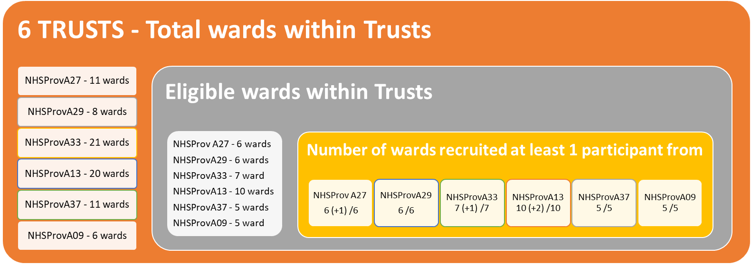
INTERVIEW PROFILE ACROSS WARDS

Slide 11
ACTUAL INTERVIEW TOTALS
Site | Staff (15) | Service Users (10) | Carers (5) | Total (30)
NHSProvA09 | 16 | 11 | 4 | 31
NHSProvA37 | 17 | 10 | 2 | 29
NHSProvA13 | 18 | 11 | 4 | 33
NHSProvA33 | 16 | 10 | 4 | 30
NHSProvA29 | 18 | 10 | 2 | 30
NHSProvA27 | 16 | 10 | 3 | 29
INTERVIEW TOTALS |  |  |  | 182/180 = 101%

Slide 12
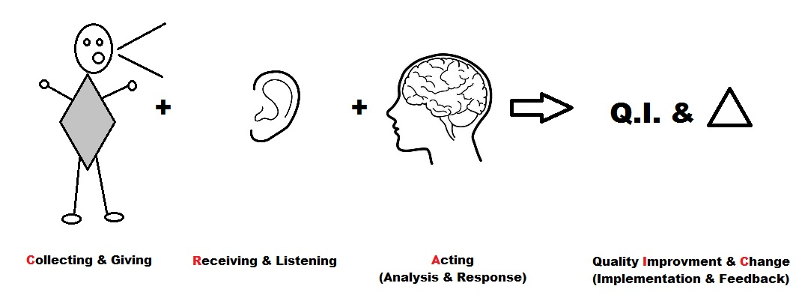
Analysis & coding: The CRAIC
All the interviews were fully transcribed and thematically coded. We developed a coding framework that took into account the patient experience feedback cycle.

Slide 13
Findings: The ‘rules’
We developed a series of ‘rules’ based on the data – here are some examples:
C: Collecting & Giving
RULE 2: MAKE SURE YOU GET BOTH POSITIVE AND NEGATIVE PATIENT EXPERIENCE FEEDBACK
Patients being asked for feedback; feeling listened to and heard; and knowing that feedback is being made use of, are essential to improving the quality of services.
Feedback from patients is often both negative and positive.
Taking note of positives helps strengthen good practice and avoid bad practice. Not understanding positive feedback is not just a lost opportunity, it is disempowering for patients.
I, C: Implementation, Change and quality improvement
RULE 3: STAFF NEED TO BE ENGAGED IN QUALITY IMPROVEMENT (QI)
It is unclear for staff how the patient experience feedback links to QI work. Understanding where the data came from that informs QI is crucial to engaging staff in that work. Change happens and is sustained when staff and wards take responsibility and ownership for the change. Individual wards cannot lead cultural systemic change that needs central and local alignment.
If staff are not engaged then there is a risk that instead of QI, tokenistic or short term changes are made e.g. to the ward environment. These changes are usually not sustained in the face of other pressures.

Slide 14
Summary of WP3
We conducted 182 interviews across 43 wards in six different NHS Trusts with patients, carers, and staff
We analysed this information and developed framework to understand not just the themes emerging, but also at what stage in the patient experience feedback cycle things were occurring. We called this the CRAIC for short!
From this emergent data we developed a set of ‘rules’ or principles for engaging in patient experience work in adult inpatient settings in order to inform and improve quality improvement initiatives. We want to build upon to think about how we might be able to implement these in real world NHS settings.
Research funding: The Evaluating the Use of Patient Experience Data to Improve the Quality of Inpatient Mental Health Care (EURIPIDES) study is funded by the National Institute for Health Research's Health Services and Delivery Research Programme.

Slide 15







Thank you
If you would like to speak to the study team, or if you have further comments about today, please get in touch:
Scott Weich (s.weich@sheffield.ac.uk)
Sarah-Jane Fenton (s.fenton@warwick.ac.uk)
Research funding
The Evaluating the Use of Patient Experience Data to Improve the Quality of Inpatient Mental Health Care (EURIPIDES) study is funded by the National Institute for Health Research's Health Services
Partner organisations

