Slide 1
Occupational Therapists: Their Lived Experience of the phenomenon of
Effective Occupational Therapy with Children & Young People
Dr Maria Avantaggiato-Quinn
Associate AHP Director CYP Services

Slide 2
‘Registrant occupational therapists must: 1. be able to practise safely and effectively within their scope of practice’
(Health Care Professions Council, 2013, p. 7)
‘We define CPD as ‘a range of learning activities through which health professionals maintain and develop throughout their career to ensure that they retain their capacity to practise safely, effectively and legally within their evolving scope of practice’.
(Health Care Professions Council, 2012, p. 1)
‘When we say someone is ‘fit to practise’, we mean that they have the skills, knowledge, character and health they need to practise their profession safely and effectively.’
(Health Care Professions Council, 2016, p. 11)

Slide 3
Clinical
Academic
Adult Social Services (84-87)
OT Mental Health (90/1)
Sen OT Drug/Alcohol (91/3)
Sen OT Child MH (93/96)
Lead OT CAMHS (96-98)
Head OT In-Patient (98-00)
Trust Head OT (2000-07)
Trust Head AHP/CYP(07/11)
Clinical Director AHP & CYP AHP Lead (11/17)
Associate AHP Director Specialist CYPs/R&D/OT
A/O entry requirements (84/86)
Dip COT (87/90)
IHBC Body Massage (90/1)
ENB 603 CAMHS (93/5)
MSc OT CAMHS (97/99)
System Leadership (2003/5)
NLP/Life Coaching(06/7)
Health Foundation Fellow (07/9)
Professional Doctorate OT (P/T, 2012/16) CYP/CAMHS
Visiting Scholar Northumbria University 2017-2020

Slide 4
Striving for Excellence
Strategically
Influence
Tackle Thorny Issues
Appreciate Support
Future Proofing
Patients
&
Carers

Slide 5
Regulatory body requirements: minimum standards, set to protect the public and provide a framework for the quality of practice expected
‘Effective: By effective, we mean that people's care, treatment and support achieves good outcomes, promotes a good quality of life and is based on the best available evidence’
Care Quality Commission (2016a)

Slide 6
The Phenomenon: Effective Occupational Therapy
Young Person
Occ
Therapy
Occ
Therapist

Slide 7
Ontology
Epistemology
Relativist
Methods of Analysis
Interpretivist
Interpretive Phenomenology
Methodology
Thematic
Metaphorical
Lifeworld
OPH
Approach
Reflexive Relational
Qualitative

Slide 8
Methods | Details
1:1 | 8 Occupational Therapists CYPS (CAMHS 0-18yr) Community and In-patient CYPS
Data Collection: | Transcribed 8 Interviews Reflexive Journal, supervision
Data Analysis | Imported: Nvivo software ‘Descriptive’ Analysis Phases 1-5 Interpretive Analysis Phases 6-10
Data Analysis: | Primary: Thematic (incl metaphorical) Lifeworld Fragments (Ashworth, 2003), Secondary: OPH

Slide 9
NVIVO

Slide 11
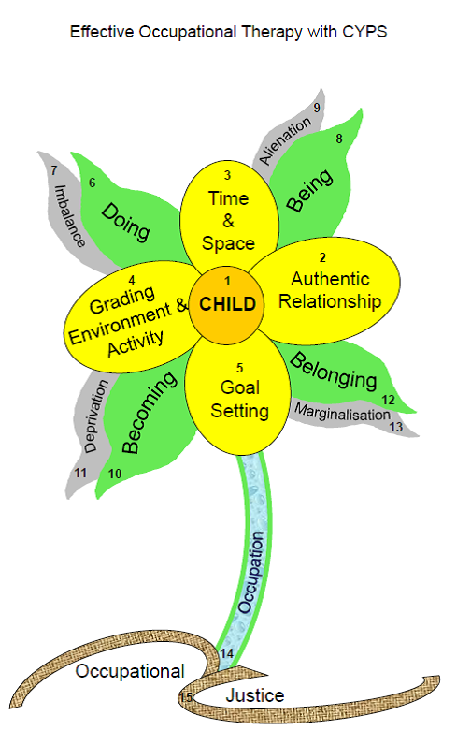

Slide 12
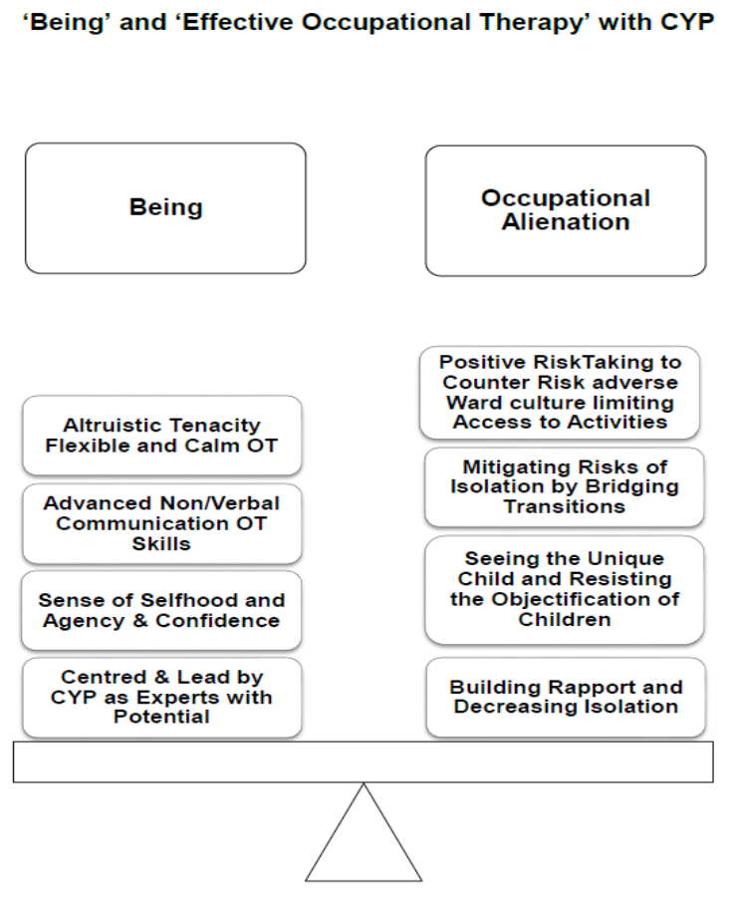

Slide 13
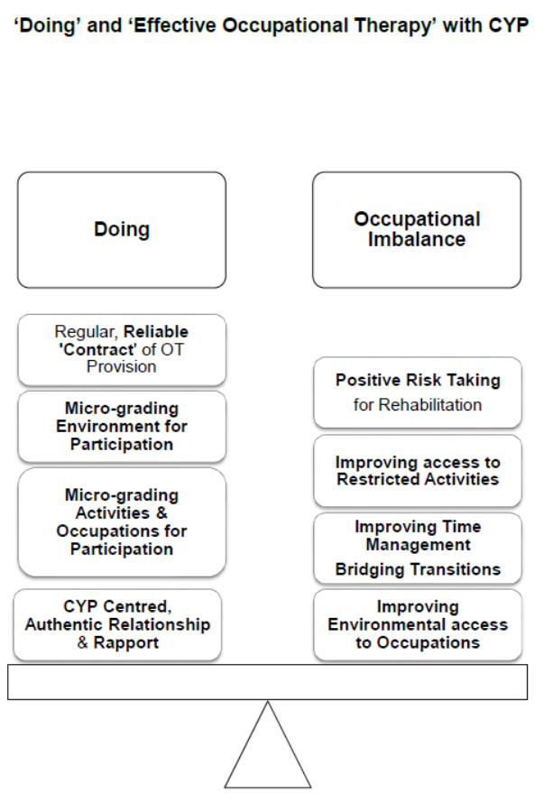

Slide 14
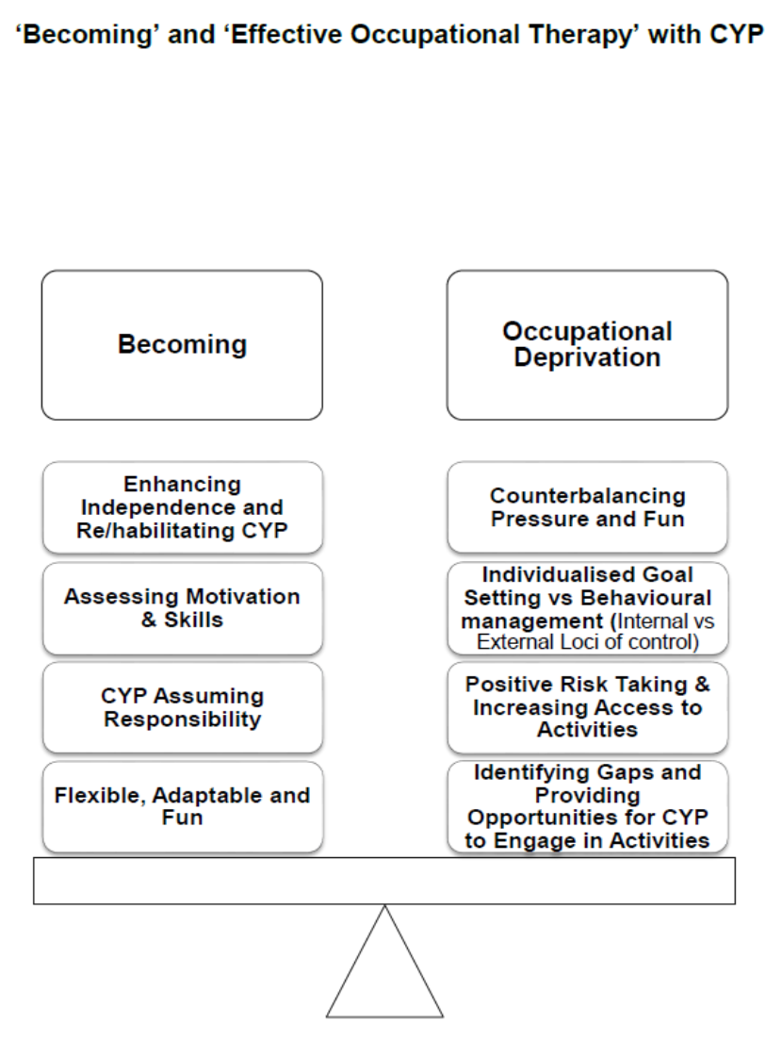

Slide 15
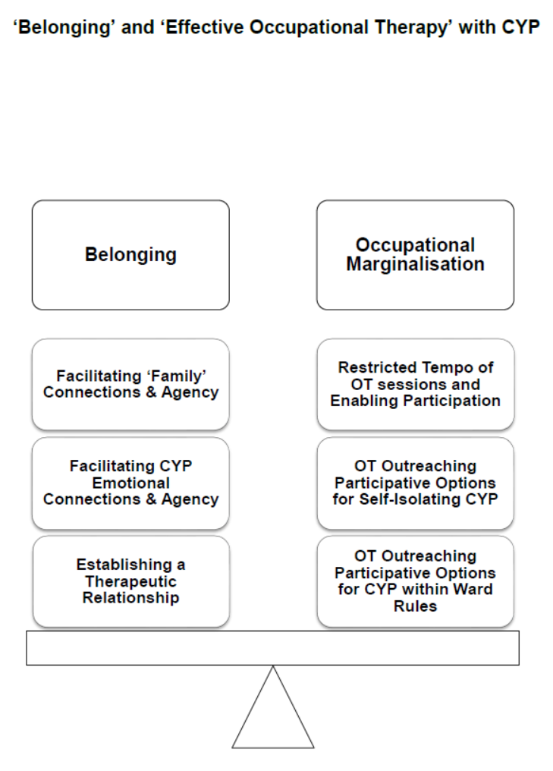

Slide 16
Future Focus
NTW AHP R&D Strategic Action Plan 2017-2022
HEI/NTW Collaborations for increased AHP research outputs
Dissemination via publications: Occ Science, Methodology, CYPs/CAMHS OT
Parents of children with VCB, themes
Implications for CYPs practice, increasing clinical effectiveness.
AHP CPD in NTW
Innovation and Quality Improvement

Slide 17
NTW AHP Strategic Ambition 5: The Trust will be a centre of excellence for mental health and disability
AHPs can lead change (USP/Core Skills)
AHPs leading on delivering CQUINs and targets
To have an AHP research aware and active culture & innovation embedded in the improvement culture for services
To forge sustainable ‘quid pro quo’ links with Universities for academic support and networking
AHPs’ Research skills can be further developed
AHPs will extend their skills/knowledge. To utilise skills and knowledge in the use of data collection and analysis and evaluating evidence to develop and improve the delivery of services
Develop business case for Trust wide AHP Consultant in R&D to facilitate and lead increased research activity
AHPs evaluate and improve and evidence the impact of their contribution
Develop commercial research portfolio, reinvesting income generation in further research initiatives
Ensure AHPs involved in research, publish and disseminate findings and contribute to NTW R&D activities
Utilising Information and Technology for Therapy:
To establish mechanisms for AHPs to respond swiftly and successfully to research funding opportunities

Slide 18
Summary
Clinically Effective
Academically robust
CPD focus on understanding, critiquing, sharing, creating and implementing new evidence.
Identify your links to people/systems to inform your options to develop research, audit and evaluation skills
Meet HCPC Standards & Professional Body Standards (eg. RCOT, CST, BDA, RCSLT)
CPD: use half day a month to develop practice
Hear the voice of your patients and families
Have excellent OT/PT/D/SLT supervision

Slide 19
Any Questions?
Reference:
http://nrl.northumbria.ac.uk/32573/1/avantaggiato-quinn.maria_phd.pdf
Maria.Avantaggiato-Quinn@ntw.nhs.uk
Maria.Avantaggiato-Quinn@northumbria.ac.uk

