Slide 1


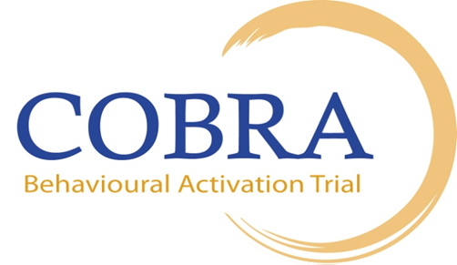

Behavioural Activation for Depression By the Non Specialist
David Ekers PhD, MSc ENB 650, RMN
Senior Visiting Research Fellow/Nurse Consultant Primary Care Mental Health

Slide 2
Overview
Introduce BA
Completed research
Where to next

Slide 3
Behavioural Activation – what is it?
Contextual rational for depression
Places depression in our relationship with our world
Largely forgotten with advent of CBT in 1980s
Simple – ‘parsimonious’ therapy with ‘less moving parts’
This may lend BA to wider dissemination

Slide 4
Our BA Research

Slide 5
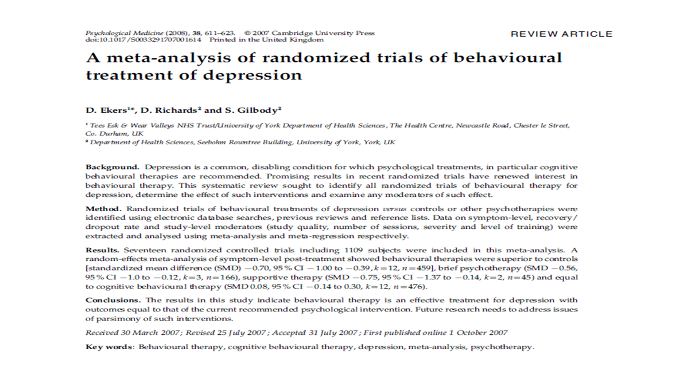

Slide 6
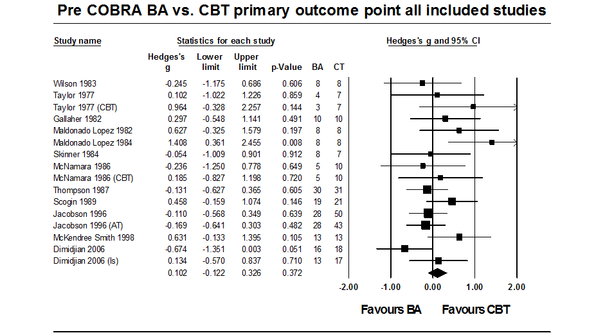
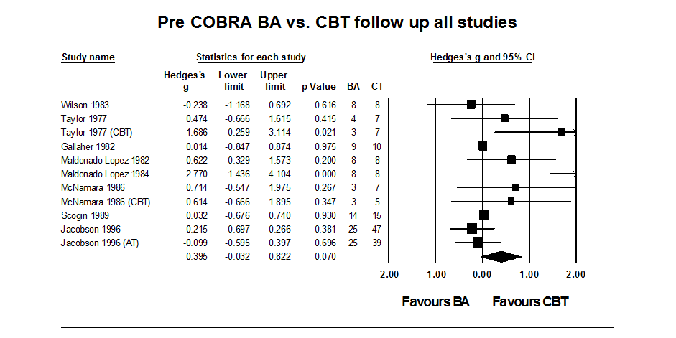

Slide 7
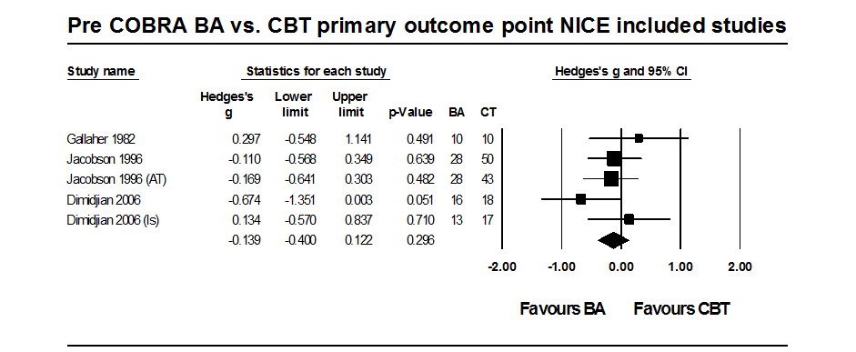
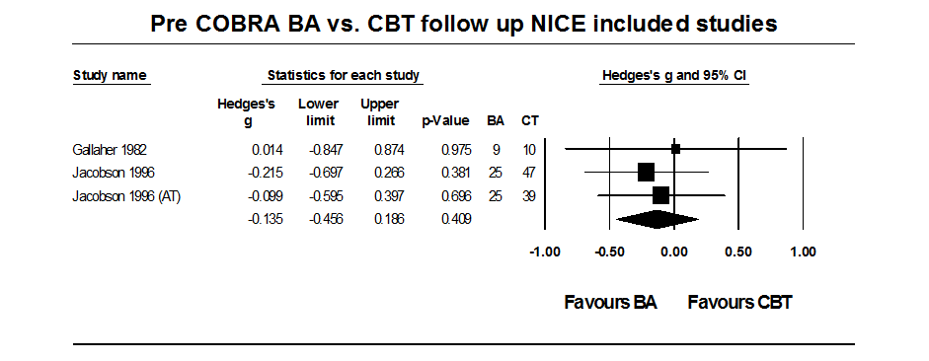

Slide 8
All experienced therapists/same people different therapy doesn’t help
Lots of small studies variable results

Slide 9
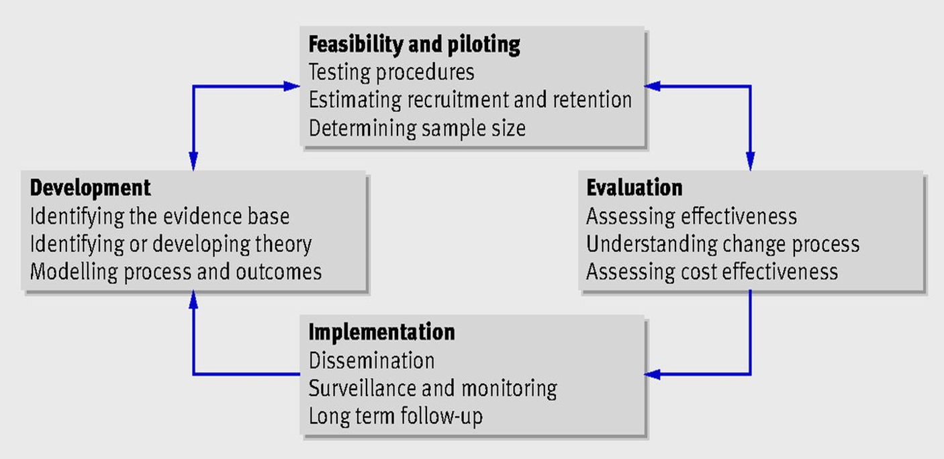
MRC Methods for Developing and Evaluating Complex Interventions

Slide 10
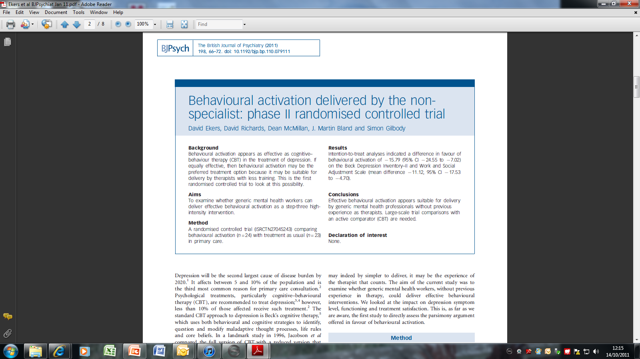
Behavioural activation delivered by the non specialist: Phase II randomised controlled trial (MH Nurses)

Slide 11
Results

Slide 12
Cost more/less effective
Cost more/more effective
Cost less/less effective
Cost less/more effective

Slide 13
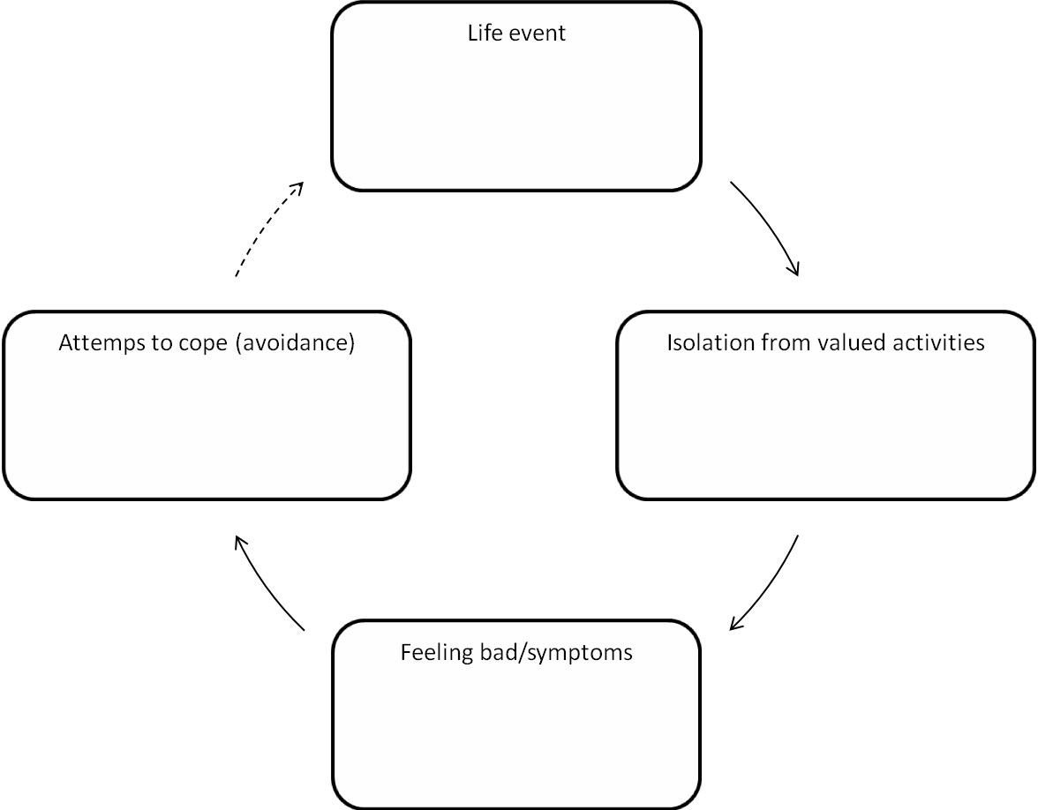
BA cycle used in current studies (Ekers et al 2011)

Slide 14
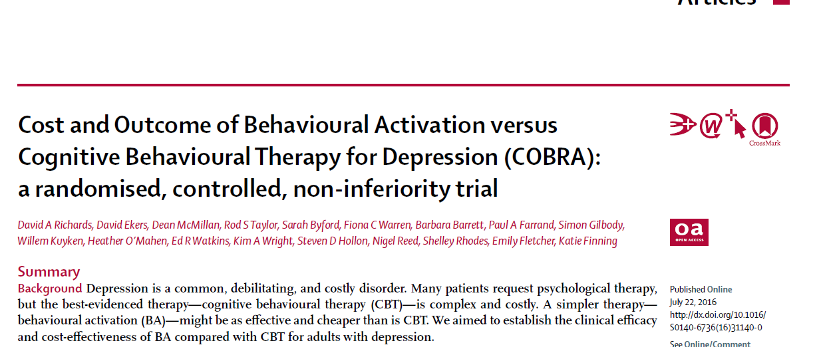
COBRA Study. NIHR HTA funded multi centre RCT. Open access- The Lancet July 2016

Slide 15
COBRA
COBRA is a two-arm Phase III, non-inferiority randomised controlled trial of a psychological intervention: Behavioural Activation (BA) N=440.
The COBRA programme of research seeks to answer two interlinked questions:
  What is the clinical effectiveness of BA compared to CBT for depressed adults in terms of depression treatment response measured by the PHQ9 at six, 12 and 18 months?
  What is the cost-effectiveness of BA compared to CBT at 18 months?

Slide 16
Interventions
BA and CBT- both active psychological treatments which have previously demonstrated positive effects for people with depression
20 face to face one-hour duration sessions over 16 weeks with the option of four additional booster sessions.
  BA: delivered by band 5 qualified Psychological Wellbeing Practitioners
  CBT: delivered by band 7 qualified CBT therapists
Both groups of therapists received five days of protocol specific training and weekly supervision from a relevant expert
Quality and fidelity assessed through independently rated audio-tapes and session records

Slide 17
Primary Outcome – PHQ-9
Primary analysis

Slide 18
 | CBT |  | BA |  | Adjusted A-B difference* | P-value
 | N | Mean (SD) | N | Mean (SD) | Mean (95% CI)
Baseline | 219 | 17.4 (4.8) | 221 | 17.7 (4.8) | - | -
Intention to treat
12-months | 189 | 8.4 (7.5) | 175 | 8.4 (7.0) | 0.1 (-1.3 to 1.5) | 0.89
Per protocol
12-months | 151 | 7.9 (7.3) | 135 | 7.8 (6.5) | 0.0 (-1.5 to 1.6) | 0.99
*Adjusted for baseline PHQ9, and stratification variables (i.e., symptom severity (PHQ < 19, PHQ ≥ 19), site (Devon, Durham, Leeds), antidepressant use (currently taking anti-depressant medication, not currently taking anti-depression medication)

Slide 19
Non-Inferiority at primary endpoint
Non inferiority margin

Slide 20
Secondary Outcomes - GAD
Primary analysis
 | CBT |  | BA |  | Adjusted difference* | P-value
 | N | Mean (SD) | N | Mean (SD) | Mean (95% CI)
Baseline | 219 | 12.6 (5.1) | 221 | 12.7 (5.1) | - | -
Intention to treat
12-months | 176 | 6.3 (6.0) | 161 | 6.4 (5.9) | 0.1 (1.3 to -1.0) | 0.82
Per protocol
12-months | 146 | 6.0 (5.8) | 129 | 5.9 (5.5) | 0.01 (-1.3 to 1.2) | 0.95
*Adjusted for baseline GAD, and stratification variables (i.e., symptom severity (PHQ < 19, PHQ ≥ 19), site (Devon, Durham, Leeds), antidepressant use (currently taking anti-depressant medication, not currently taking anti-depression medication)

Slide 21
SCID Caseness Across Trial
(repeated measures logistic regression model)
Intention to Treat
Treatment | Baseline | 6 months | 12 months | 18 months
CBT n/N (%) | 219/219 (100%) | 49/171 (29%) | 37/163 (23%) | 34/162 (21%)
BA n/N (%) | 221/221 (100%) | 51/167 (31%) | 31/154 (20%) | 35/156 (22%)
P-value for between groups comparison: |  |  |  | P=0.73
Per protocol
Treatment | Baseline | 6 months | 12 months | 18 months
CBT n/N (%) | 158/158 (100%) | 37/140 (26%) | 30/141 (21%) | 25/137 (18%)
BA n/N (%) | 147/147 (100%) | 42/138 (30%) | 24/128 (18%) | 25/125 (20%)
P-value for between groups comparison: |  |  |  | P=0.80

Slide 22
Cost Effectiveness Plane
Cost More/Less Effective
Cost More/More Effective
Difference in cost
4%
6%
£500
Difference in QALY
-.1
-.05
£0
0
.05
.1
.15
-£500
-£1000
24%
66%
Cost Less/Less Effective
Cost Less/More Effective
£20k/QALY threshold line
95% confidence ellipse

Slide 23
Summary of Health Economics
Probability of BA being cost-effective vs. CBT does not fall below 75% and is closer to 80% at the NICE preferred willingness to pay level of £20,000 to £30,000 per QALY.
Potentially very interesting for NHS providers

Slide 24
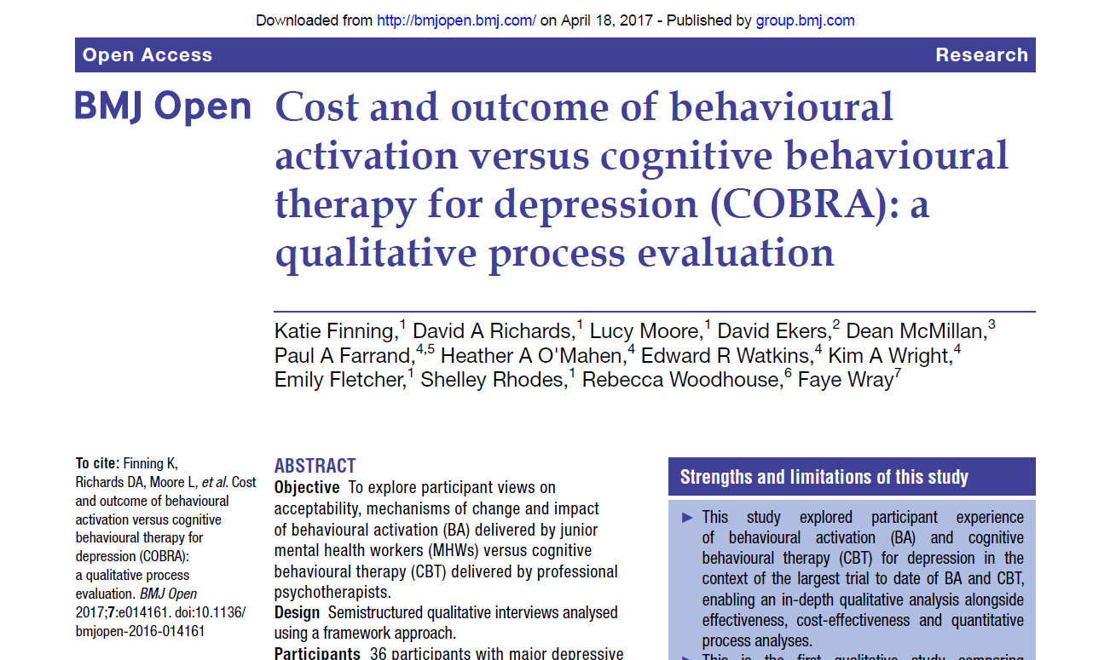
Qualitative study

Slide 25
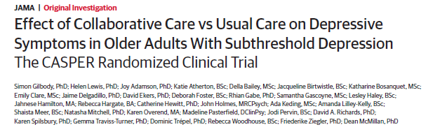


Slide 26
Who took part?
705 participants
Over 65s – mean age 77 (range 65 – 99 yrs)
Whooley +ve with DSM-IV Subthreshold depression
Very few exclusions
  Recently bereaved
  Alcohol dependence
  Terminal illness
  Cognitive impairment (ascertained by the GP)
Comorbidity OK – 80% or more had 2+ LTCs

Slide 27
Intervention
Case management (PWPs)
  Brief psychological intervention – Behavioural Activation
  6-8 sessions over the phone
GP liaison as needed
Scheduled follow up
Session by session symptom profiling – GDS10
Medication management if needed
Stepping up
Vs TAU

Slide 28
PHQ9 scores at 4 and 12 months

Slide 29
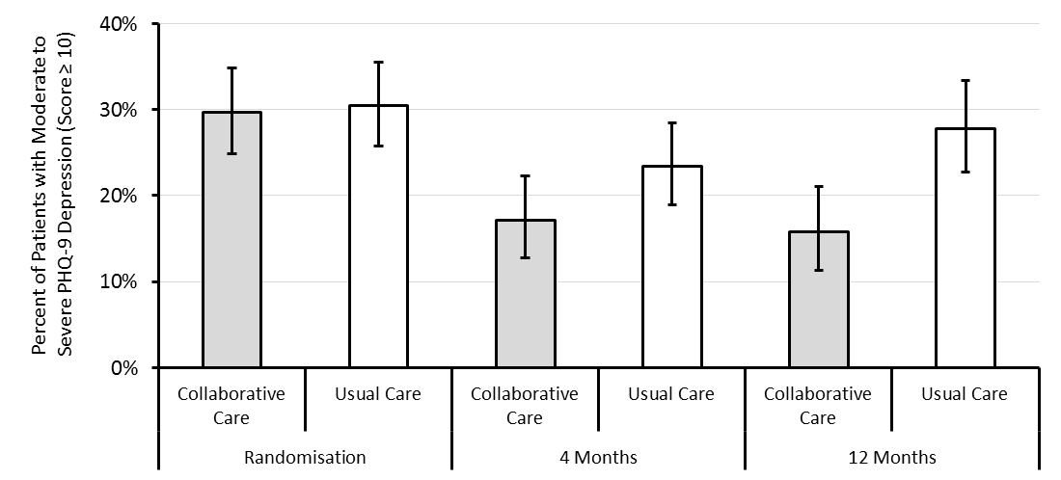
Is there a preventative element to BA in this delivery model ?
Odds of case level depression were halved at 12 months
OR = 1.98 (1.21 to 3.25)

Slide 30
Clinical Implications from studies
BA delivered by less experienced mental health workers leads to identical clinical outcomes than those of specialists at a financial saving to clinical providers of 21% compared with the costs of providing CBT.
Non specialists providing brief BA can work on mild symptoms and have a preventative effect in at risk groups

Slide 31
New studies
Next steps

Slide 32

Community Pharmacy mood Intervention Study CHEMIST?
Based in community pharmacies
Health promotion/depression prevention
Provide Enhanced Support Intervention (ES Intervention) to adults with LTCs and low mood within a ‘Collaborative Care’ framework (adapted from CASPER)
Enhanced Support Intervention delivered by trained pharmacy staff (‘Healthy Living Advisors’)

Slide 33
CHEMIST study
Feasibility and pilot study (NIHR PHR 3 years)
Adapt existing training and self-help materials for use in community pharmacies
Can we train community pharmacy staff to deliver the ES Intervention
Conduct a pilot randomised controlled trial

Slide 34
Feasibility findings
Pharmacy staff/participants viewed community
pharmacies as appropriate to support people with mental health problems using a non-stigmatising approach.
Able to train health promotion staff with no previous background in MH to deliver the intervention
Materials were found to be helpful and acceptable to patients and staff

Slide 35
Thank You
David.ekers@nhs.net
Thanks to
TEWV NHS FT for their support
COBRA/CASPER/CHEMIST study teams
Participants in the research studies listed

