Slide 1
Designing Research that Improves Health and Wellbeing for All How the NIHR Research Design Service North East can help

Slide 2
RDS Remit
"to increase the number and proportion of applications for NIHR research funding that are high quality”

Slide 3
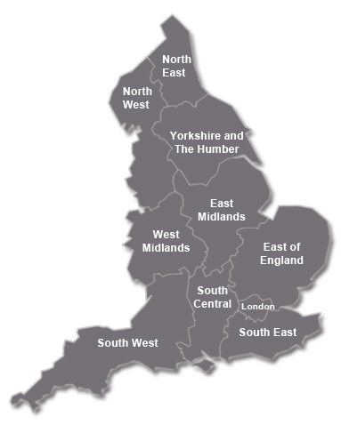
National RDS

Slide 4
Who is eligible?
Investigators preparing research proposals for national peer-reviewed funding competitions in applied health, public health or social care research*
Priority given to those applying to NIHR funding bodies
Available to NHS and academics
Free service
* Not just NIHR funding streams

Slide 5
When can we help?
Come as early as possible
Support up to funding award
Limited trouble shooting available post-award

Slide 6
Where to start?
Feasibility
Meaningful & appropriate
Cohort, case-control, RCT, ethnographic, interview
Multidisciplinary team
Involvement
of patients
and public
Study
Design
Research
team
Scope
Consent
Appropriate
funding stream
Ethical
considerations
Peer-reviewed journals
Grey literature
Registered trials database
Research
Question
Research
Proposal
Benefit to NHS and patients
Literature
Impact

Slide 7
How can the RDS help?
Peer-reviewed journals
Grey literature
Registered trials database
Research
Question
Literature

Slide 8
Is it the right question?
Does it fit the problem?
Is it timely? Is it important?
Is it answerable?
Is it original? Has it been answered before?
“Checking that a research idea is really novel”
https://youtu.be/jFrfnM9JBaI

Slide 9
How can the RDS help?
Scope
Appropriate
funding stream
Peer-reviewed journals
Grey literature
Registered trials database
Research
Question
Literature

Slide 10
Which funder?

Slide 11
How can the RDS help?
Cohort, case-control, RCT, ethnographic, interview
Study
Design
Scope
Appropriate
funding stream
Peer-reviewed journals
Grey literature
Registered trials database
Research
Question
Literature

Slide 12
RDS Expertise
Specialist methodological advisors:
Statistics
Clinical Trials
Qualitative
Health Economics
Health Psychology
Epidemiology
Evidence Synthesis

Slide 13
How can the RDS help?
Cost issues
Recruitment
Appropriate time scale?
Cohort, case-control, RCT, ethnographic, interview
Feasibility
Study
Design
Scope
Appropriate
funding stream
Peer-reviewed journals
Grey literature
Registered trials database
Research
Question
Literature

Slide 14
What to cost & who will pay?
Costing signposting
Costs of R&D in the NHS are split into 3 categories:
Research Costs
NHS Support Costs (service support)
Treatment Costs
https://www.gov.uk/government/news/attributing-the-costs-of-health-social-care-research-development-acord
Notes:
10/05/2018
www.rds.nihr.ac.uk
14

Slide 15
How can the RDS help?
Cost issues
Recruitment
Appropriate time scale?
Meaningful & appropriate
Cohort, case-control, RCT, ethnographic, interview
Feasibility
Involvement
of patients
and public
Study
Design
Scope
Appropriate
funding stream
Peer-reviewed journals
Grey literature
Registered trials database
Research
Question
Literature

Slide 16
What is Public Involvement?
Defined as research being carried out ‘with’ or ‘by’ members of the public rather than ‘to’, ‘about’ or ‘for’ them.
Definition of ‘public’ includes:
Patients
Potential patients
Carers
People who use health and social care services

Slide 17
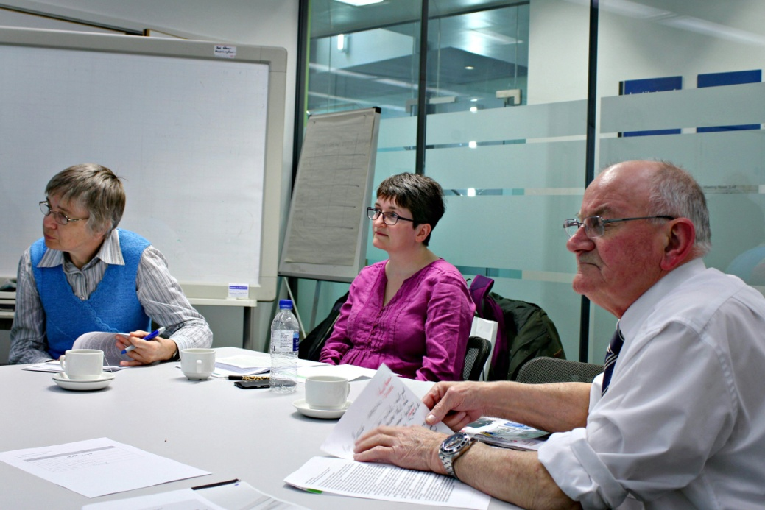
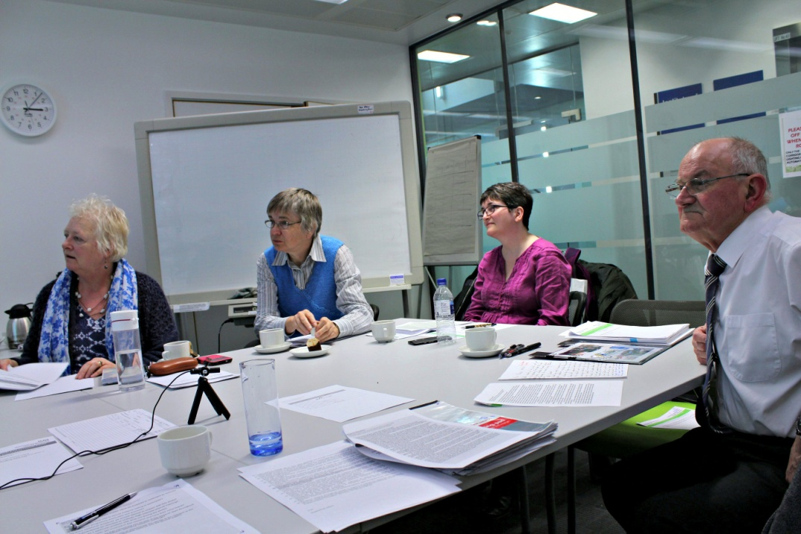
RDS NE Consumer Panel

Slide 18
How can the RDS help?
Cost issues
Recruitment
Appropriate time scale?
Meaningful & appropriate
Cohort, case-control, RCT, ethnographic, interview
Feasibility
Involvement
of patients
and public
Multidisciplinary team
Study
Design
Research
team
Scope
Appropriate
funding stream
Peer-reviewed journals
Grey literature
Registered trials database
Research
Question
Literature

Slide 19
Highlight the skill mix
Relevant skills and experience of the team
Different components of the project
‘Sell’previous experience of the team
Track-record in delivering research to time and budget?
Can also help to identifying collaborators

Slide 20
How can the RDS help?
Cost issues
Recruitment
Appropriate time scale?
Meaningful & appropriate
Cohort, case-control, RCT, ethnographic, interview
Feasibility
Involvement
of patients
and public
Multidisciplinary team
Study
Design
Research
team
Scope
Consent
Appropriate
funding stream
Ethical
considerations
Peer-reviewed journals
Grey literature
Registered trials database
Research
Question
Literature

Slide 21
Ethical issues
Vulnerable participants
Highly sensitive topics
Highly sensitive methods
Patient burden
Notes:
10/05/2018
www.rds.nihr.ac.uk
21

Slide 22
How can the RDS help?
Cost issues
Recruitment
Appropriate time scale?
Meaningful & appropriate
Cohort, case-control, RCT, ethnographic, interview
Feasibility
Involvement
of patients
and public
Multidisciplinary team
Study
Design
Research
team
Scope
Consent
Appropriate
funding stream
Ethical
considerations
Peer-reviewed journals
Grey literature
Registered trials database
Benefit to NHS and patients
Research
Question
Impact
Literature

Slide 23
Impact
NIHR – Patient benefit within 5 years
Dissemination

Slide 24
10 key points why applications struggle
https://www.youtube.com/watch?v=71zAufavf6g

Slide 25
Success Maker Service
https://youtu.be/A9e4SJSJ9aM

Slide 26
How to contact us
https://rds-ne.nihr.ac.uk/

