Slide 1



Sport, exercise and mental health

Slide 2
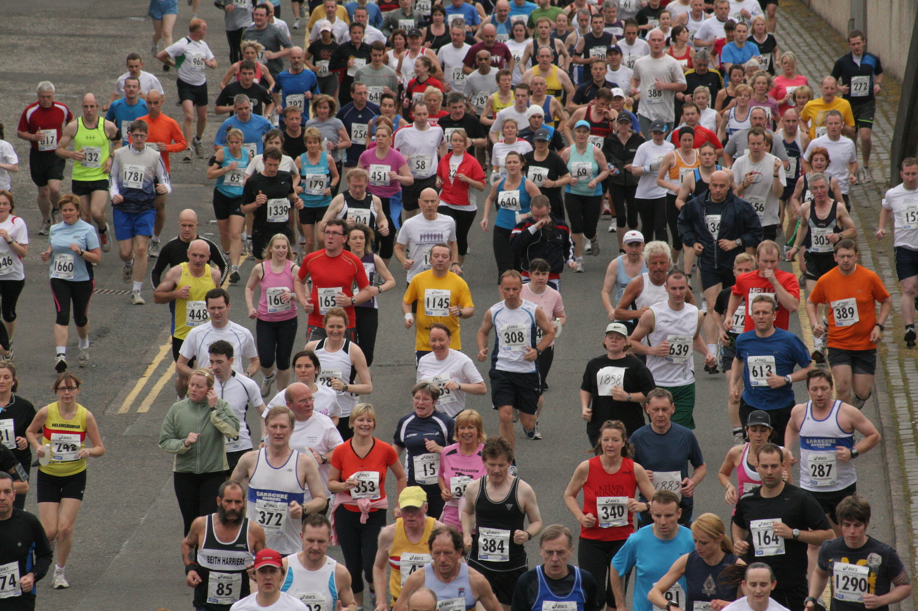
Exercise and mental health
Psychological
Self esteem
Self-confidence/mastery
Mindful
Social
  Confidence
  Social skills
  Networks and support
Biological
  Endorphins and endo-cannibinoids
  Stress hormone regulation
  Inflammatory molecules
  Reduced oxidative stress
  BDNF and neuroplasticity

Slide 3
Inactivity
International comparison of physical inactivity (at ages 15 and over)
Note: Comparator = Not meeting any of the following per week: (a) 5 x 30 mins moderate-intensity activity; (b) 3 x 20 mins vigorous-intensity activity; (c) equivalent combination achieving 600 metabolic equivalent-min.

Slide 4
Exercise data – 1441 adult IP (age 30-69)
Notes:
The charts show smoking status and exercise levels for the MH cohort and compared to England.
Smoking:
MH = 60%
England = 15.8% (from ONS, 2016)
North East = 17.2% (PHE, 2016)
Exercise:
MH = 14% (this may be an overestimation due to data quality issues)
England = 68.4%, 62.7% (Sport England, 2015/16)
The RiO form expresses exercise in hours per week, however the national comparator is minutes per day. The RiO data has been converted to the national format for this analysis.

Slide 5
Physical activity and SMI
‘People with psychosis or schizophrenia, especially those taking antipsychotics, should be offered... a physical activity programme by their mental health provider’ (NICE, 2014)

Slide 6

Barriers to Physical Activity
A survey of community mental health staff

Slide 7
Barriers to Physical Activity
Lack of training
Competing priorities
Patient motivation
Happell et al., 2012; Soundy et al., 2014
Moderators of Physical Activity
Trained professionals
Continuous support
Vancampfort et al., 2015

Slide 8

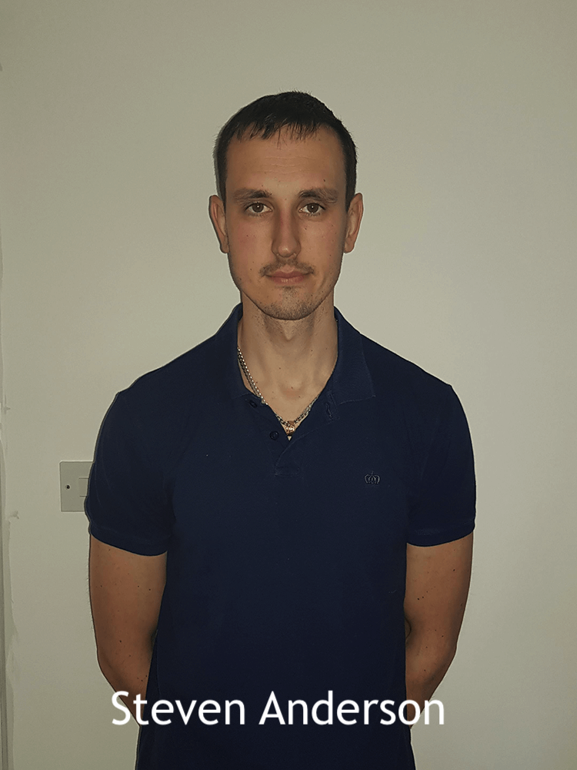


Faculty of Health Sciences and Wellbeing
University of Sunderland
Dr Sandra D. Leyland
Dr Steven D Anderson
Dr Eddie Bradley
Prof Jonathan Ling

Slide 9
Design
Facilitated discussion
  Exploring staff beliefs around behaviour change
  2 researchers unknown to participants
4 community teams
  3 randomly selected ‘generic’ adult teams
  1 randomly selected EIP team
Team manager invites all clinicians

Slide 10
Participants
28% offered PA advice ‘almost always/most of the time’
72% offered advice ‘occasionally or never’
87% had no specific training regarding PA guidelines

Slide 11
Control beliefs
Barriers
Patient’s motivation
Patient’s age and fitness
Funding. Pruning of services
Competing priorities Lack of expertise

Slide 12
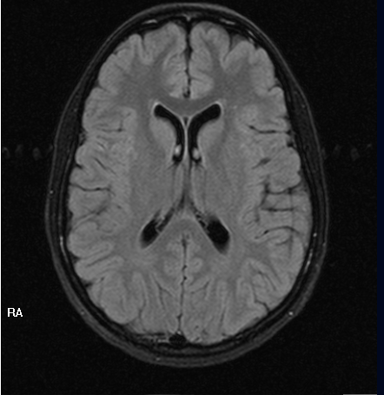
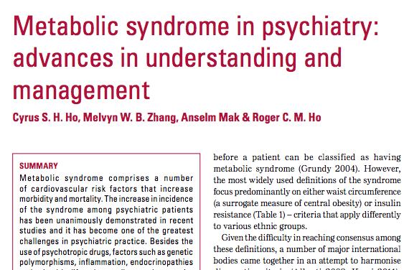

Using sport/exercise to improve mental health outcomes in schizophrenia
Metabolic syndrome
Social Exclusion
Disease modifying

Slide 13
Metabolic syndrome & severe mental illness
Lethal association
Contributed to by
  Genetics
  Inflammatory molecules
  Hypothalamic-pituitary adrenal axis abnormalities
  Drug effects on sedation and metabolism
  Lifestyle

Slide 14
Metabolic syndrome & severe mental illness – where might physical activity help?
Contributed to by
  Genetics
  Inflammatory molecules
  Hypothalamic-pituitary adrenal axis abnormalities
  Drug effects on sedation and metabolism
  Lifestyle – e.g. circadian rhythms, diet, lipid profile, weight, BP, sugar levels etc

Slide 15
Social Exclusion
A cause and a consequence of mental illness
Often multiple
Cumulative
  Friendships and support networks
  Education & employment
  Housing
  Leisure

Slide 16
Sport & Social Inclusion
Social Confidence
Self-management skills
Socialisation
  Co-operative skills
  ‘Normal’ interactions (away from health services)
  ‘Recovery’

Slide 17
Exercise and Schizophrenia
Pathophysiology
  Altered mono-amine system
  Altered neurogenesis
  Neuro-immune disturbance
  HPA axis disturbance
Exercise effects
  Mono-amine effects (DA mainly). No studies.
  Improved neurogenesis (via BDNF). Few studies.
  Neuroimmune changes (reduction in inflammatory markers and oxidative stress). No studies.
  HPA axis changes. No studies.
Vancampfort, 2014. Review.

Slide 18
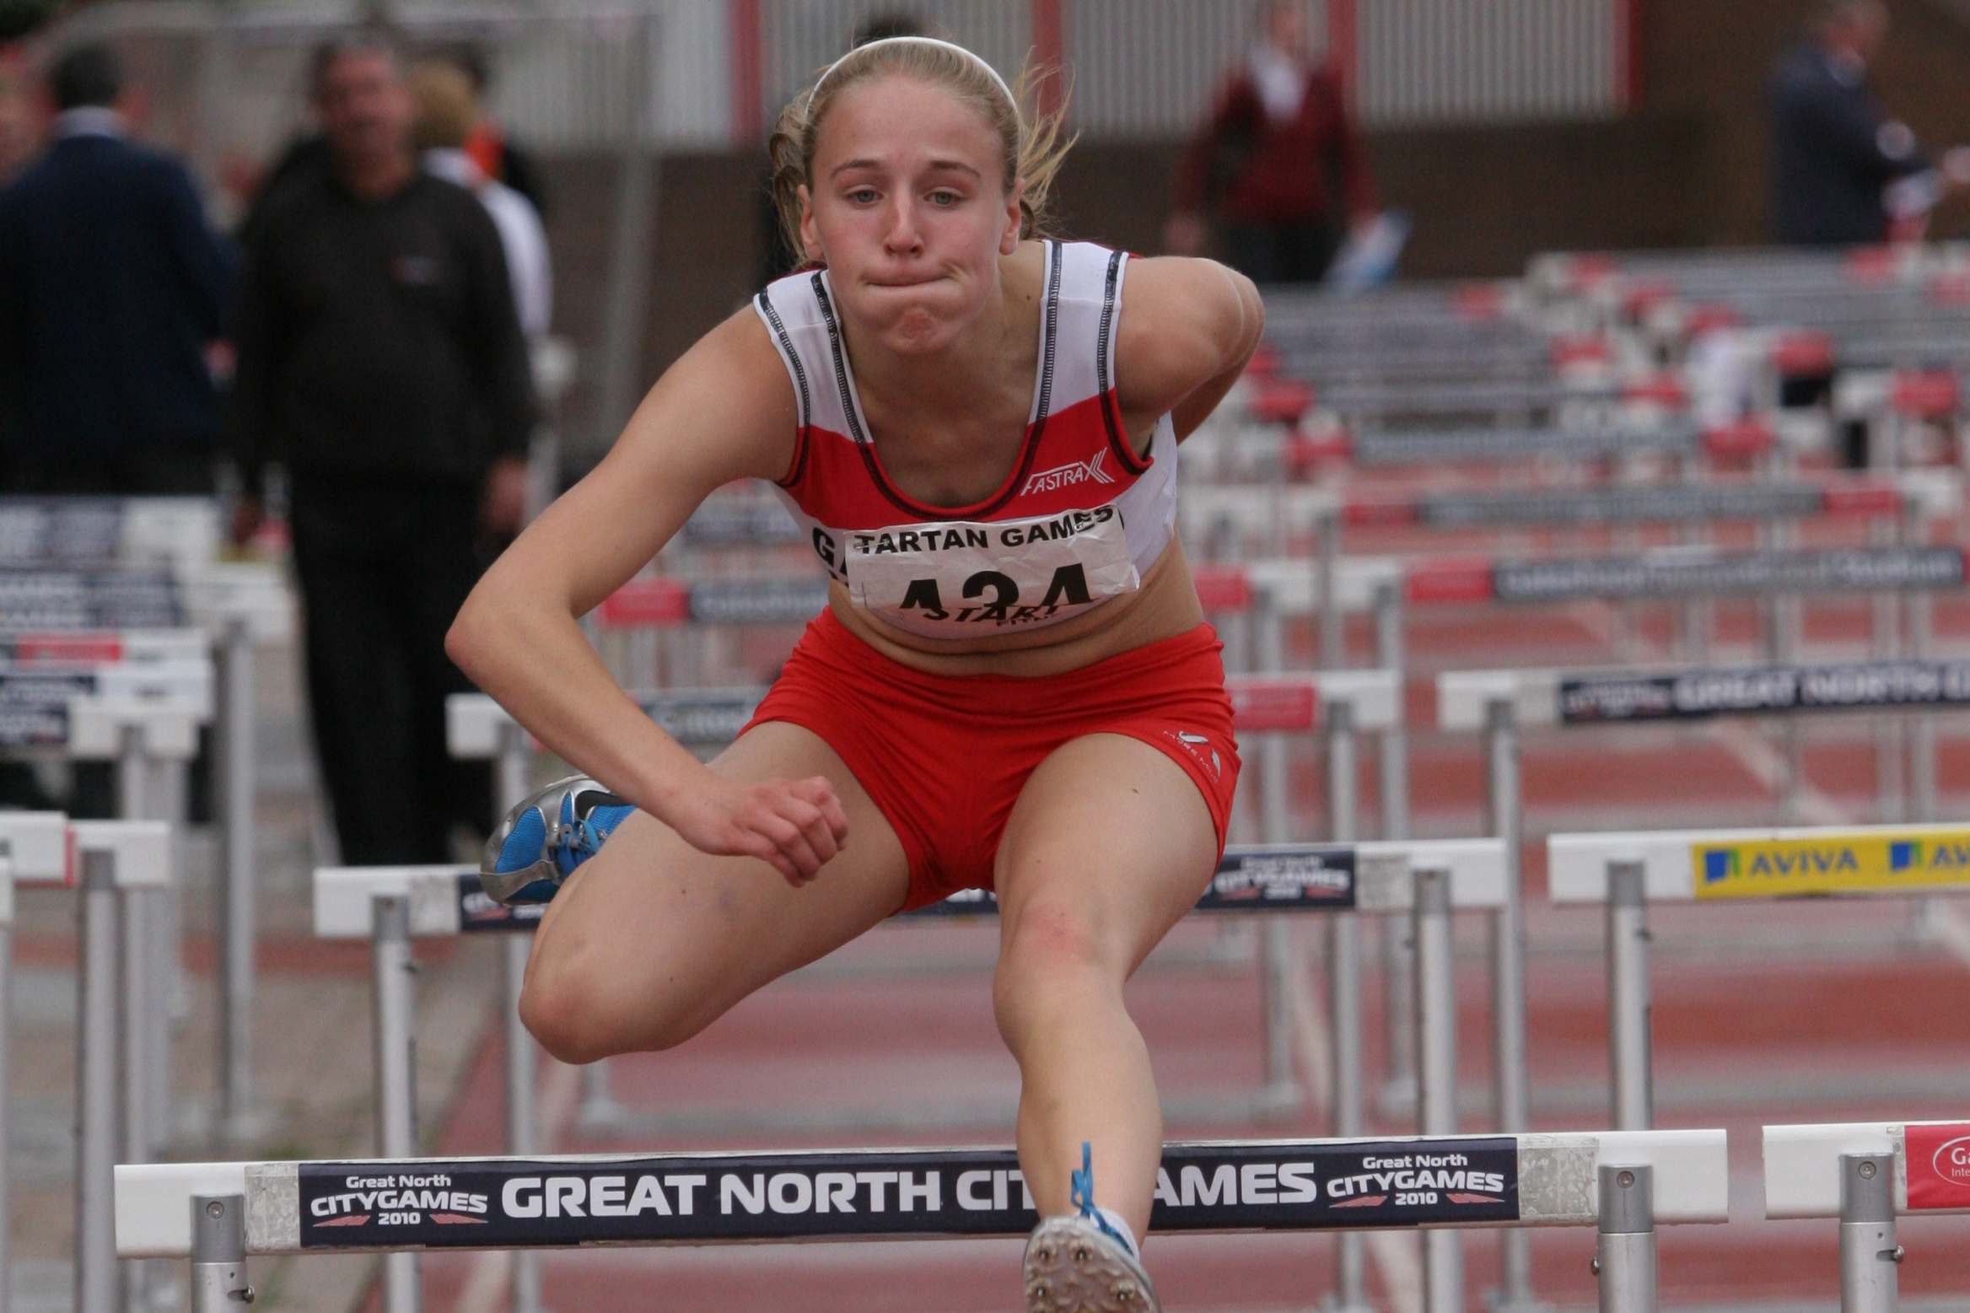
Sport and mental health
Athletes attain high levels of success in spite of a co-existing primary psychiatric disorder
Athletes chose the athletic arena as a means of coping with disorder
Athletes have a psychiatric illness precipitated or exacerbated by sport

Slide 19
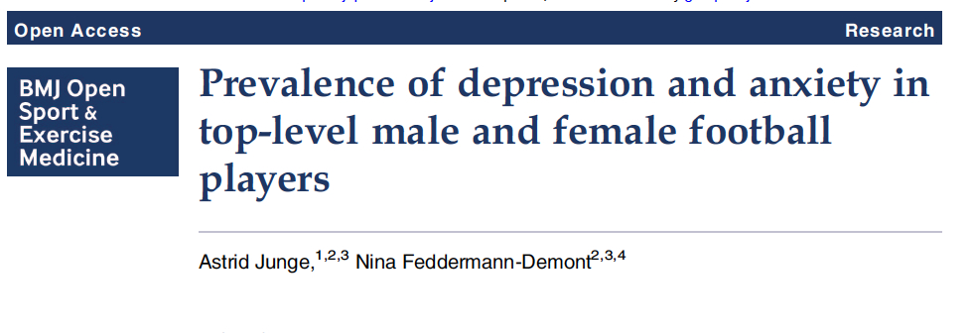
471 male and female footballers
Comparable rates of depression
  Associated with injury
  Injury rate = 20%
  Most depression is untreated

Slide 20
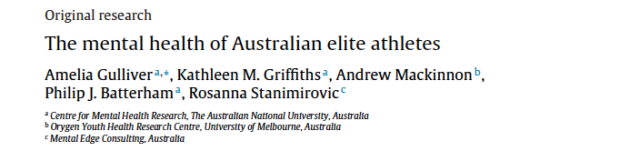
224 elite Australian athletes (many sports)
  Mental health problems at population levels
  Strong association with injury
  Injury rate = 25%

Slide 21
Prevalence of psychiatric morbidity in elite sport

Slide 22
Prevalence of psychiatric morbidity in elite sport
No formal data in England
Desire to provide appropriate support

Slide 23
Prevalence of psychiatric morbidity in elite sport
1500 athletes receiving support and funding
Winter and summer Olympic and Paralympic sports
A 5 minute on-line survey

Slide 24
Prevalence of psychiatric morbidity in elite sport
Population data for comparison
3 measures
  GHQ 12
  Kesler’s Psychological Distress Scale (K10)
  WHO-5 well being scale

Slide 25
Sport, exercise and mental health
Exercise
Sport
Good for your mental health
Almost without exception
In many ways
Exposed to risks
Need to acknowledged
Need to be managed
Prevalence of morbidity in elite sport
Barriers to exercise in SMI

